Slide 1
SHAPING OUR FUTURE FOUNDATION
Malawian Non-Governmental Organization registered in August 2020 with all relevant Government Entities (Registrar General, NGO Board, CONGOMA, MRA)
Board of Directors with background in Finance, Legal, Development Management, Communications, among others.

Slide 2
OUR PHILOSOPHY
MISSION
Promoting the holistic development of the rural (village) girl and street child
VISION
A holistic citizen empowered for social impact through emancipation from a difficult childhood in the village or on the streets.
VALUES
Compassion, Partnership, Integrity, Impact and Dignity.

Slide 3
OUR OBJECTIVES
To expand educational opportunities for all including society’s most vulnerable
To promote all-encompassing health and wellness amongst young people
To economically empower society’s disadvantaged groups including the youth
To promote sustainable agricultural practices (Climate SMART Agriculture)

Slide 4
MALAWI’S EDUCATION SECTOR – THE FOUNDATION’S MAIN FOCUS AREA
Malawi recognizes that education is at the heart of the Sustainable Development Goals (SDGs), the African Union Agenda 2030, and Agenda 2063
Primary School (Std 1-8)
Biggest Sub-Sector (6million learners)
Net Enrollment 90%
Completion 58%
Only 38% transition to secondary school)
Secondary School (Forms 1 – 4)
460,000
Net Enrollment 16%
Completion 24%
Only 6% transition to University
Tertiary
60,000
Net Enrollment <1%
Access to primary (standard 1) 101 girls, 97 boys
Primary completion (standard 8) 31 girls, 45 boys
Access to lower secondary (Forms 1–2) 22 girls 30 boys
Lower secondary completion 17 girls 27 boys
Access to upper secondary (Forms 3–4) 10 girls 22 boys
Upper secondary completion 7 girls 15 boys
Sources: Malawi Ministry of Education, Science, and Technology (MOEST), Education Statistics 2012 (Lilongwe: Education Management Information System, Department of Education Planning, 2013); World Bank, The Education System in Malawi, World Bank Working Paper 182 (Washington: World Bank, 2010).

Slide 5
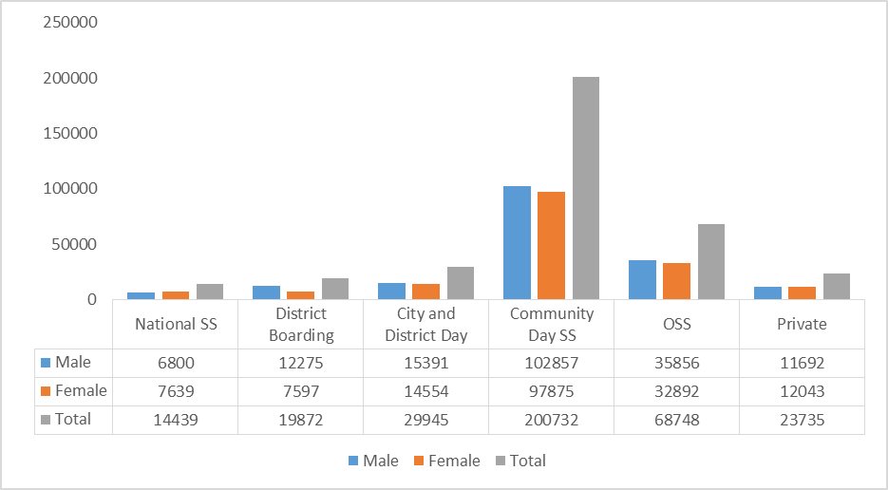
MALAWI’S SECONDARY SCHOOLS AND BOYS AND GIRLS ENROLMENT
CDSS’ and Open Secondary Schools have the highest enrolment at 83.8%.
Girls make up 48.5% of those enrolled in CDSS’ and Open Secondary Schools.
Out of 1,735831 Secondary school going age children, only 460,000 are in a secondary school
84% of 14-17 years old are not in secondary school- ( Net enrolment rate - 16%)
Regardless of age, 73% of children who should have been in secondary school are not school (Gross enrolment rate - 27%)
Both indicators reveal that there is wastage in the system, considering that more than half the population in Malawi are young people

Slide 6
MALAWI’S SECONDARY SCHOOLS CATEGORIES
National Public (4) & Grant Aided Boarding SS (20)
District Boarding Secondary Schools (48)
City (13) & District (48) Day Sec. Sch.
Community Day Secondary Schools (775)
District Day Secondary Schools
Private Sec. Schools
Open Secondary Schools (303)
The lowest 2 wealth quintiles of the population are in the Community Day Secondary Schools.
Open Secondary Schools are part of the new reforms in order to increase access for secondary education in Malawi. OSS takes care of those who dropped out, are married or in employment to give them flexibility to attend school.
There is very low absorption capacity at Secondary School level Malawi

Slide 7
THE STATE OF QUALITY AND RELEVANCE OF SECONDARY EDUCATION IN MALAWI
Students textbook ratio 5:1
Low completion rate (24%)
Drop out rate (11)%
Repetition rate (3%)
MSCE Pass rate (50.3)
Low transition to university (6%)
Unqualified teachers
Insufficient teachers especially in sciences
Insufficient teaching and learning materials
District Day Secondary Schools

Slide 8
QUALIFICATION OF SECONDARY SCHOOL TEACHERS IN MALAWI
Masters in Education (165)
Non Education Masters (96)
Degree in Education (4,700)
Non Education Degree (906)
Diploma in Education (3,364)
Non Diploma in Education (632)
University Certificate in Education (13)
District Day Secondary Schools
Malawi School Certificate of Education (2,364)
Malawi needs 26,000 teachers in secondary schools against 12,240 currently in place representing 47.08% (qualified, underqualified and unqualified).
Trained teachers currently make up 67.34% of teachers in secondary schools. The rest are either under qualified or unqualified.

Slide 9
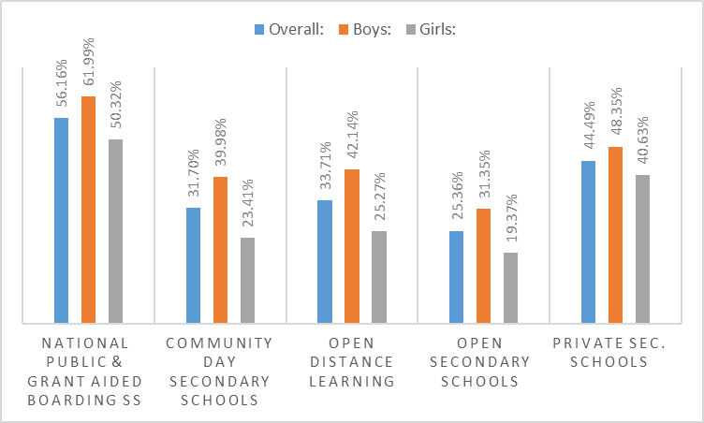
2020 MALAWI SCHOOL CERTIFICATE EXAMINATIONS (MSCE) PASS RATE PER SCHOOL CATEGORY PER SEX
Pass rate for girls is less than 13% overall than boys.
Pass rate for Girls in CDSS, ODL and OSS much lower than boys.
Those in CDSS and Open Schools performing poorer than other schools because of quality of education

Slide 10
THE ECOSYSTEM – THE FOUNDATION’S FOCUS TO ENSURE ACCESS TO QUALITY EDUCATION FOR GIRLS
Dealing with harmful social and cultural norm
42% < age 18 (9% < age 15) - UNICEF
44,874 teenage pregnancies and 12,995 child marriages (Min. of Gender)
Scholarships and Learning Materials
Security issues
Safe Schools for Girls (SRGBV 70%)
Hostels- distance
District Day Secondary Schools
Sexual Reproductive Health
Sanitary pads provision, wash facilities, safe toilets friendly to girls
Mentorship
Economic Empowerment

Slide 11
2019 VS 2020 TEEN PREGNANCY CASES IN SELECTED DISTRICTS
The onset of COVID-19 has further revealed a deep seated problem of teenage pregnancies that needs to be urgently addressed in Malawi (44,874 teenage pregnancies between 2019 and 2020) .

Slide 12
2019 VS 2020 CHILD MARRIAGE CASES
12,995 child marriages (Ministry of Gender, Social Welfare and Community Development)

Slide 13
DESIRED IMPACT
Rural Malawian girls and boys are better equipped with academic, social and leadership skills, have acquired improved employment and life opportunities, and have become change agents for resilient and equitable communities and are protected from violence.
Pathway 1: Enhance skills and mindsets, transferable and employability skills among adolescent girls and boys
Pathway 2: Strengthen capacity of in-service and student teachers in skills and mindsets, content delivery and pedagogy of high quality education of girls’ and boys’ academic success
Pathway 3: Support Ministry of Education school governing structures to develop and implement evidence-based policies aimed at improving quality learning for adolescent girls and boys
Pathway 4: Strengthen the capacity of informal local institutions (incl. traditional and cultural institutions) and local organisations to deliver on their mandates while increasing financial independence and self reliance

Slide 14
SWOT ANALYSIS
STRENGTH
WEAKNESS
OPPORTUNITIES
THREATS
Independent professional board with relevant expertise (legal, finance etc.)
Legal Compliance
Infancy Stage
Inadequate funding to employ technical staff
Chance to change lives for good
A lot of good will and support
Donor fatigue
Political Dynamics

Slide 15
OUR STRATEGIC GOAL
Increase enrollment, retention and completion of secondary school education of 5,000 village girls by 31st December, 2026.
Notes:
Loc. 221

Slide 16
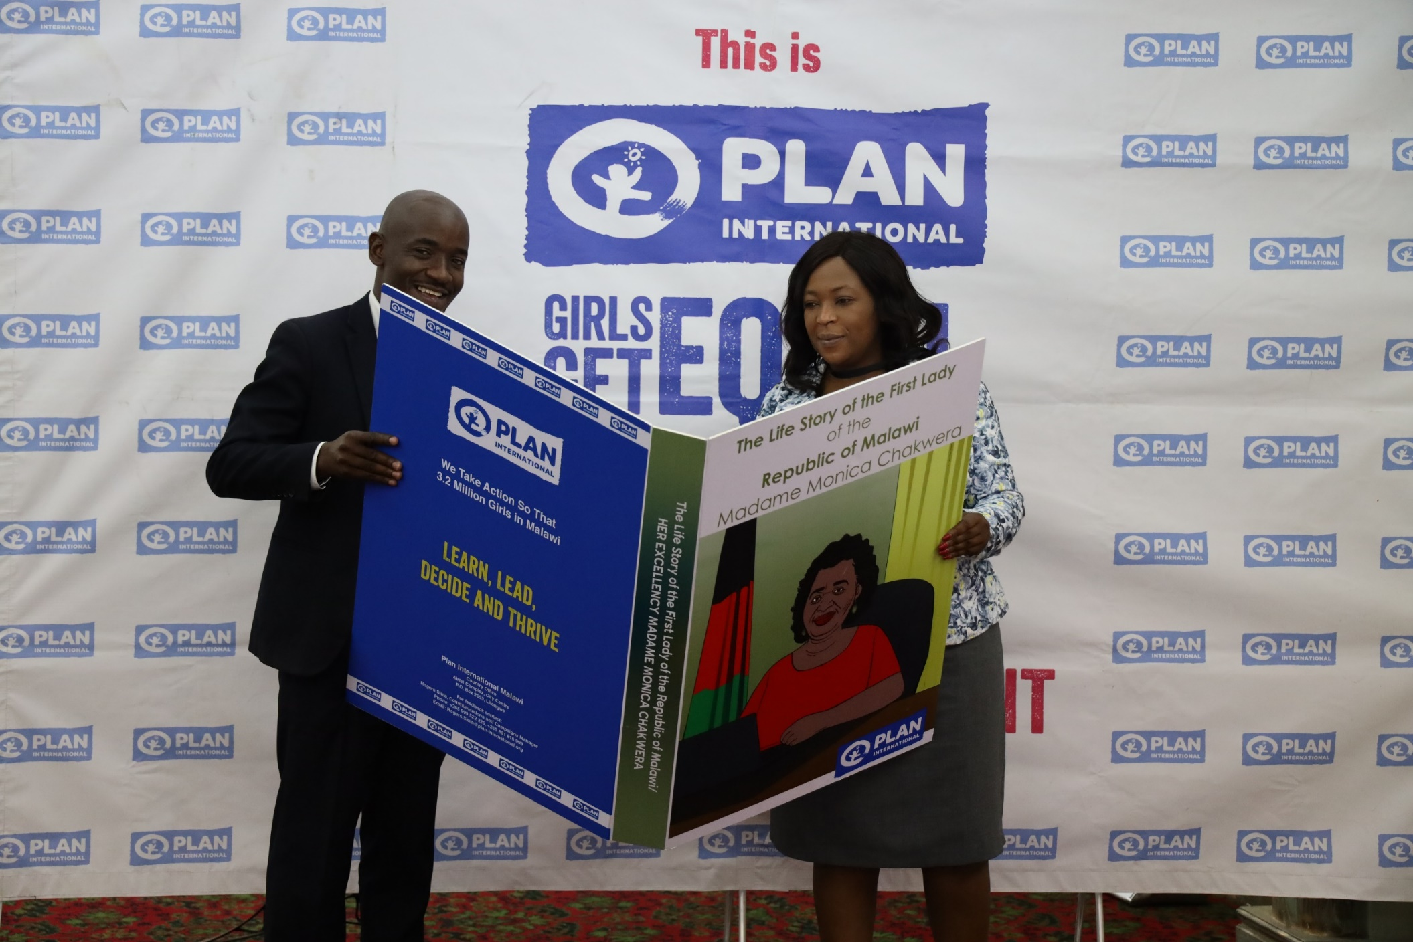
Publication of a children’s booklet based on the life story of the First Lady in collaboration with Plan International Malawi
£0.10p/booklet
Notes:
Loc. 221

Slide 17
Notes:
Loc. 221

Slide 18
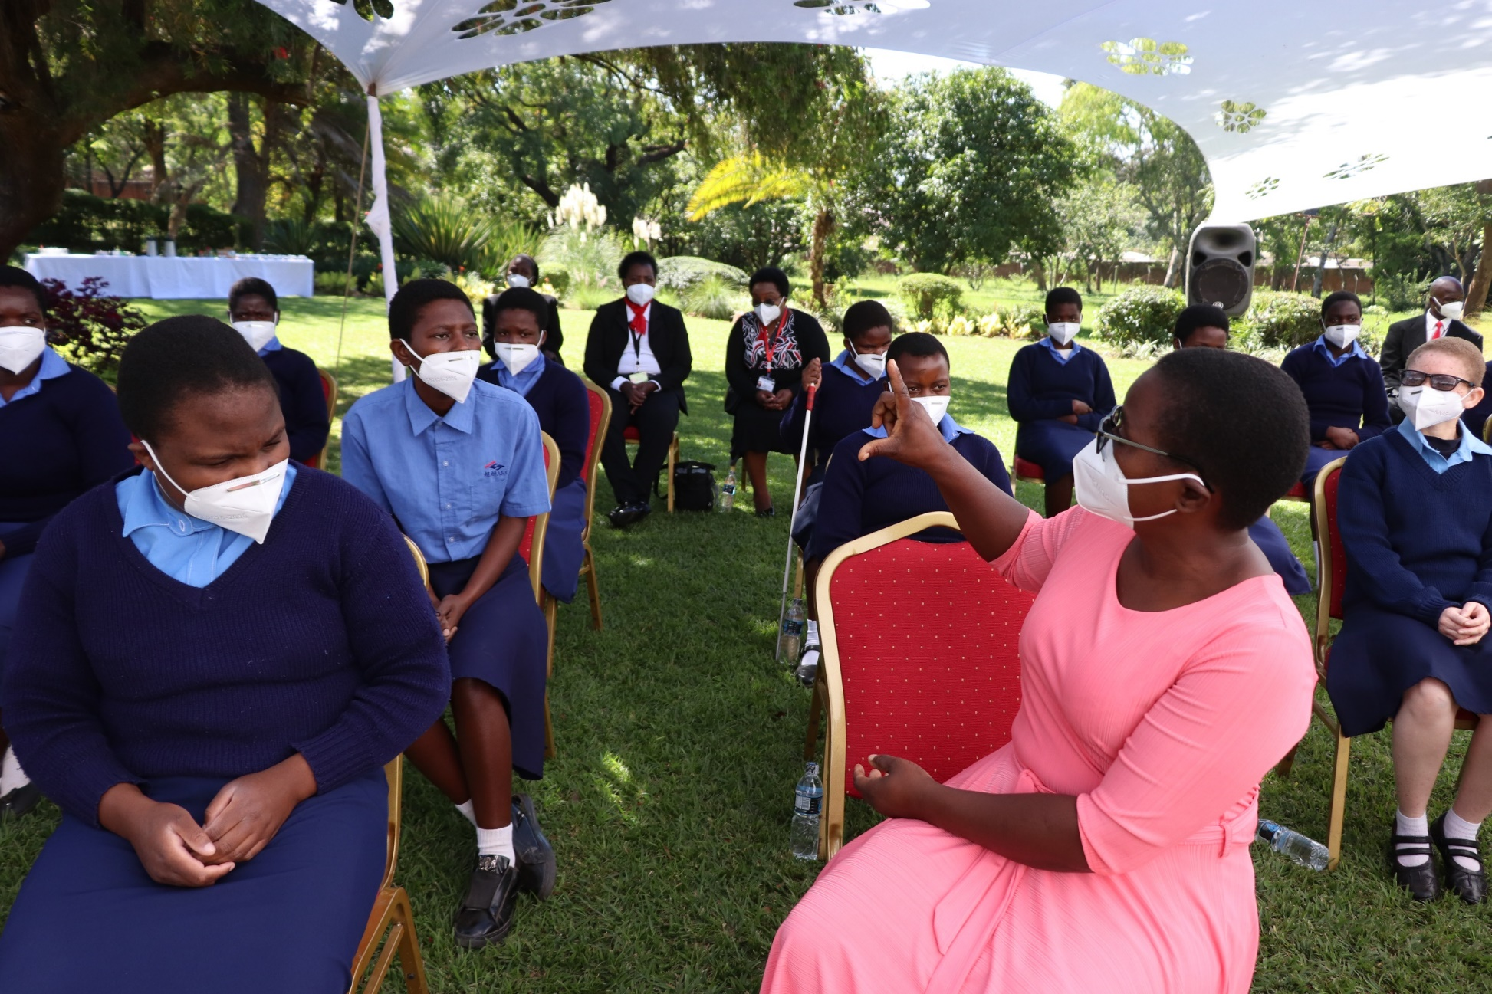
Keeping Girls in School: 312 Scholarships awarded (including 148 street connected children) in 88 secondary schools.
Notes:
Loc. 221

Slide 19
School Fees Per Year Plus Uniform, Shoes, School Bag, Exercise Books, Uniform, Sanitary Pads, Socks, Mathematical Instrument, Pens and Pencils
National Public Boarding Secondary | £133.66
National Grant Aided Boarding Secondary | £389.76
District Boarding Secondary Schools | £190.37
Community Day Secondary Schools with Boarding Facilities | £186.10

Slide 20
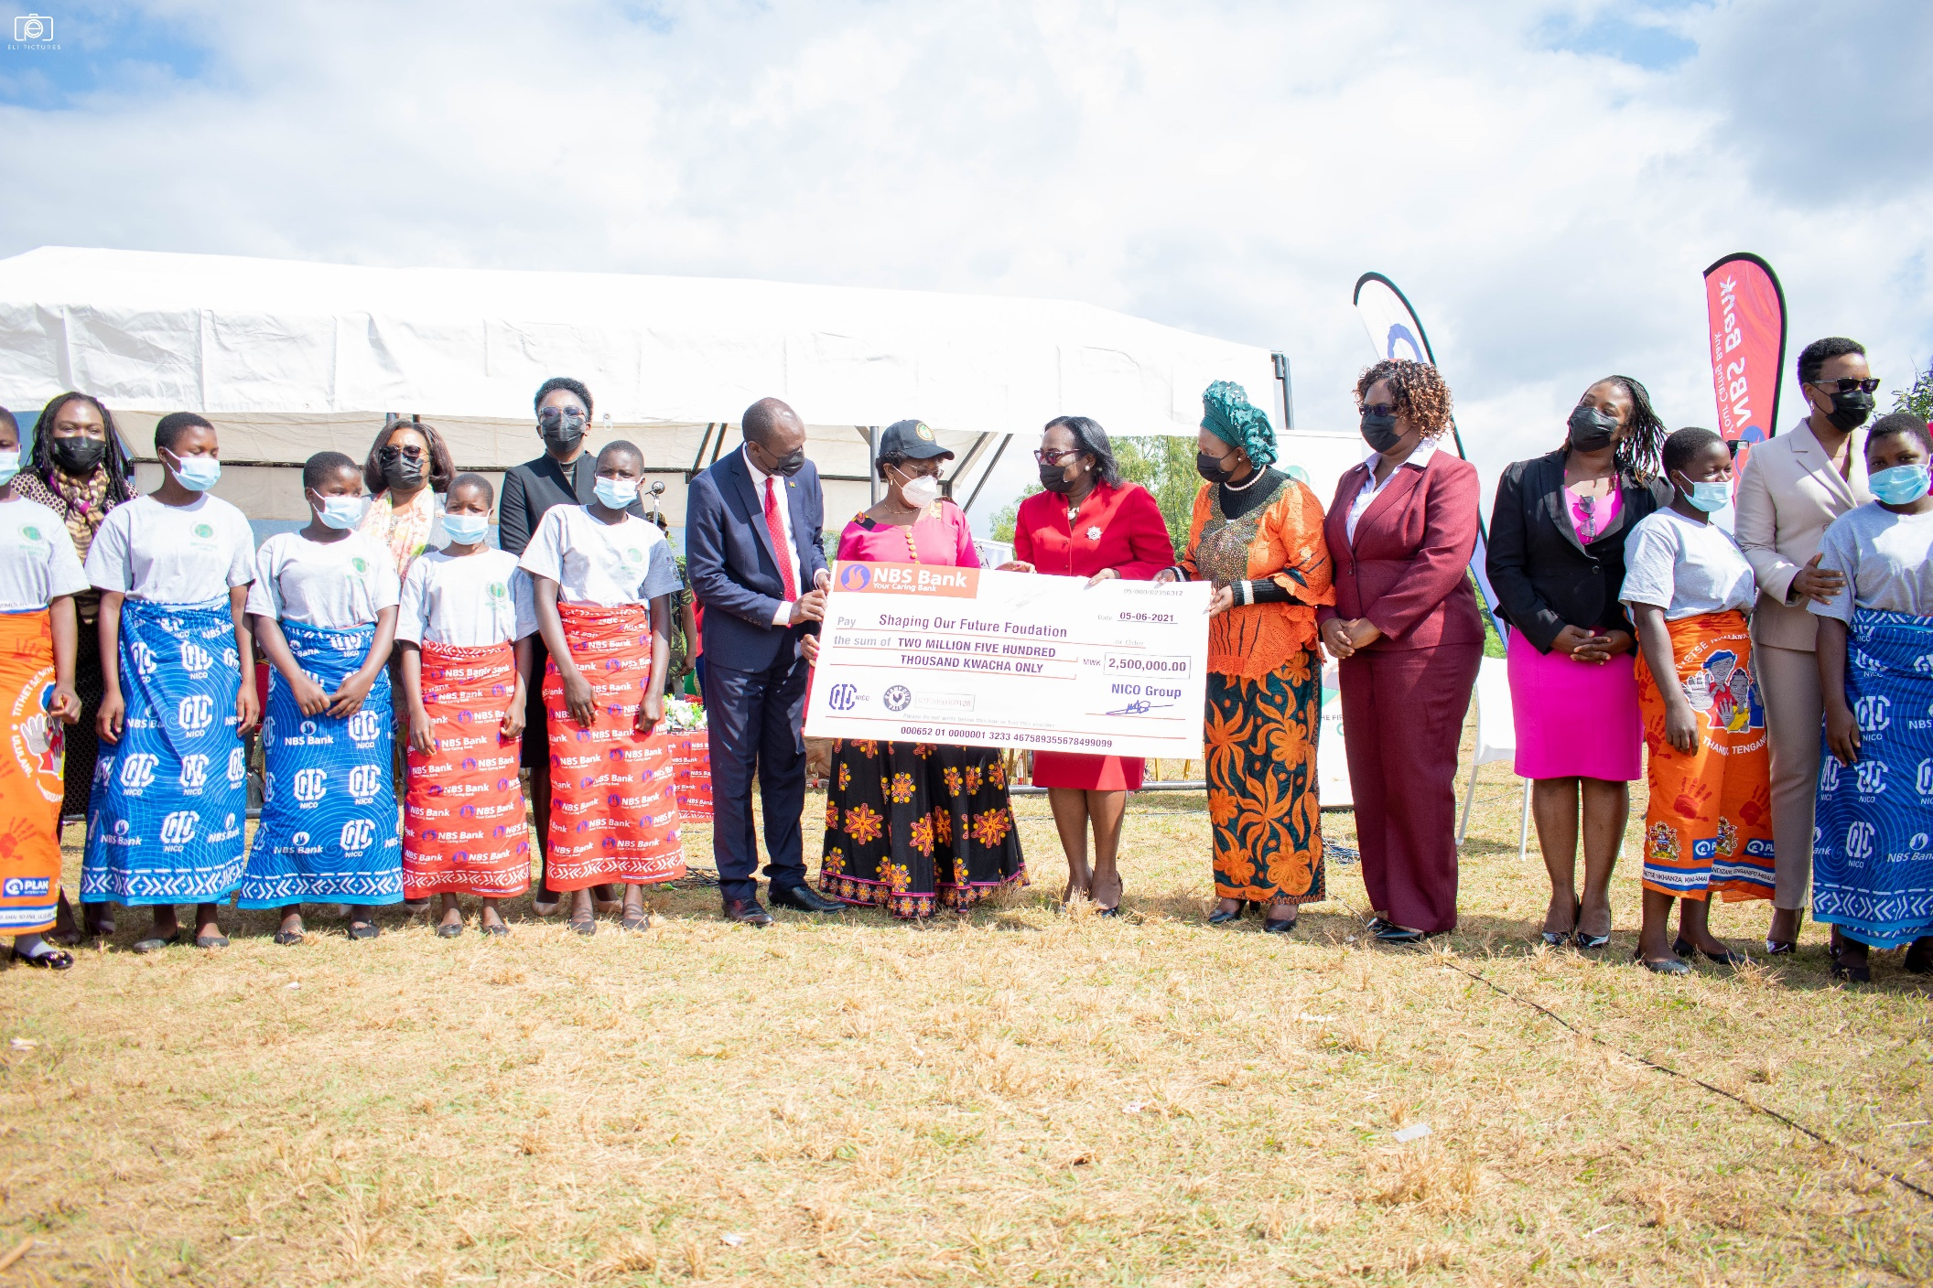
Mentorship Programme: In collaboration with NBS Bank, Eris Properties, NICO Life and NICO General.
Notes:
Loc. 221

Slide 21
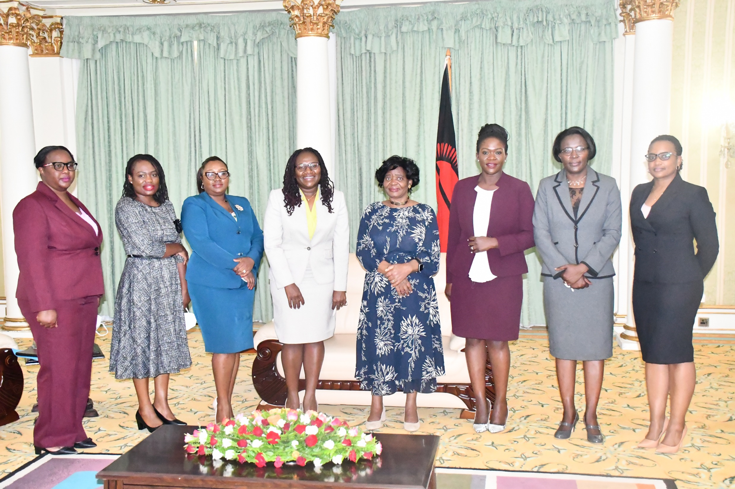
Girls Education Mentors
Notes:
Loc. 221

Slide 22
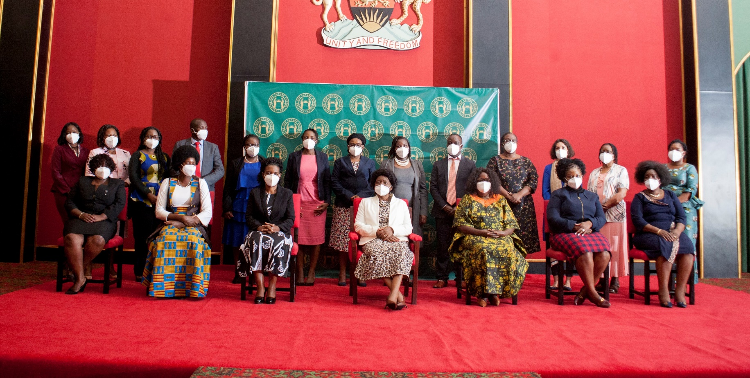
Girls Education Programming Think Tank: (Oxfam, CRECCOM, Girls Education Trust, Plan Malawi, UNICEF, Ipas, TEVETA, Save the Children, Yamba Malawi, Chancellor College, Transform Education, Malawi Girl Guides Association).
Notes:
Loc. 221

Slide 23
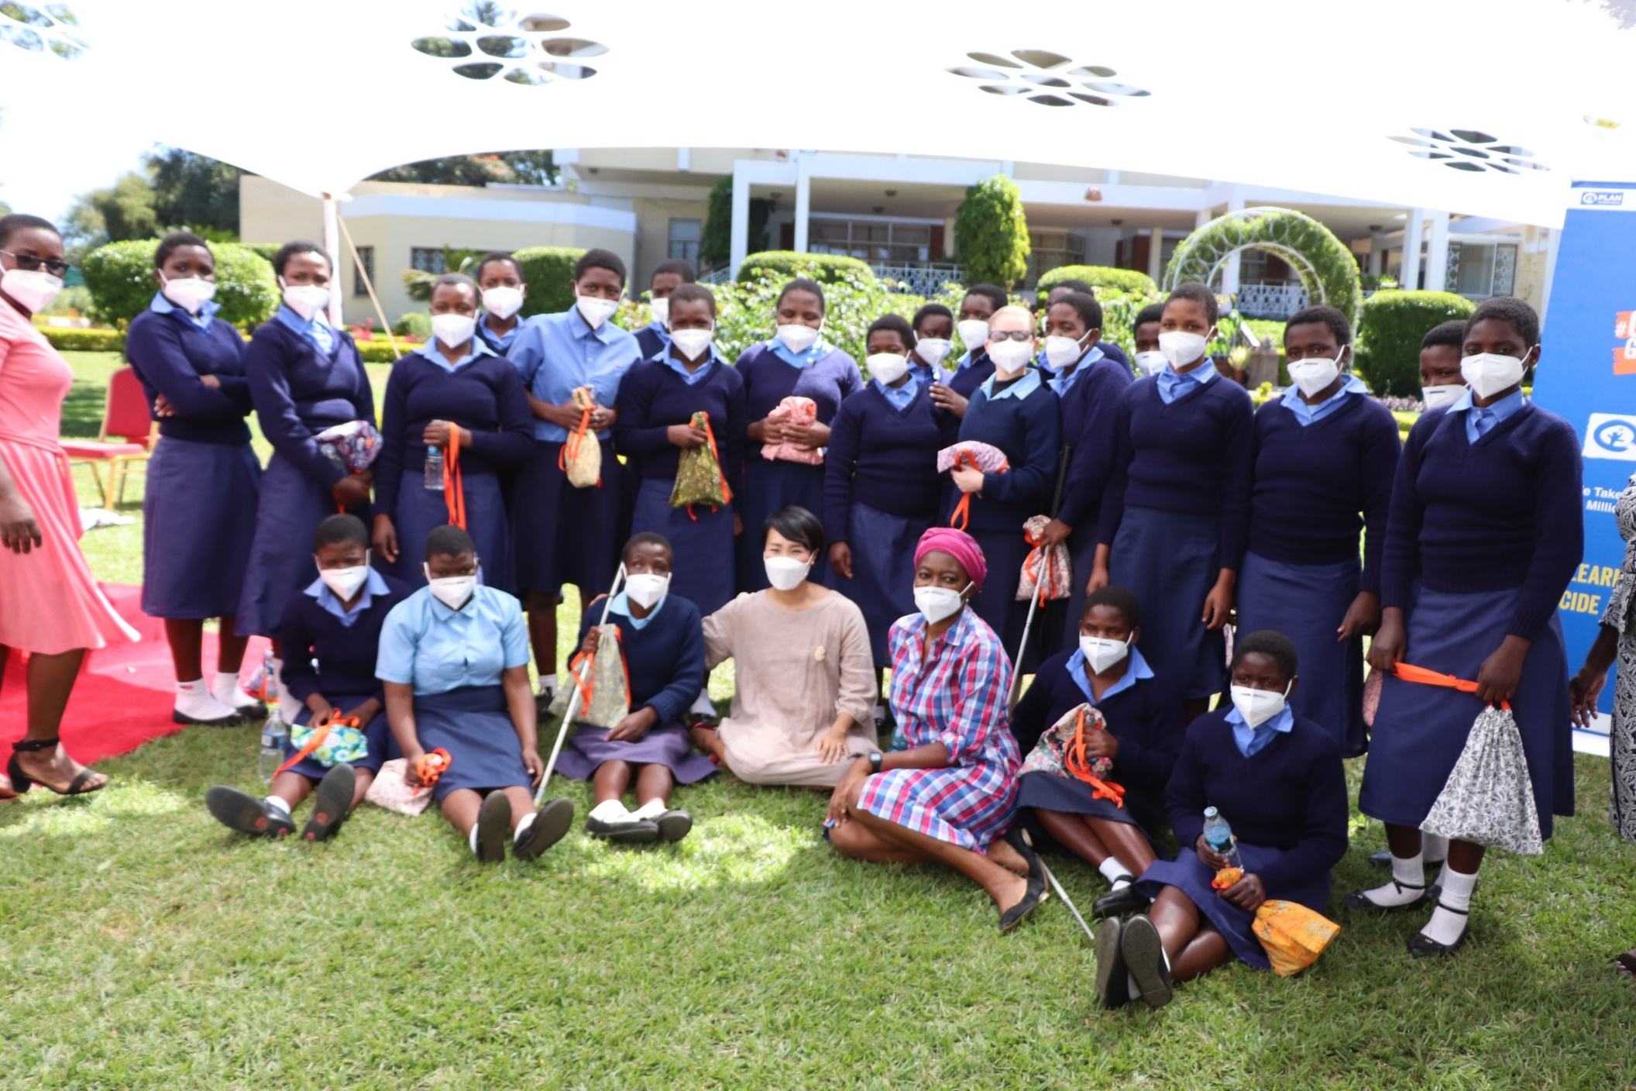
Sexual Reproductive Health (Advancing Menstrual Health Equity in Schools and Communities in 7 Districts in Malawi): Days for Girls International, Plan International Malawi, UNFPA
£10.00 pack of 3 washable reusable pads
Notes:
Loc. 221

Slide 24
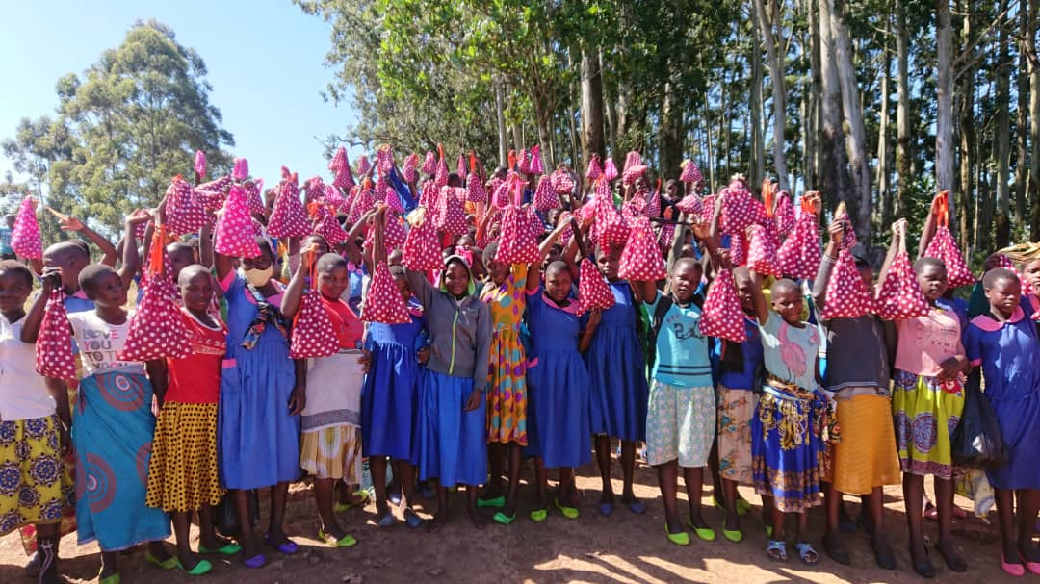
Notes:
Loc. 221

Slide 25
KEY THOUGHTS
Social and economic benefits of secondary education are directly linked to the poverty reduction and shared prosperity efforts for Malawi
Keeping girls in school is a vehicle towards enhancing women empowerment, women’s economic empowerment and ending violence against women and girls.
CDSS’ continue to provide high percentage of access to secondary education. 2019/20 Form One selection 79% of those selected went to CDSS
A well-educated population leads to a well-educated and productive workforce, especially in today’s ‘knowledge-oriented’ economies.

Slide 26
THANK YOU
Shaping Our Future Foundation
Plot 6/263
PO Box 30508
Lilongwe, Malawi
Website: https://www.shapingourfuturefoundation.org

