Slide 1
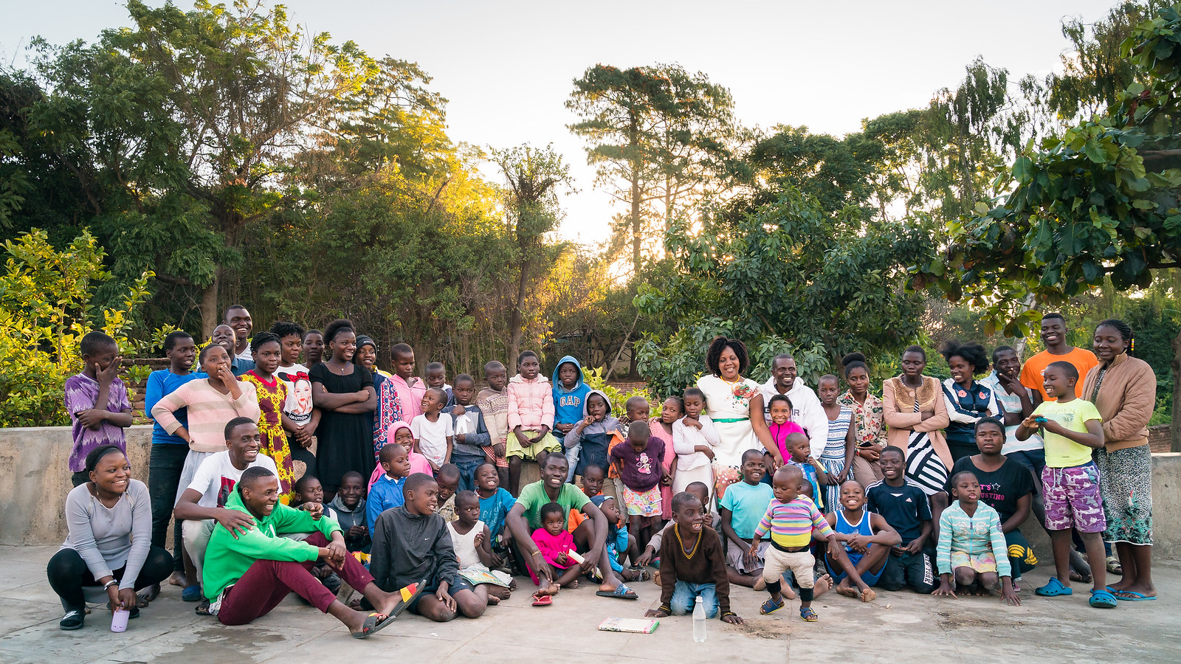
Godknows Maseko:
A new model of voluntourism –
the Umunthu Dialogues
Notes:
Story of GN Helen = most senior in Catholic church ….

Slide 2
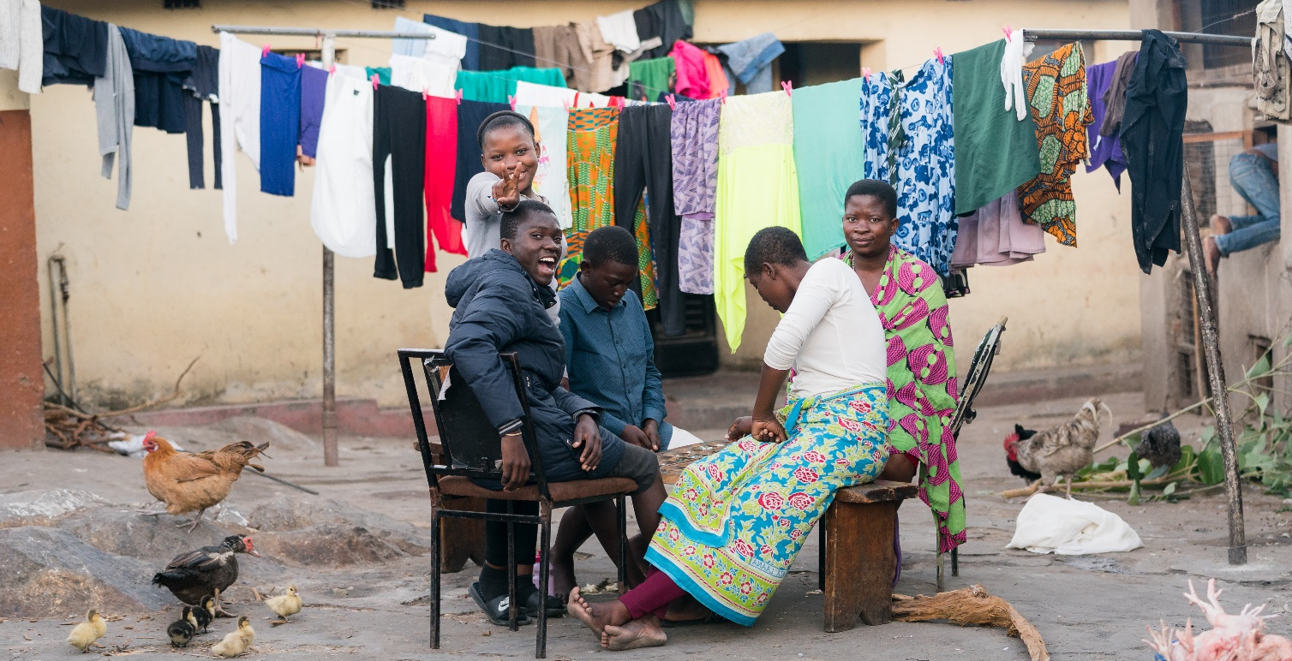
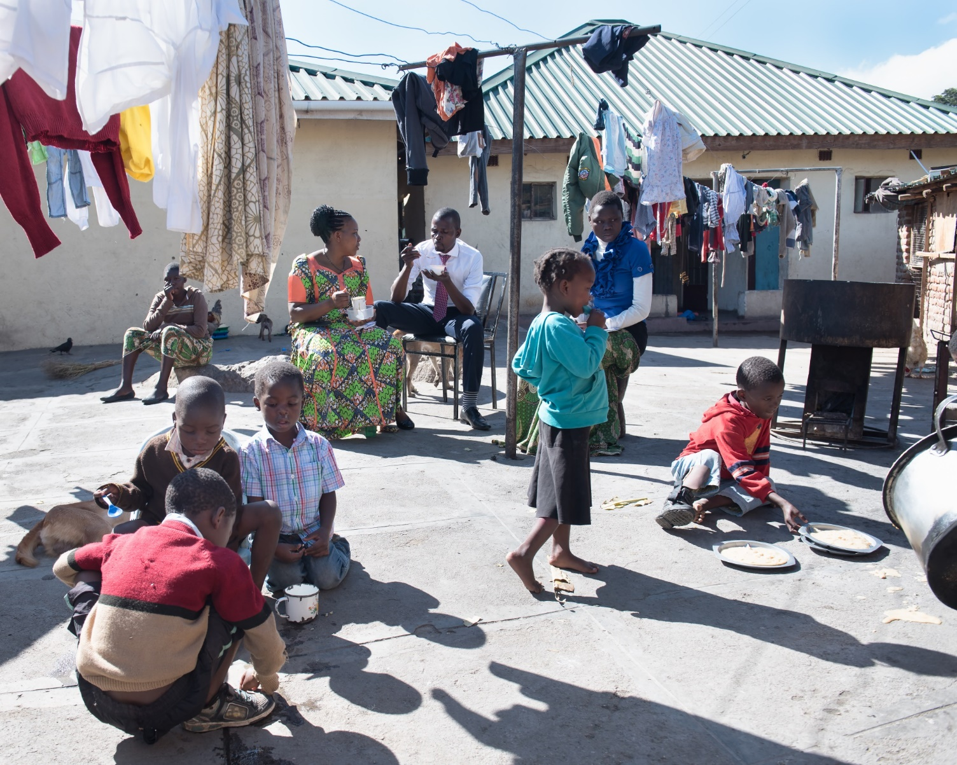
STEKA
A
Malawian
Family
Home
Notes:
Story of GN Helen = most senior in Catholic church ….

Slide 3
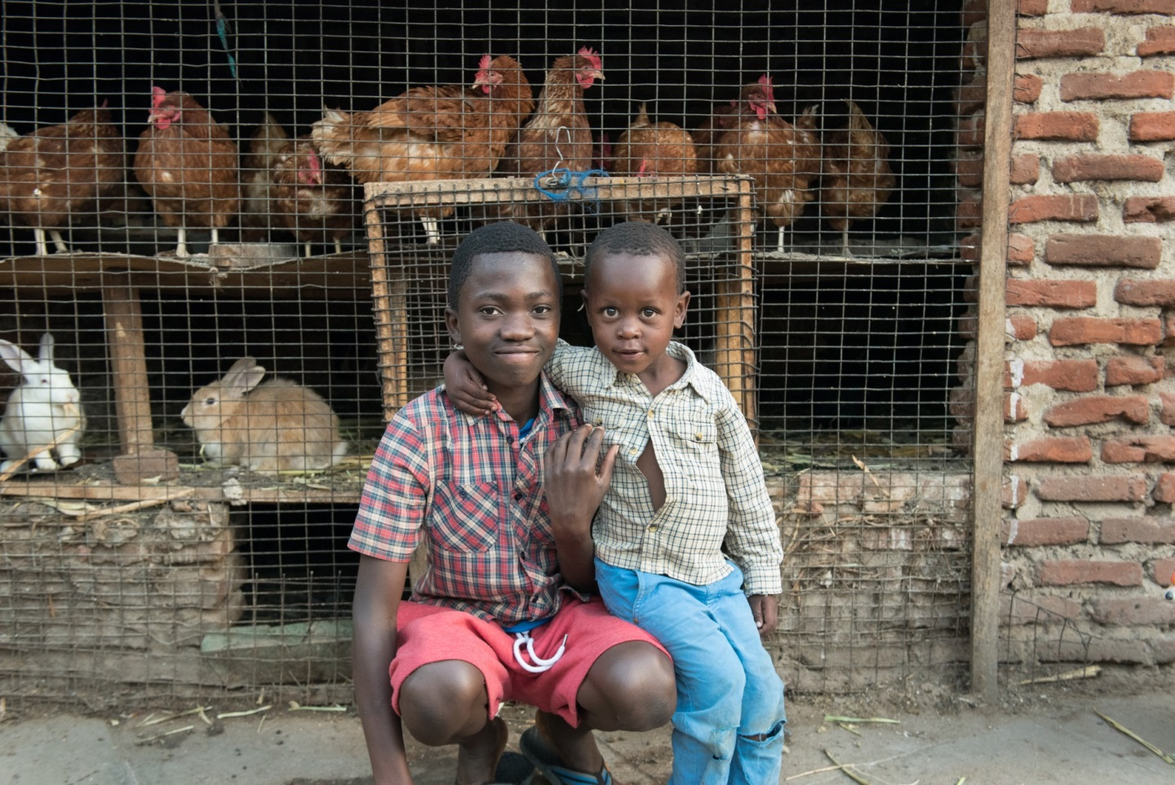
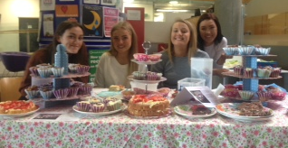
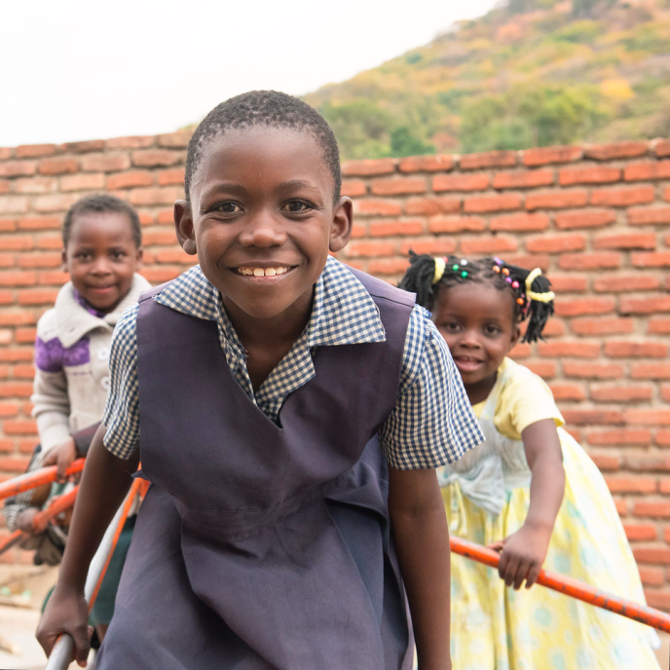
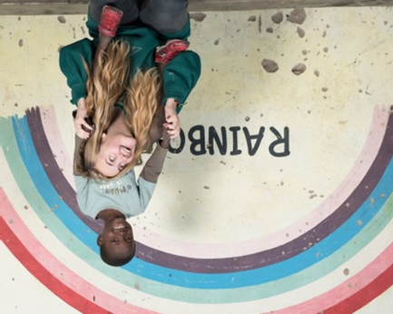
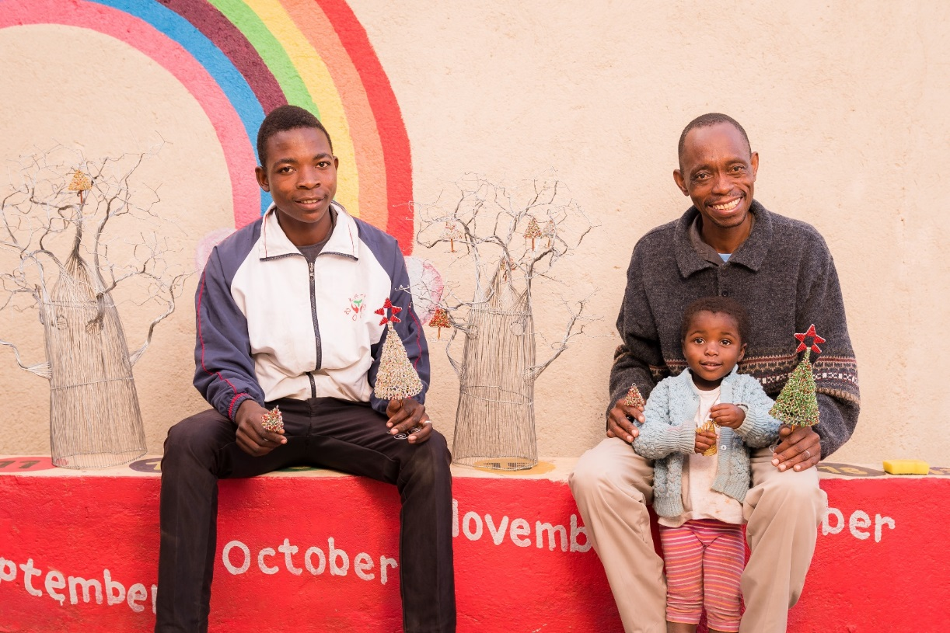

Slide 4
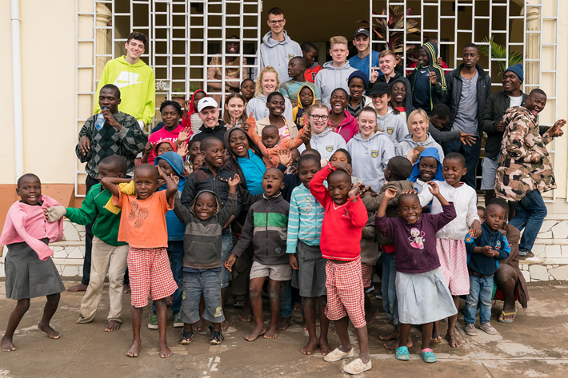
Voluntourism
Volunteer trips. A growth area within the tourism sector (Wearing & Mcgehee 2013 Atkins & Thompson 2012, Conran 2011)
Tourism-oriented NGOs are becoming increasingly relevant as an alternative and legitimate source of development aid for poverty reduction (Kennedy & Dornan 2009).

Slide 5
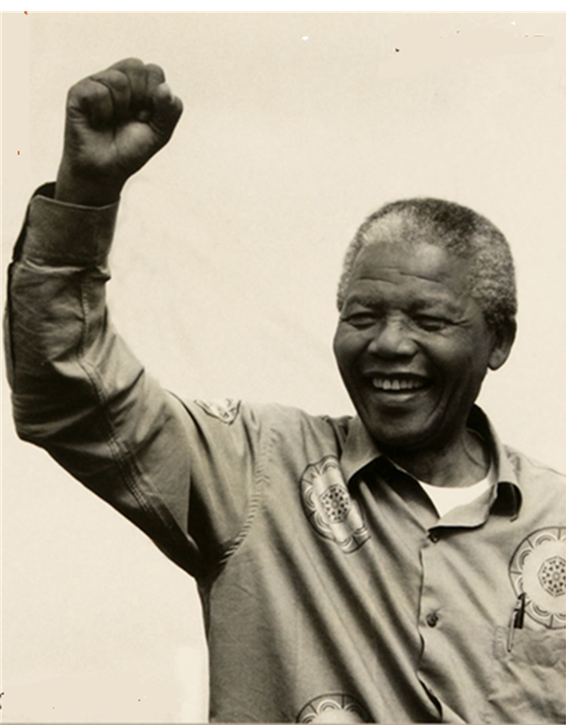
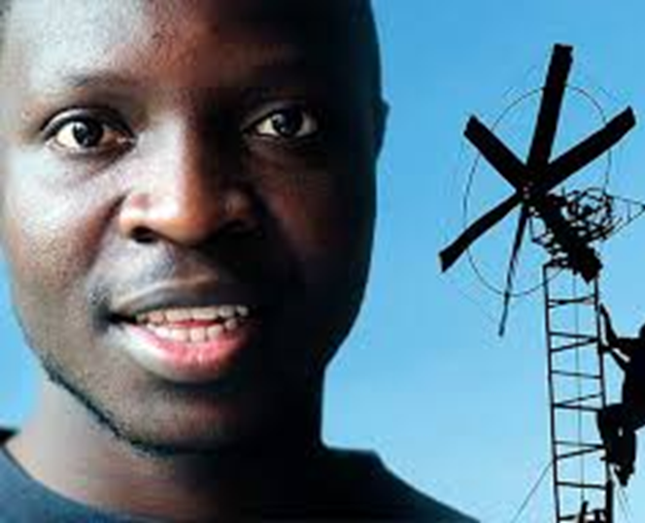
POTENTIAL PROBLEM: Can reinforce aid framed agendas – instead of human rights
Assumes the voluntourist is the active agent in positive social change NOT that people in the local community can effect their own change..’ (Mcgloin & Georgeou 2016)

Slide 6
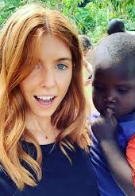
POTENTIAL PROBLEM: Reinforces inequality
Normalises idea of ‘developed’ and ‘undeveloped’ … that Global North countries ‘help’ those less privileged.
Shouldn’t the Global North learn too de-develop?
How to, foster community spirit, halt climate change…?

Slide 7
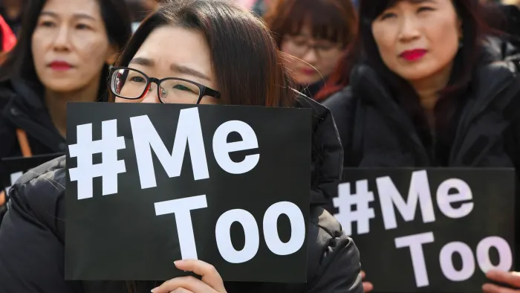
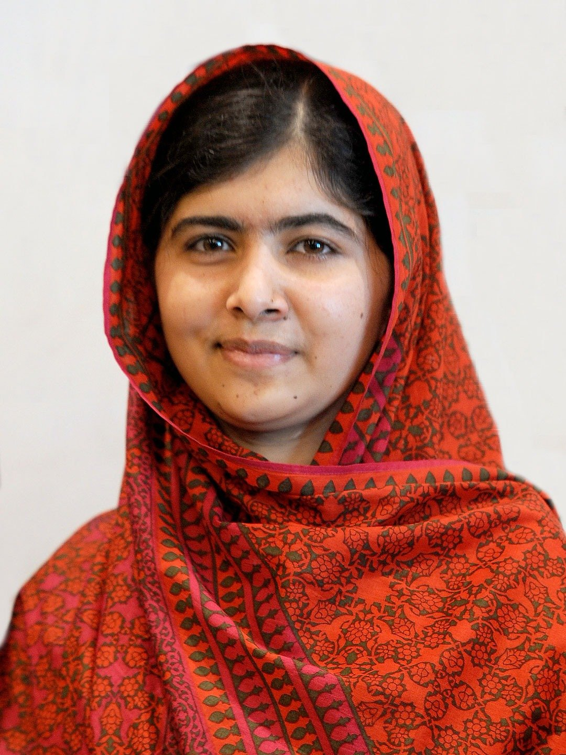
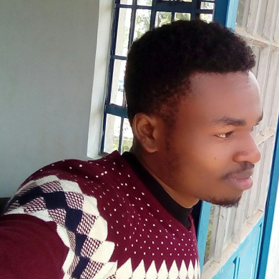
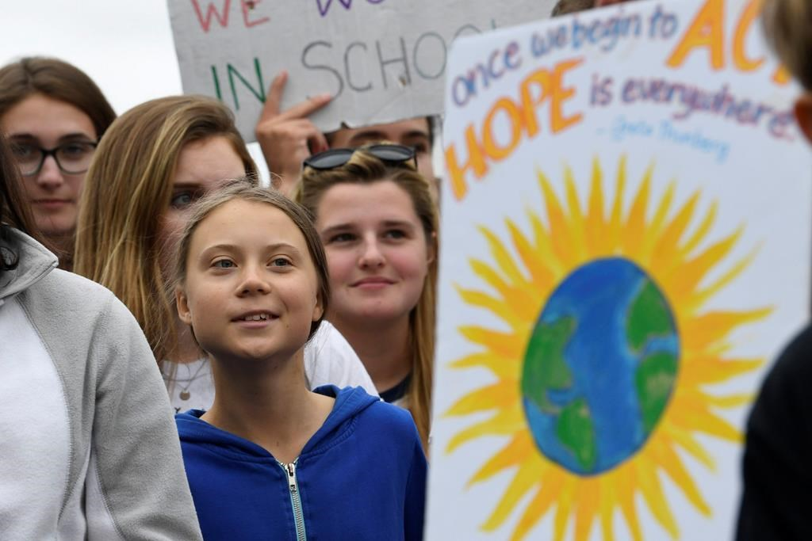
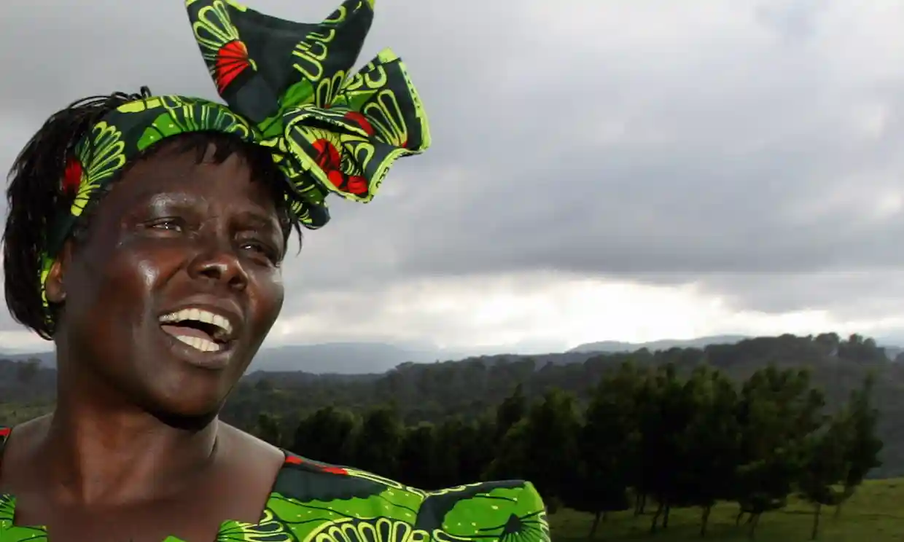
Inhibits solidarity & activism
Kaluki Paul Mutuku
African Youth Initiative on Climate Change
Kenyan 2004 Nobel peace prize winner and environmentalist Wangari Maathai
Notes:
So – job done, go home, nothing changes. Continue to consume and contribute to climate change because there’s nothing to be done.

Slide 8
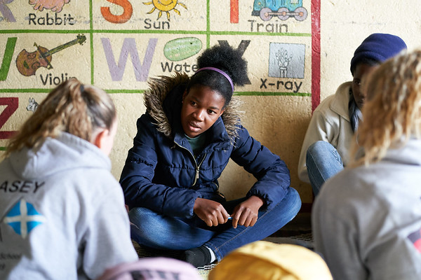
Our solution: Umunthu Dialogues
Building solidarity with allies and stopping the selfie…

Slide 9
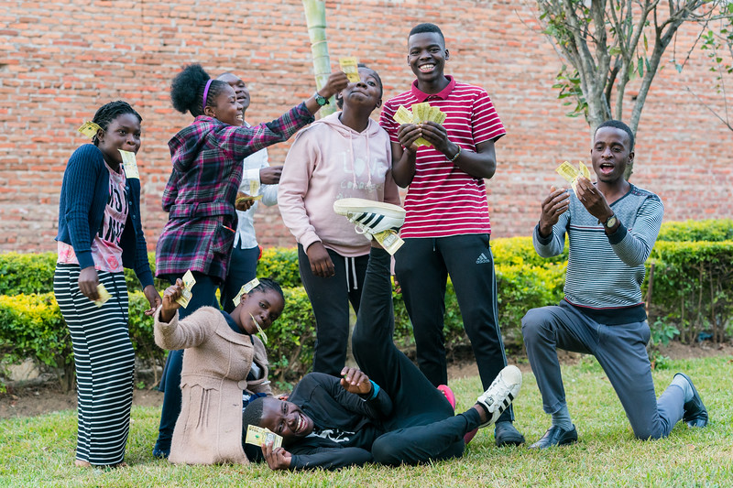
Young Malawians respected & earn income instead of hoping for donations. Young Scots learn from people with different lived experiences

Slide 10
Click here to hear about the impact
https://www.youtube.com/watch?v=SWJKmVy92Lc
Fights aid framed views of development. Promotes:
Rights & equality
Relationships & solidarity
Learning about resilience & the reality of SDGs for allies
Using skills to fight for change #STEKAskills

