Slide 1
Decolonising the Curriculum Why, What and How
Open Lecture
Yonah Hisbon Matemba
Division of Education
Scotland-Malawi Partnership
Edinburgh City Chambers
11th October 2023

Slide 2
Introduction
“… Epistemic privilege is in the side of the colonizer [not the colonized …]” (Mignolo, 2007: 459)

Slide 3
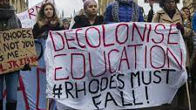
Of Black History Month, (Anti/Neo)coloniality and Hashtag Activism
This October is Black History month.
Has decolonisation lost its lustre? Who is afraid of decolonisation (Hall, Ansley and Connolly, 2023)
Anticolonial movement (Marmon, 2023)
Postcolonial environment (Fanon, 1967; Ngugi, 1986)
#BlackLivesMatter (Busey and Coleman-King, 2023),
#RhodesMustFall (Pillary, 2016)

Slide 4
Scottish Context
“Yet I live here, I live here too …” (Heaney, 1990: 22)

Slide 5
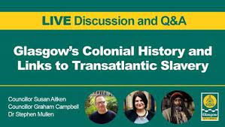
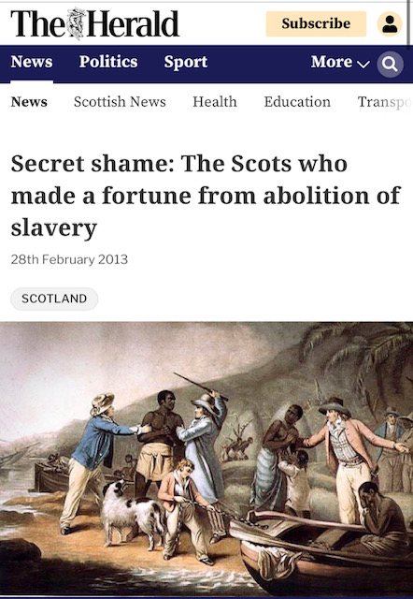
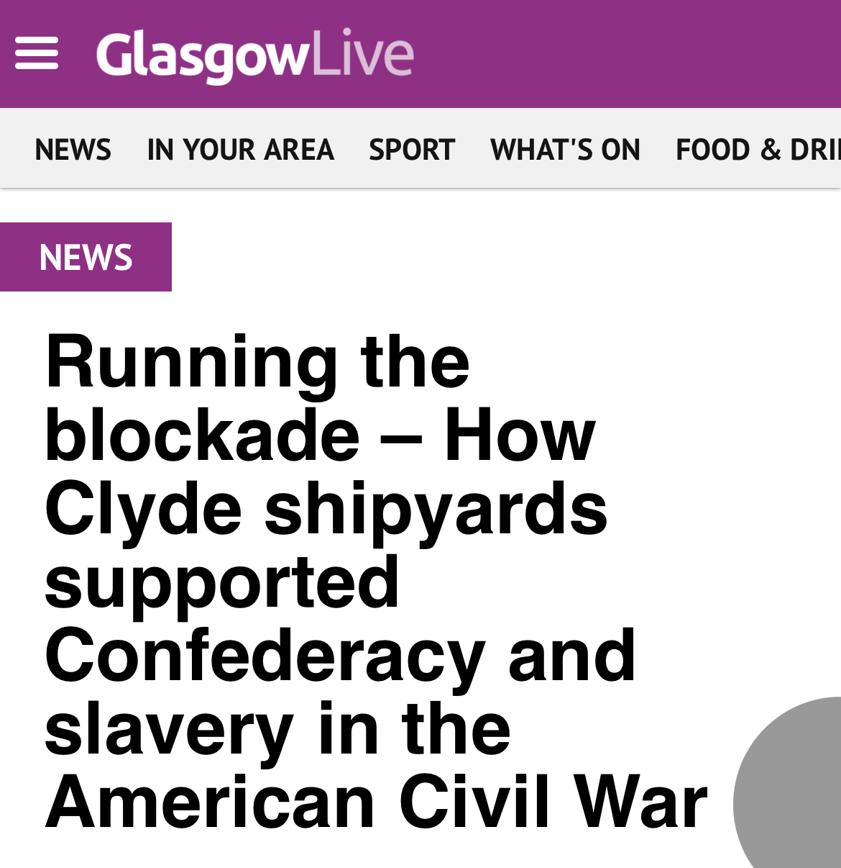
Scottish History, Colonialism and the Curriculum
Curriculum exists in and responds to socio-cultural context
Collusion with colonialism as part of the British Empire.
Connections with slavery and the slave trade.
River Clyde, ship building and Trans-Atlantic Slave Trade.
Scottish slave owners beneficiaries of a secret British government pay (£1.5 billion) for the loss of “property”.

Slide 6
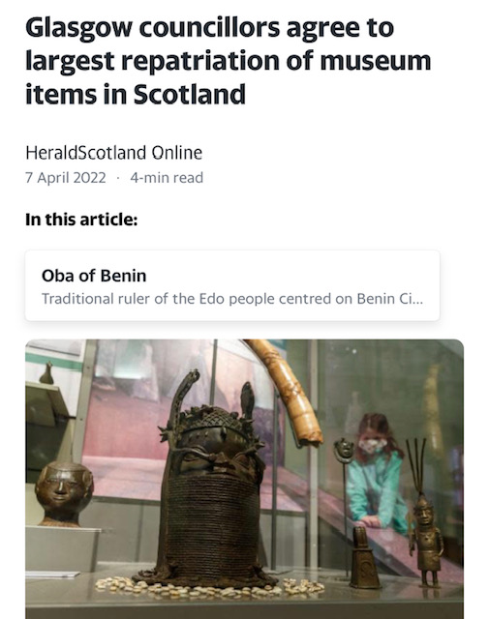
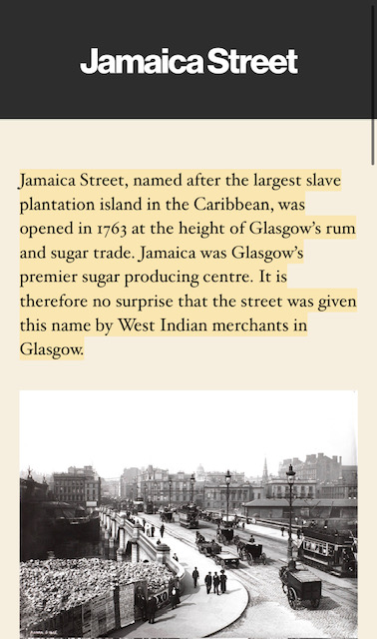
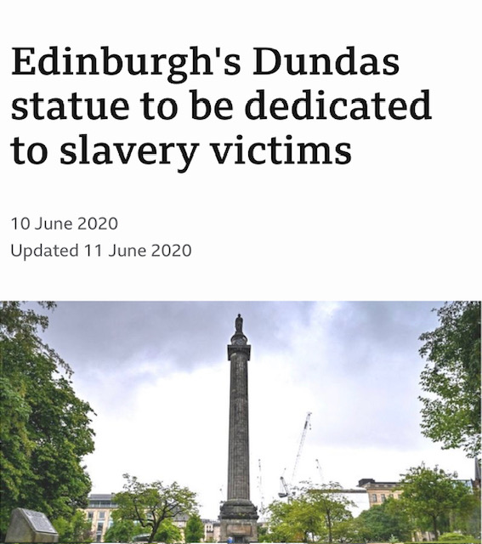
Scottish missionary movement’s complicity with British colonialism.
Scottish museums’ colonial legacy
Scottish street names, statues, and other monuments
Scotland has a sizeable immigrant population

Slide 7
Complexities of the Curriculum
“Curriculum is a complex phenomenon” (Johnson-Mardones, 2015: 123)

Slide 8
The Curriculum
What is the Curriculum?
Totality of students’ regular learning and related experiences occurring in the educational process, whether planned or not.
Types of Curriculum
Formal/official curriculum
Actual/delivered curriculum
Informal curriculum
Null/excluded/hidden curriculum

Slide 9
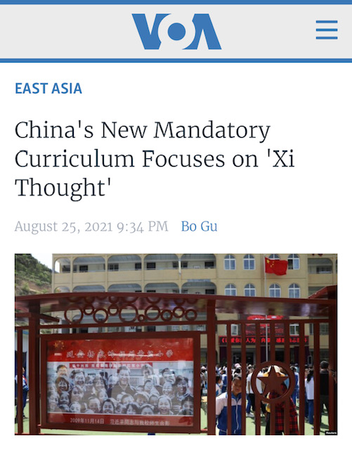
Purpose of the Curriculum
Encapsulates norms, values and philosophies society thinks will benefit the child.
Curriculum aims/outcomes
Political
Ideological
Propaganda
Educational
Cultural
Economic
Curriculum not value-neutral
Assumptions
Ambitions
Beliefs
Ideologies
Selective tradition
Selection/deselection of knowledge - what is included or not in the curriculum, and why (Apple, 2004)
Hegemonic epistemologies as ‘official knowledge’.

Slide 10
Colonial-Neocolonial Continuum "Colonial exploitation is not the same as other forms of exploitation…” (Fanon, 1967: 88)

Slide 11
Coloniality
Epistemological frame and the colonial project (Mignolo, 2007)
Matrix of power (Quijano, 2000)
Privilege and racialised politics (Mignolo, 2000)
Domination and history of epistemic violence (Spivak, 1991)
Silencing and relegating other epistemologies (Mignolo, 2007)
White fragility and white guilt/shame (DiAngelo, 2011; Hess, 2017)

Slide 12
Neocoloniality
False ‘decoloniality’; illusions of liberation (Kepe and Hall, 2018)
Entrapped in a colonial caged mentality (Cossa, 2018)
False belief in universalism that only ‘Westernised’ canons attribute to truth (Ngugi, 1986)
White saviour industrial complex (Hoffman, 2022)
Dependency culture on Western materialism (Clapman, 2020)
Double consciousness, identity masks and the colonised mind (Fanon, 1986)
Colonial space still scripting the ‘other’” (Simmons and Sefa-Dei 2012)
Commodification and coloniality ratified with a code ethics (Quijano, 2000)

Slide 13
Colonised Curriculum
“The colonised curriculum serves the interest of the rich people as it prepares some people to be dominated” (Mashiyi, Meda, and Swart, 2020)

Slide 14
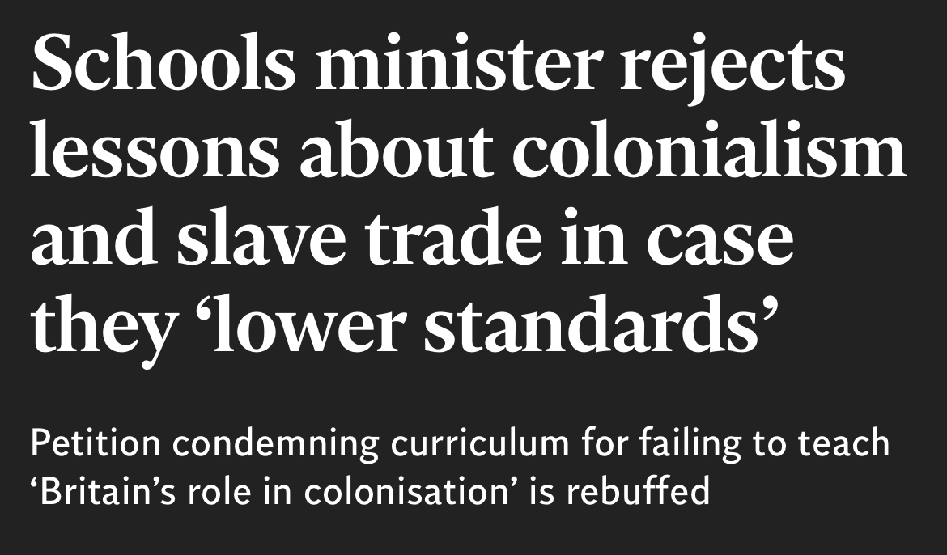
Curriculum in a ‘Colonial’ Formulation
Centres on selected knowledge
Focuses on singularity of interpretation to knowledge-making.
Ignores colonial epistemic violence
Does not engage with uncomfortable issues.
Celebrates supposed colonial triumphalism.
Draws on theories only from hegemonic discourses.
Does not acknowledge its omissions and exclusions.
Demonises non-normative knowledges
Minimises Black pain (Motshabi, 2020)
Antipathetic to reparations
Peppers over structural racism
Fails to interrogate structural location

Slide 15
Decolonisation “It is … in relation to the place of the Other that colonial desire is articulated…” (Fanon, 1967: xv)

Slide 16
Decolonisation “Taking the Bull [Colonialism/Coloniality] by the Horns”
Challenging (neo/re)colonisation (Hundle, 2019; Matemba, 2021).
Undoing coloniality (Heleta, 2016; Fanon, 1967)
Disobeying coloniality (Mignolo, 2007)
Different ways of thinking, knowing, and doing (Nye 2019; Emard and Nelson, 2020)
Re-embodiment of thought (Nyoni, 2019)
Decentering hegemonic epistemologies (Jansen cited in Mathebula, 2019).
Encouraging plurality and democratic open-endedness (Manthalu and Waghid, 2019),
Critiquing self (as well as others) (Matemba, 2022),
Decolonisation towards social justice, equity and equality (Albertus, 2019)

Slide 17
Decolonisation, Not Erasure
Decolonisation is not about deleting.
Prof Rowena Arshad (2021) has said:
“To decolonise is not about deleting knowledge or histories that have been developed in the West or colonial nations, rather it is to situate the histories and knowledges that do not originate from the West against the context of imperialism, colonialism and power and to consider why these have been marginalised and de-centered” (2021).
Do not tear down statues but decolonise them (Palmer, 2021)

Slide 18
Decolonising the Curriculum
“Statues fall, fees fall but curricula don’t “fall” (Shay, 2016: np)
“The university went to ‘decolonise’ and all they brought back was lousy diversity double-speak!” (Doharty, Madriaga and Joseph-Salisbury, 2021)

Slide 19
How To Decolonise the Curriculum
Pay attention to structural location (Matemba, 2022)
Teach ‘difficult’ colonial history (MacDonald, L. and Kidman, 2022)
Embed counter-hegemonic strategies (Sathorar and Geduld, 2018)
Create decolonial spaces (Matemba, 2021)
Involve different voices (Shay, 2016)
Teach white fragility (DiAngleo, 2011)
Recentre marginalised knowledges (Mignolo, 2007)

Slide 20
Use diverse sources in teaching (Winter, Webb, and Turner, 2022)
Challenge racial stereotypes (DiAngelo, 2011)
Alter assessment (Winter, Webb, and Turner, 2022)
Foster inclusive practices (Baumfield, 2003).
Decolonise first before diversifying it (Doharty, Madriaga and Joseph-Salisbury, 2021)
Include anti-racist programmes (Hall, Ansley and Connolly, 2023)

Slide 21
Plenary “Silence … a form of quiet, slow, psychological violence…” (Pillay, 2016: 157)
What is your structural location related to decolonisation?
How can you deconstruct yourself in order to decolonise praxis?
How does your structural location facilitate or hinder the decolonisation of the curriculum?

Slide 22
Thank You
Further inquiry, please email: Yonah.Matemba@uws.ac.uk

Slide 23
References
Apple, M. (2004) Ideology and Curriculum, New York: Routledge
Clapham, C. (2020) “Briefing Decolonising African Studies?” The Journal of Modern African Studies, 58(1), pp. 137-153.
Busey, C.L. and Coleman-King, C. (2023) “All Around the World Same Song: Transnational Anti-Black Racism and New (and Old) Directions for Critical Race Theory in Educational Research,” Urban Education, 58(6), pp. 1327–1354.
Cossa, J. (2018) “Addressing the Challenge of Coloniality in the Promise of Modernity and Cosmopolitanism to Higher Education: De-Bordering, De-centrering/De-peripherizing, and De-colonilizing.” In Re-Visioning Education in Africa: Ubuntu-Inspired Education for Humanity, edited by E. J. Takyi-Amoako and N. T. Assie-Lumumba, 193–204. London: Palgrave- MacMillan.
Doharty, N., Madriaga, M. and Joseph-Salisbury, R. (2021) “The university went to ‘decolonise’ and all they brought back was lousy diversity double-speak! Critical race counter-stories from faculty of colour in ‘decolonial’ times,” Educational Philosophy and Theory, 53(3), PP. 233-244.
DiAngelo, R. (2011) “White Fragility,” International Journal of Critical Pedagogy, 3(3), pp. 54-70.
Fanon, F. (1967) Black Skin, White Masks, Grove Press.
Heaney, S. (1990) New Selected Poems 1966–1987, London, Faber & Faber.
Hess, M. (2017) “White Religious Educators Resisiting White Fragility: Lesson from Mystics,” Religious Education, 112(1), pp. 46-57.
Hall, R., Ansley, L. and Connolly, P (2023) “Decolonising or anti-racism? Exploring the limits of possibility in higher education,” Teaching in Higher Education: DOI: 10.1080/13562517.2023.2201676 (10 October 2023).
Hoffman, D.M. (2022) “White Savior or Local Hero?: Conflicting Narratives of Help in Haiti,” Georgetown Journal of International Affairs, 23(1), pp. 99-104.
Johnson-Mardones, D. (2015) “Understanding Curriculum as Phenomenon, Field and Design International Dialogues on Education,” 2(2), pp. 123-130

Slide 24
Kepe, T. and Hall, R. (2018) “Land Distribution in South Africa: Towards Decolonisation or Recolinisation?” Politikon, 45(1).
Mashiyi, N. F., Meda, L., and Swart, A. (2020) “Lecturer conceptions of and approaches to decolonisation of curricula in higher education,” South African Journal of Higher Education, 34(2), pp. 146-163.
Matemba, Y.H. (2022) “Towards an Anticolonial Agenda for Decolonising Theological Education South of the Sahara,” in Chimera, F., Mvula H. and Ross, K. (Eds.) Decolonising the Theological Curriculum in an Online Age, Mzuzu: Mzuni Press, pp. 131-156.
Mignolo, W. (2007) “Delinking: The Rhetoric of modernity, the logic of coloniality and the grammar of de-coloniality,” Cultural Studies, 21(2), pp. 449-514.
Motshabi, K.B. (2020) “Decolonising affirmative action in 21st-century Africa: Reparatory alternatives for affirming South Africa,” Journal of Decolonising Disciplines, 2(1): https://doi.org/10.35293/jdd.v2i1.44 (accessed 8 October 2023).
Pillay, S.R. (2016) “Silence is violence: (critical) psychology in an era of Rhodes Must Fall and Fees Must Fall,” South African Journal of Psychology, 46(2), pp. 155–159.
Quijano, A. (2000) “Coloniality of power and Eurocentrism in Latin America,” International Sociology, 15(2), pp. 215-232.
Shahjahan, R. (2011) “Decolonizing the Evidence-based Education and Policy Movement: Revealing the Colonial Vestiges in Educational Policy, Research, and Neoliberal Reform,” Journal of Education Policy, 26 (2), pp. 181–206.
Shay, S. (2016) “Decolonising the curriculum: it’s time for a strategy,” The Conversation (https://worldpece.org/sites/default/files/artifacts/media/pdf/decolonising_the_curriculum-_its_time_for_a_strategy.pdf (accessed 10 October 2023).
Spivak, G.C. (1991) “Neocolonialism and the secret agent of knowledge,” Oxford Literature Review, 13(1-2), pp. 220-251.
Winter, J., Webb, O. and Turner, R. (2022) “Decolonising the curriculum: A survey of current practice in a modern UK university,” Innovations in Education and Teaching International, https://doi.org/10.1080/14703297.2022.2121305 (accessed 30 August 2023).

