Slide 1
Building a Partnership in ‘the Warm Heart of Africa’
Notes:
Good afternoon everyone. Thank you for joining us today. Today myself, Nicole and Lindsey would like to chat to you about our partnership working with Khaya.
Previously as a school we worked in partnership with schools in Norway and China. We offered young people an opportunity to stay in our community and study in Armadale.
When covid effected unfortunately a lot of our ties with Norway did too.

Slide 2
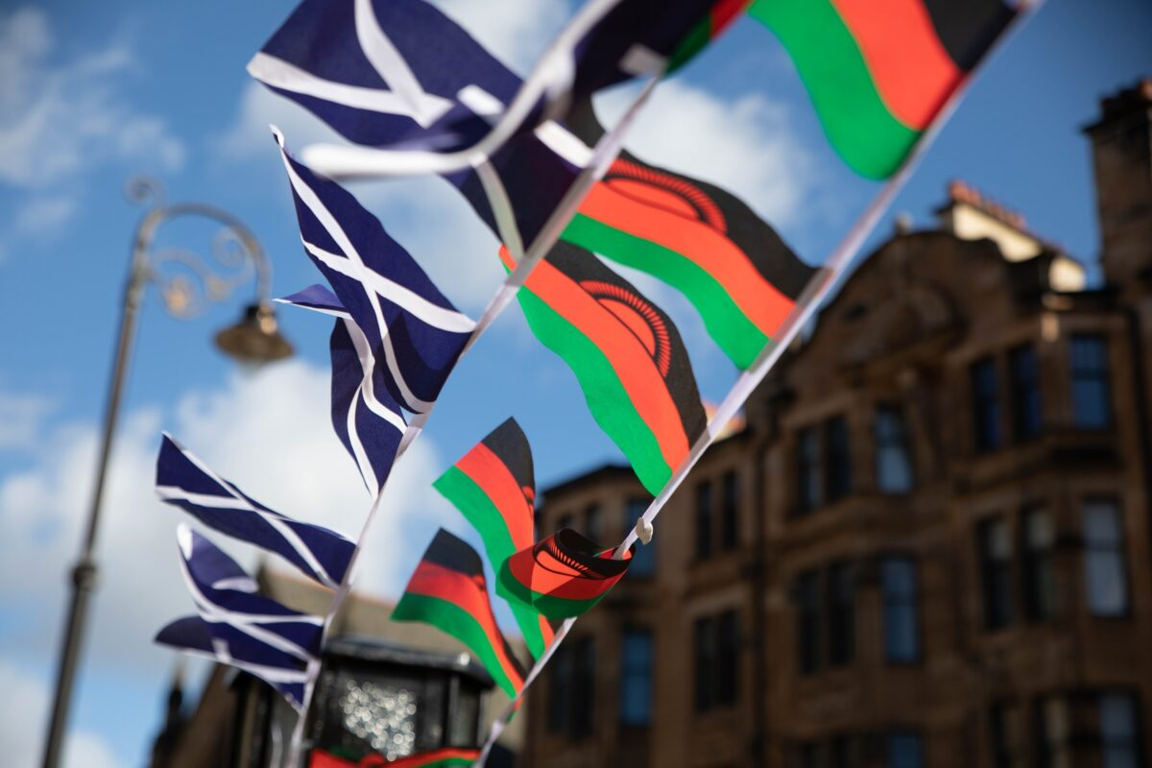
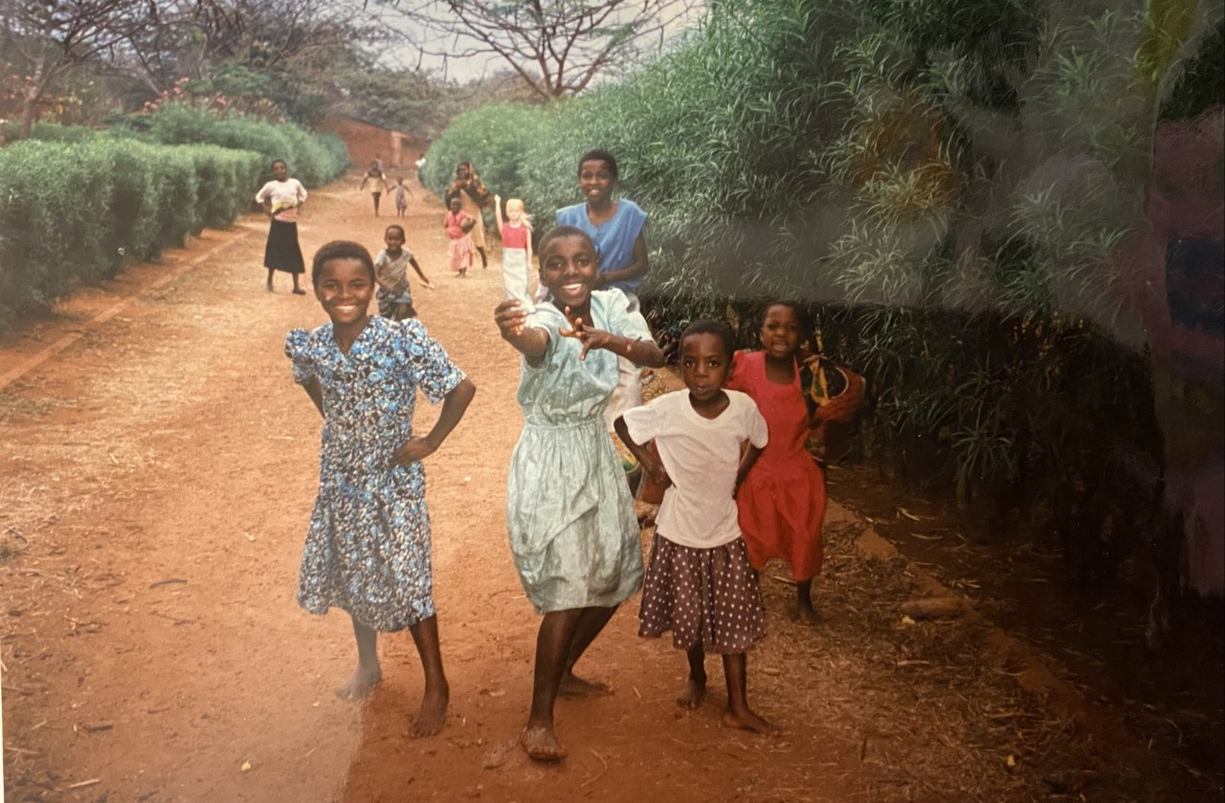
Why Malawi?
For 160 years there has been a proud friendship between Scotland and Malawi
This friendship began in 1859, with the warm welcome extended to David Livingstone and his companions
This friendship continues to be supported by our Government – which makes school partnerships more viable and sustainable
Our headtacher shared her experiences on when she first visited Malawi when she was 20 and it changed her life in many ways…
Learning Together, Achieving Together

Slide 3
Headteacher’s Experience of a School Partnership
Over 7 years Nicola’s previous school have supported our partner schools with:
Repairs to school buildings
Providing resources such as books, paper, chalk
Sanitation products during Covid, and most recently the cholera outbreak
Purchase of sanitary products and underwear for female learners
Providing music, art and sports equipment
Creating scholarships for students to continue their studies
In addition, we have:
November 2014 – paid two Malawian Teachers to visit Scotland
October 2016 - first trip to Malawi (6 staff & 17 learners)
October 2017 - staff visit to Malawi (3 staff)
October 2018 - second trip (5 staff & 8 learners)
October 2019 - staff visit (4 staff, plus ex-Rector)
Summer 2020 – planned reciprocal visit for Malawian colleagues – cancelled due to Covid
October 2023 – planning a third visit with learners…
Learning Together, Achieving Together
Notes:
Engaging with Nicola and hearing her perspectives and further visits form Mitch was very interesting as it was clear they clear objectives regarding Beiths partnerships with Malawi. The school had unique approaches on how they wanted to tackle these goals, allowing them to broaden their outlook when considering different issues.

Slide 4
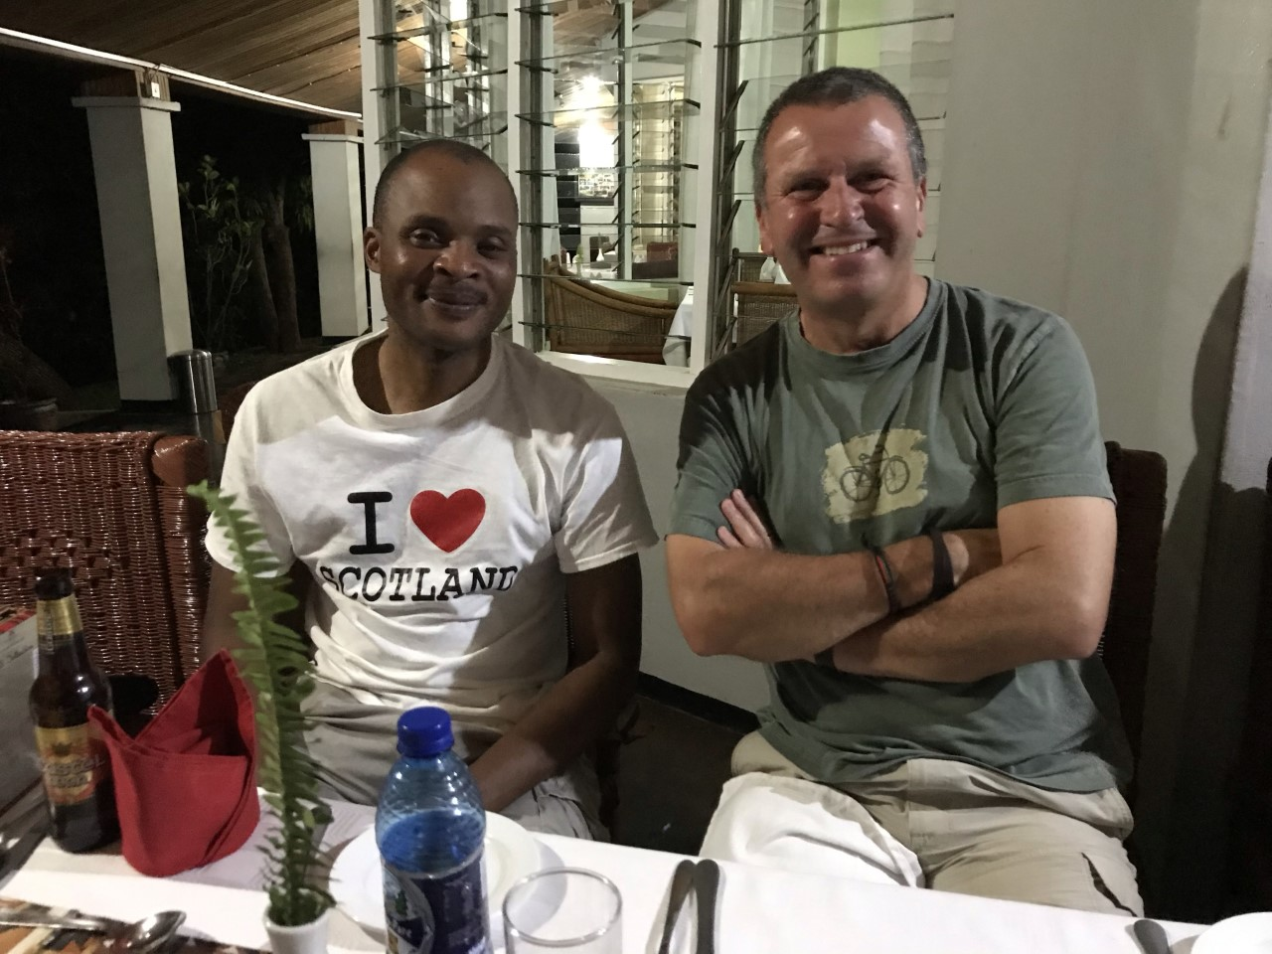
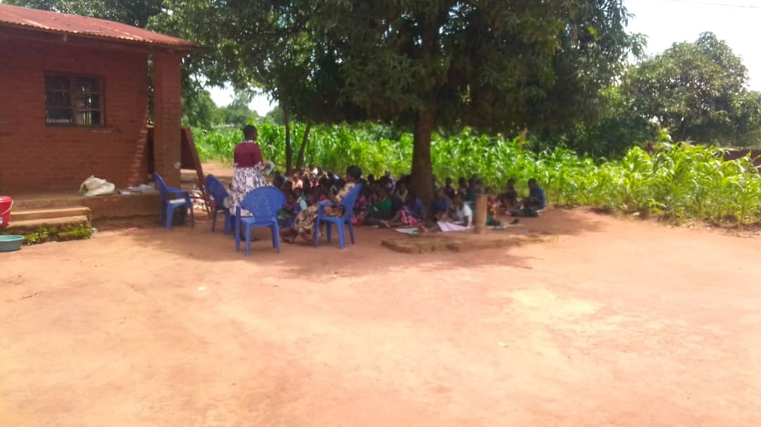
Why Armadale Academy and Khaya Primary School?…
Learning Together, Achieving Together
Notes:
We heard from Nicola about her experiences and were eager to learn more. We contacted Chad and Douglas and asked if they would be happy to visit. We wanted to hear more about the Scotland Malawi Partnership.
Chad and Douglas visited Armadale Academy on Friday 16th June and shared their experiences of setting up a partnership. Douglas started the Beath Malawi Partnership so was very experienced in this area. Chad was a teacher and lived in Malawi so he also brought a wealth of knowledge
We feel that working together in a coordinated and effective way for the benefit of both schools. We do this by harnessing experience, expertise and enthusiasm across our school where ideas, activities and information can be shared between our staff, pupils and our community.
Our Partnership with Khaya is to build connections and collaboration on a multi-sectoral basis between two small nations in ways that are transformational for both.

Slide 5
Why have a School Partnership?
​
Through our partnership, our school communities will develop: ​
​
Improve awareness of global Issues
​
Increase understanding of different cultures and traditions​
Share educational experiences​
Personal and professional relationships​
​
An ongoing benefit is the potential development of curricular links to enhance learning and teaching, and therefore outcomes for learners in both schools​
​
Our partnership should be built on the core values of mutual understanding, reciprocity and trust; and have equity of access to education as a central consideration. ​
​
​
Learning Together, Achieving Together
Notes:
We also through our partnership will address global Sustainable goals
4 Quality Education
5 Gender Equality
10 Reduced Inequalities
17 Partnership for the goals

Slide 6
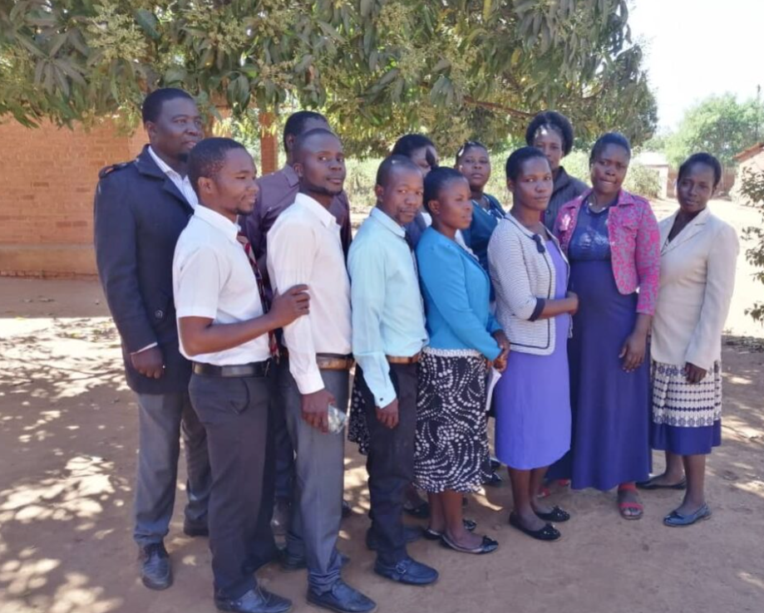
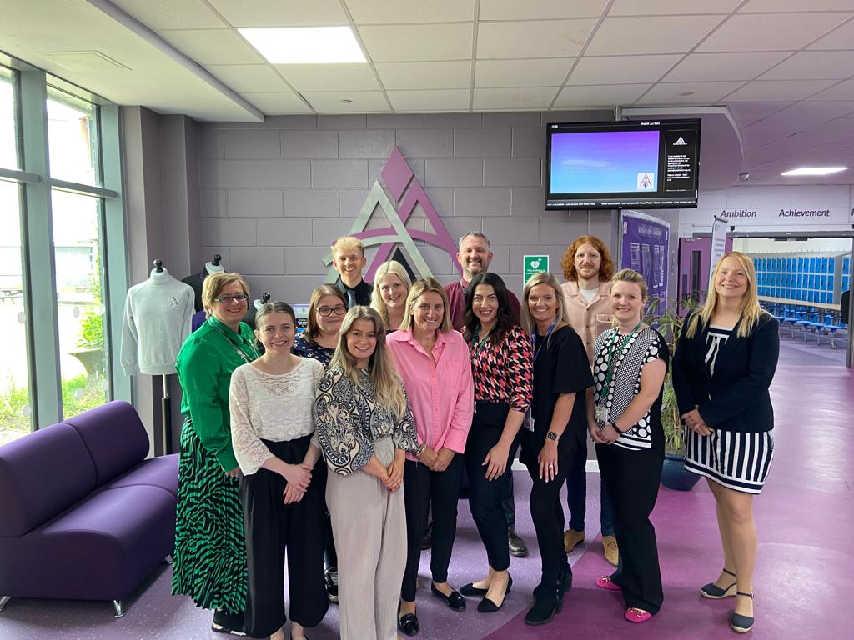
What did we consider next​
​
We set up a Committee – agreed office bearers​
Meetings – identified regular time​
Students – how best to involve them​
Partners – how best to introduce Armadale Academy to Khaya PS
​
Invite education reps from Scotland Malawi Partnership to visit?​
Trip – Looking to possibly link with Beath’s next trip?
​
​
Learning Together, Achieving Together
Notes:
When we get an opportunity to visit Khaya we will hopefully get an opportunity to be involved in teaching lesson, help in classrooms, be involved in community activities and cultural exchanges.

Slide 7
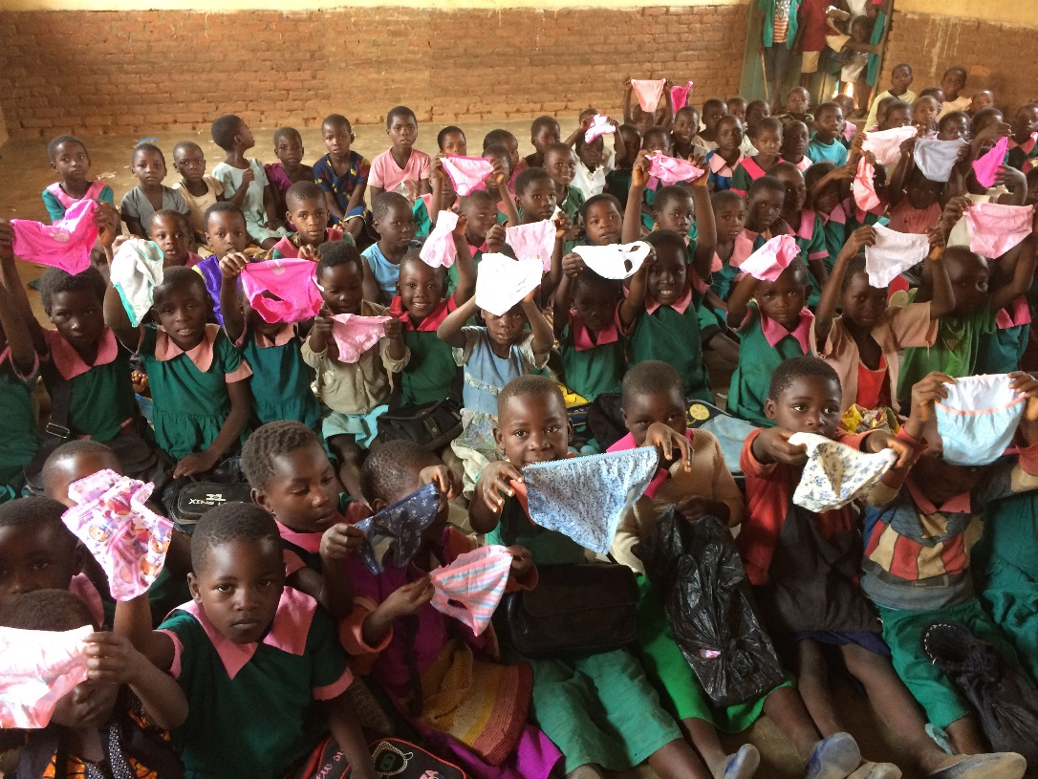
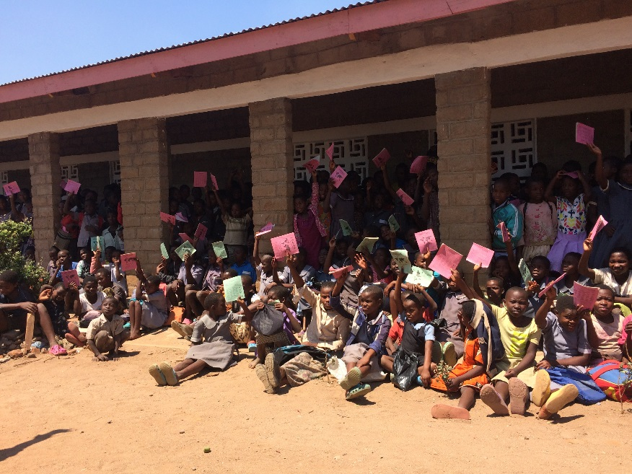
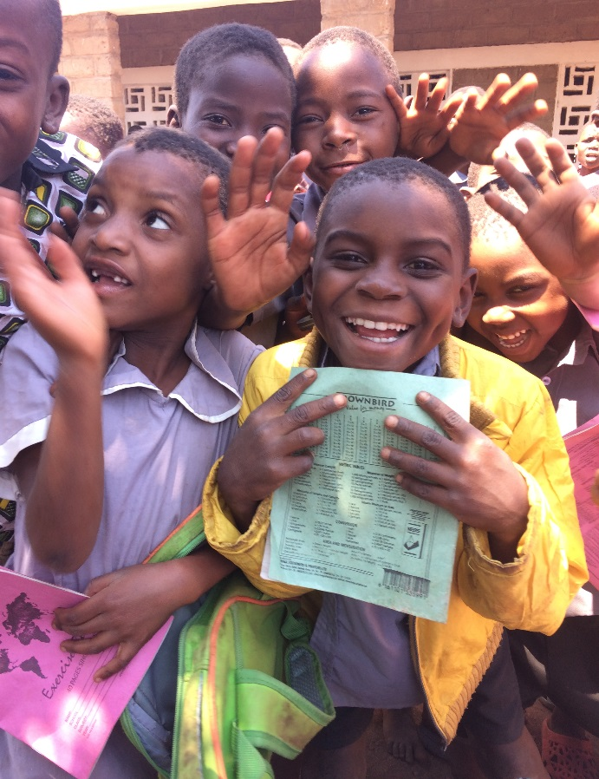
Others Experiences of a School Partnership
Ian Mitchell – from Beath came to visit and spoke to our staff. Mitch came in on a Friday afternoon to share his experience of curricular links and trips to Malawi.
Chad and Douglas from the Scotland Malawi Partnership visited Armadale Academy on Friday 16th June and shared their experiences of setting up a partnership. Douglas started the Beath Malawi Partnership so was very experienced in this area. Chad was a teacher and lived in Malawi so he also brought a wealth of knowledge
Learning Together, Achieving Together
Notes:
When Ian visited Armadale he stressed to us that partnerships are built upon the ambition of improving the educational experiences of learners in all schools and underpinning this are the values of mutual understanding, reciprocity.
For our young people and those of our partner school we want to provide real life experiences to build friendships across the continents and cultivate attitude, knowledge and compassion.
When Ian and Douglas came to chat with us at Armadale they spoke about how the Beath community developed a greater understanding for another culture, a desire to effect change in both countries and a willingness to support each other.

Slide 8
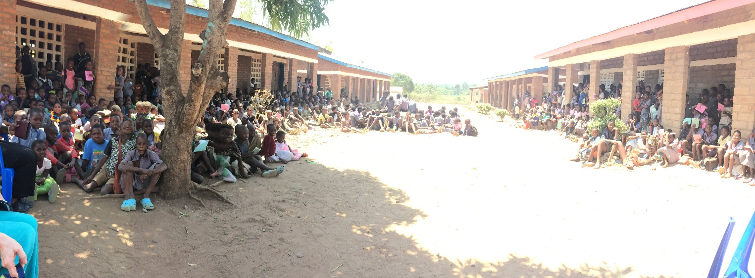
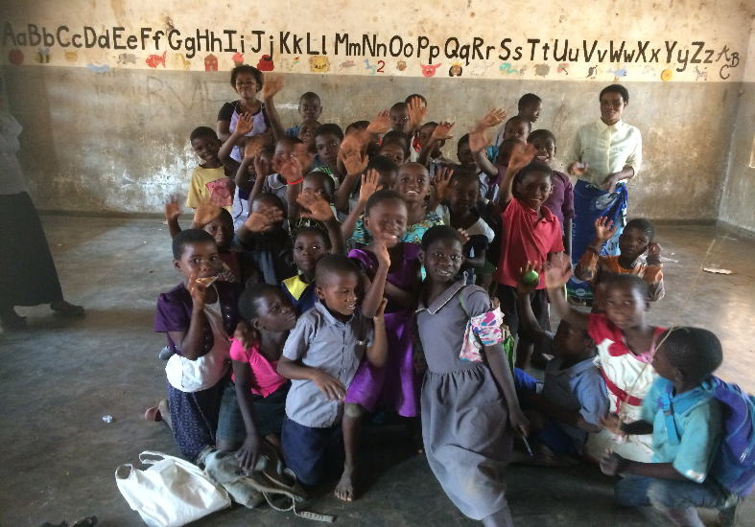
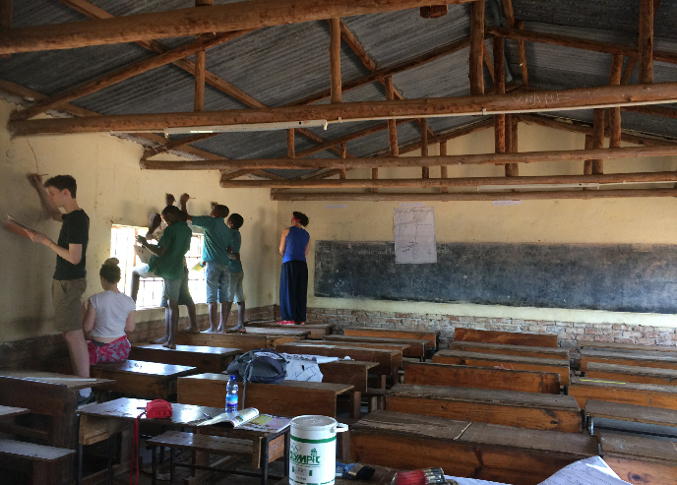
In the schools
Learning Together, Achieving Together
Notes:
We as a Armadale community have a desire to understand another culture, a desire to effect change in both countries and a willingness to support others in the same roles as ourselves.
Education is a powerful tool.

Slide 9
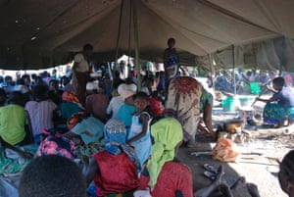
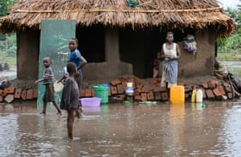
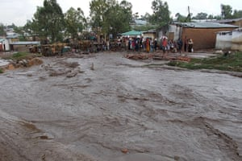
Situation so far
Advertiser
Money from the dress down day on the last day of term £200
raised and was used to help families in Malawi affected by the floods
Bake off
Whats app
Video meet and greet
Learning Together, Achieving Together

Slide 10
What next?
We will raise/discuss at DMs how their subject(s) could how to include something Malawi related in their
Potential for a research project in Social Studies with the best to be presented at assemblies/shared electronically – prize for best projects
Links to UNCRC
Outdoor learning – potential for links
Scope for filming experiments etc in Science
Malawi/Scotland Day discussed - linked project across two school
Zikomo!!
Learning Together, Achieving Together

Slide 11
What next?
Pupil focus group
Link with our primary school
Fund raising events October break (Friday 6th October.
Armadale Talent show
S6 Prom Fashion Show.
Burns Supper – ceilidh – February
Quiz/Bingo Night – Summer event
Christmas High Tea
Any questions Zikomo!!
Learning Together, Achieving Together

