Slide 1
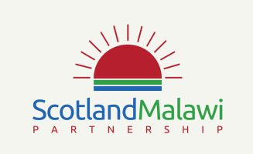
Teacher Notes – Getting to know Malawi: its language and culture
Modern Languages: CfE Experiences and Outcomes, MLAN 2-11c, MLAN 3-11b
Support for Delivery
Aims:. This session looks to build an understanding of Malawi, with a basic introduction to the language of Chichewa and culture, as well as discussion-led activity around what culture and stereoypes.
Objective: To start building an understanding of Malawi, with basic insight into: where Malawi is; the Malawian flag; the currency in Malawi; traditional Malawian dress; as well as shopping and food. It teaches a few basic greetings in Chichewa. But, before this, the session takes time to explore what ‘culture’ means, discussing the complexities and sensitivities, encouraging empathy, and giving practical advice about how to avoid harmful stereotypes when discussing a ‘national culture’.
What’s included?: An interactive lesson, which encourages learners to speak some of the Chichewa language and gives a basic understanding of the Malawi’s culture and how it compares to Scottish culture.
Teacher led activities: : Teachers are encouraged to work through the associated PowerPoint Presentation with their learners, following the lead of what is stated in the slide notes. Slide notes have been provided to fully support the practitioner in the delivery of this session and to provide appropriate challenge questions that can be worked through.
Learner led activities: Learners can work in pairs or groups to practice Chichewa. Learners are also encouraged to participate in discussion around the inequality's between Scottish and Malawian culture.
Support for partnerships: While information and resources are available to allow schools to deliver this session themselves, the SMP is able to offer Malawian language and culture workshops which can be delivered by one of our tutors who are happy to deliver the content either in person or digitally, please get in contact with Chad our Youth and Schools officer to arrange.
Extension Activity: If learners are gaining confidence in using the language and would like to apply it in practice. Please look at out going to the Market lesson where learners will be given the opportunity to use there new skills in a realistic scenario.
We would like the learners to gain an understanding of:
The value of learning about others’ culture and importance of remembering that cultural generalisations aren’t true for everyone.
Different cultures existing in the same place –e.g. a ‘Scottish culture’ and a ‘youth culture’.
The importance of respect when learning about cultures and how to avoid harmful stereotypes
A basic insight into aspects of Malawian culture and identity
The number of different languages in Malawi and the legacy of UK colonial rule.
A few basic words and greetings in Chichewa.
Desired outcome for learners:
I understand that it’s important to respect different cultures and can imagine what it is like to be stereotyped
I can see that, in some ways, life in Malawi is quite different to life in Scotland, but in other ways we’re much the same
I can speak a little of one of Malawi’s languages
Further support/information required?
Please e-mail our Youth and Schools Officer, Chad Morse
youth@scotland-malawipartnership.org
Opportunities for Cross Curricular links.
Maths and Numeracy

Slide 2

Getting to know Malawi,
its Language and Culture
Notes:
Explain to learners that before learning more about Malawi’s language and culture, it’s first important to explore a bit more about ‘culture’, what it means, why it’s important and how to avoid reinforcing stereotypes when talking about culture.

Slide 3
What is ‘culture’
There are lots of different definitions:
the ideas, customs, and social behaviour of a particular people or society.
the characteristic features of everyday existence (such as diversions or a way of life) shared by people in a place or time
the way of life, especially the general customs and beliefs, of a particular group of people at a particular time
the customary beliefs, social forms, and material traits of a racial, religious, or social group
the set of shared attitudes, values, goals, and practices that characterizes an institution or organisation
the integrated pattern of human knowledge, belief, and behaviour that depends upon the capacity for learning and transmitting knowledge to succeeding generations
Notes:
If learners struggle to give a definition of the word, try starting by asking for examples of culture and work backwards from that.
Only once you have answers from the class and have had a discussion, click to reveal the different definitions.
Key points to draw out from discussions:
The truth is it’s a very hard word to define as it’s a broad concept that includes lots of aspects.
What ‘culture’ is, and what it includes, is constantly changing and is seen by different people in quite different ways.
Descriptions of a country’s ‘culture’ are really ‘cultural generalisations’: not everyone conforms to all aspects but it describes certain common aspects of shared belief, behaviour and customs.
An example of a cultural generalisation would be “People from country X tend to have a direct style of communication.” This statement is not true of everyone in country X. Some may disagree with the statement and some may agree (it is subjective – not something that can easily be proved).

Slide 4
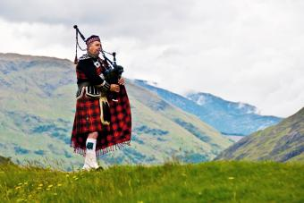
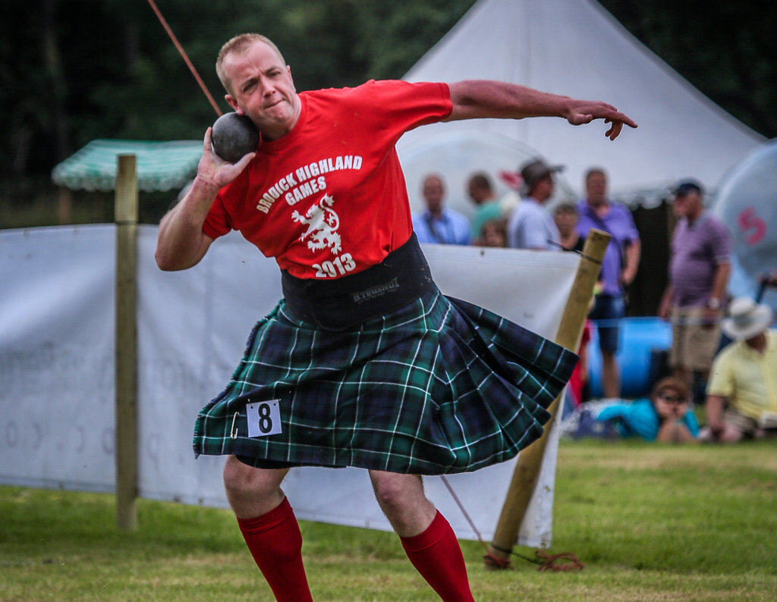
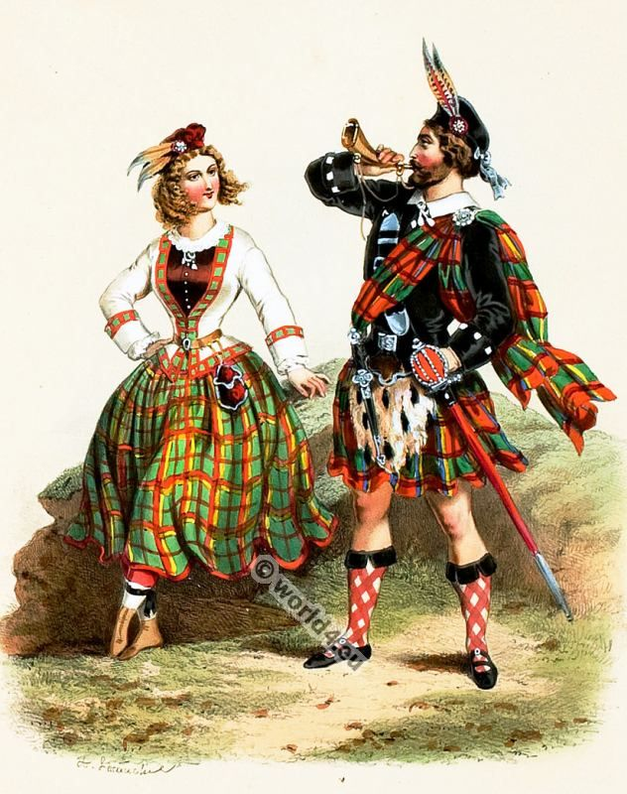
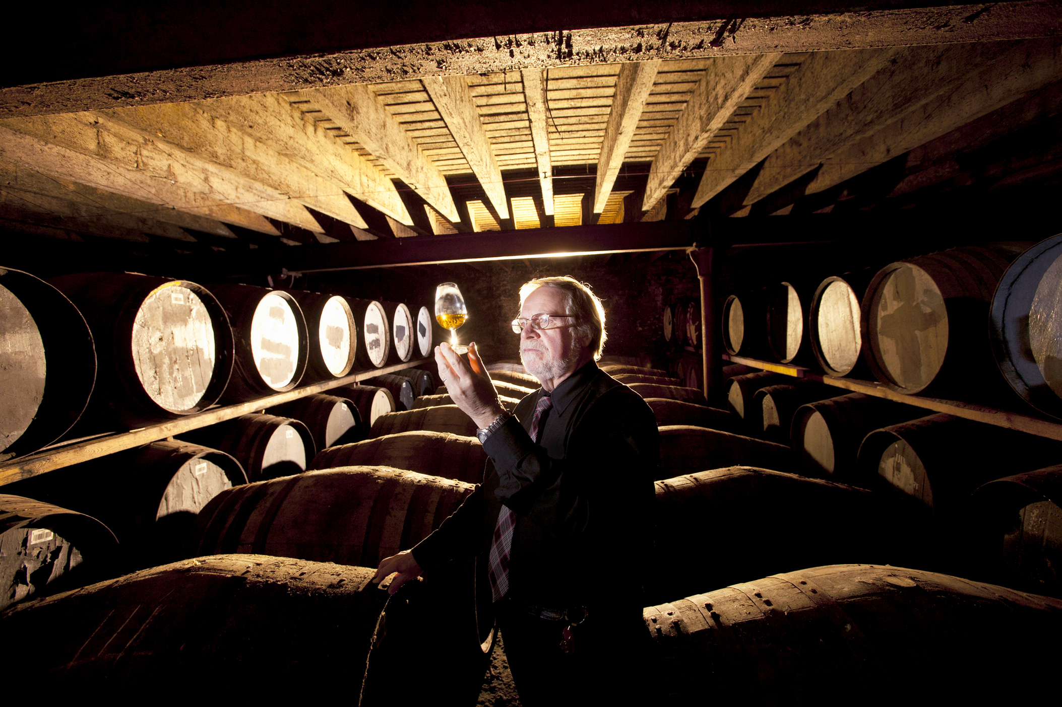
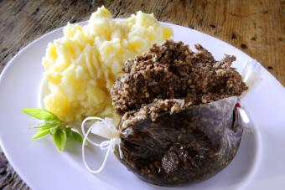
What is ‘Scottish culture’
Notes:
Encourage learners to share as many different points as possible. When you have a good list, ask individuals if everyone in the class is all of these things?
Emphasise that culture is not uniform: not everyone in a country shares precisely the same culture (not even everyone in the same family shares all the same culture).
Encourage learners to reflect on what is their culture: is it a ‘Scottish culture’, a ‘young person culture’, a culture defined by their music, style or identity, or all of these.
There are overlapping and competing cultures; there are dominant cultures and sub-cultures.
Help learners see how complicated ‘culture’ is when you stop and drill down into it: it’s all too easy to say sweeping things about other people’s culture but there’s a risk in doing this you’re really just defining them as ‘different’ to yourselves.

Slide 5
What is a stereotype?
Definitions include:
a widely held but fixed and oversimplified image or idea of a particular type of person or thing.
a set idea that people have about what someone or something is like, especially an idea that is wrong
a standardized mental picture that is held in common by members of a group and that represents an oversimplified opinion, prejudiced attitude, or uncritical judgment
Notes:
Only once you have answers from the class and have had a discussion, click to reveal the different definitions.

Slide 6
How does it feel to be on the receiving end of a negative stereotype?
How it would feel if someone you met:
-insisted that everyone in Scotland shared exactly the same culture, or
-insisted they ‘understood you because they understood Scottish culture’, or
-laughed at Scottish men for wearing “multi-coloured skirts” (kilts).
Notes:
Aspects of other people’s culture may seem strange, or even funny at times, but it can be insensitive and harmful to joke about someone’s culture or to stereotype people – not least because you’re often just showing your own ignorance (a kilt is not a skirt!).
Keeping asking yourself ‘how would I feel if people were talking about me and my family in this way’. This encourages empathy - the ability to understand and share the feelings of others.

Slide 7
What is the difference between a ‘cultural generalisation’ and a ‘stereotype’:
Generalisations become stereotypes when all members of a group are categorized as having the same characteristics.
Notes:
Only once you have answers from the class and have had a discussion, click the slide.
Generalisations become stereotypes when all members of a group are categorized as having the same characteristics.
Both stereotypes and generalisations can be linked to any type of cultural membership, such as nationality, religion, gender, race, or age. They can also both be good, bad, or neutral.
Stereotypes are typically inflexible and resistant to new information: it is assumed that all members of a particular group follow these traits.
Stereotypes can, and often do, lead to prejudice and intentional or unintentional discrimination.
But the difference between a ‘stereotype’ and a ‘cultural generalisation’ can be hard to see.

Slide 8
How do you discuss culture without stereotyping?
Be very careful about your language when talking about others’ culture
Be sure you are not implying all people in a group all have these same characteristics
Keep asking yourself, ‘how would I feel if people were saying this about me’
Think about what the impact of your assumptions or generalisations might be
Respect complex and overlapping cultures
Try to avoid language of ‘them’ and ‘us’

Slide 9
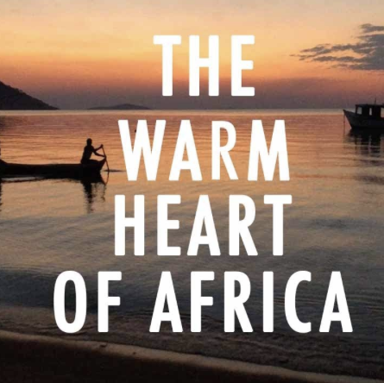

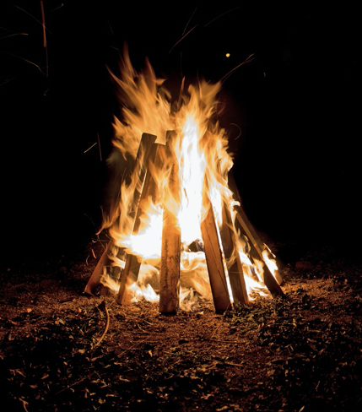
What does ‘Malawi’ mean?
‘MALAWI’ MEANS ’FLAMES OF FIRE’ AND IS ALSO KNOWN AS ‘THE WARM HEART OF AFRICA’
Notes:
The name Malawi means ‘flames of fire’. The country is known as the ‘Warm Heart of Africa’, due to its rich and friendly culture, its land-locked position in south-eastern Africa.

Slide 10
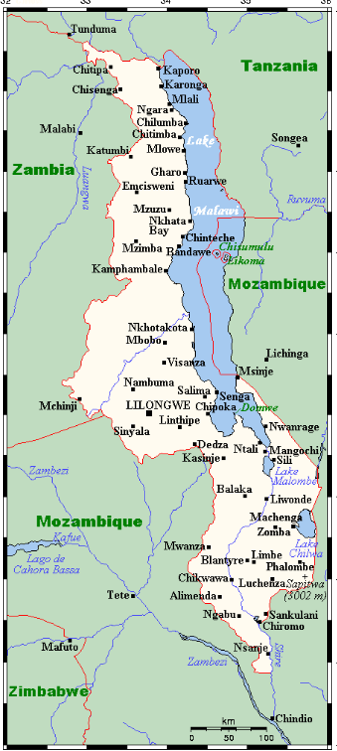
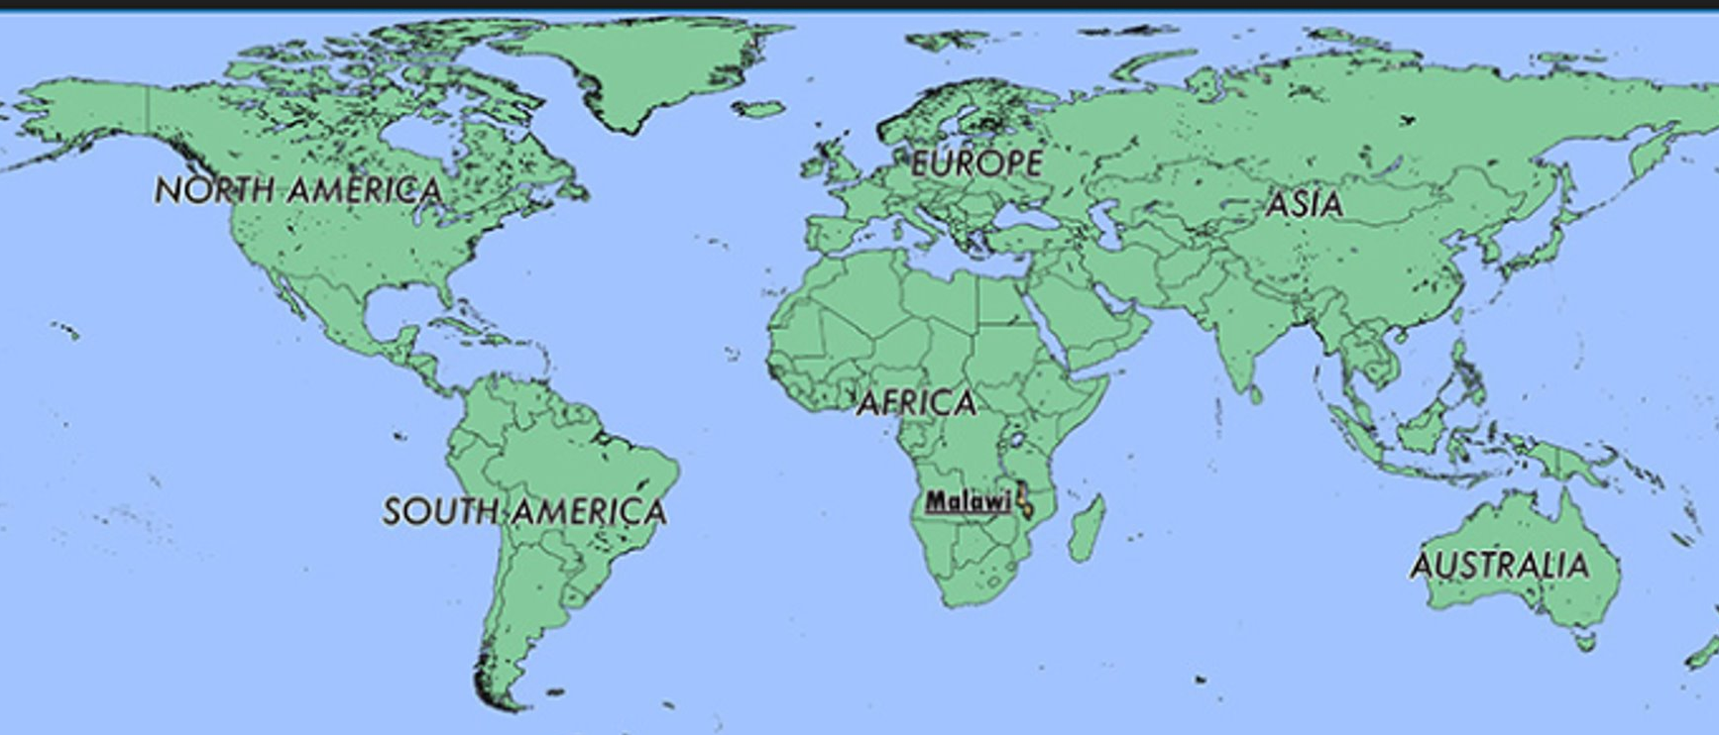
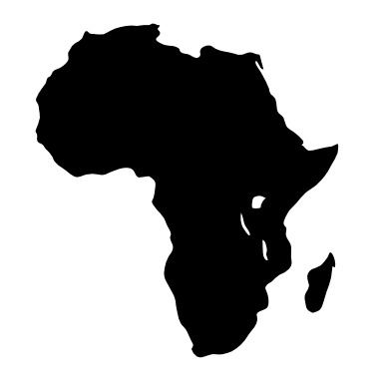
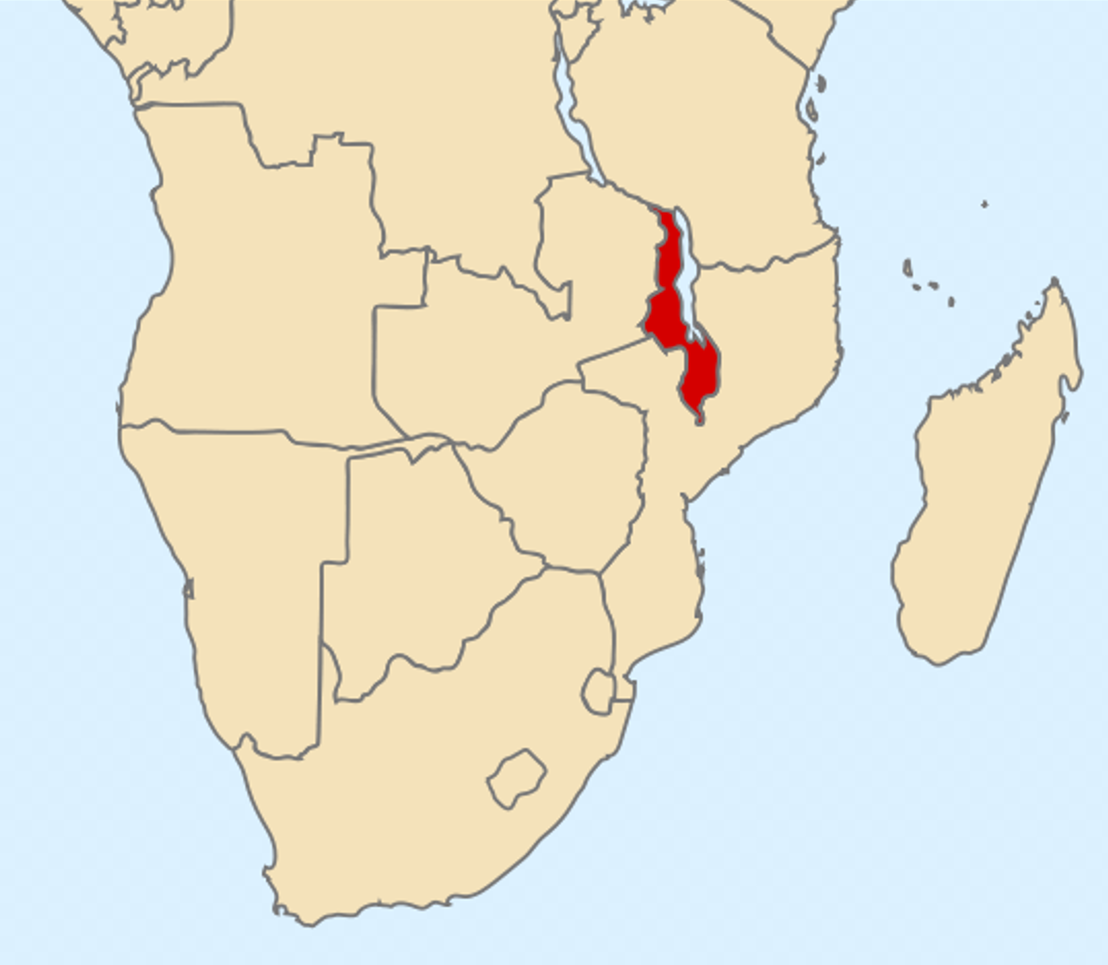
Where is Malawi?
Notes:
Malawi is a landlocked country on the continent of Africa, it is landlocked by the countries of Zambia, Tanzania and Mozambique.
Teachers may wish to take time to explain what the terms ‘continent’ and ‘landlocked’ mean.
One third of Malawi's landscape is taken up by Lake Malawi, in Chichewa this is known as Lake Nyasa, the word Nyasa means ‘lake’ in Chichewa, so this translates to ‘lake lake’! Malawi also used to be known as Nyasaland before it changed its name to Malawi in 1964, when it became an independent country.

Slide 11
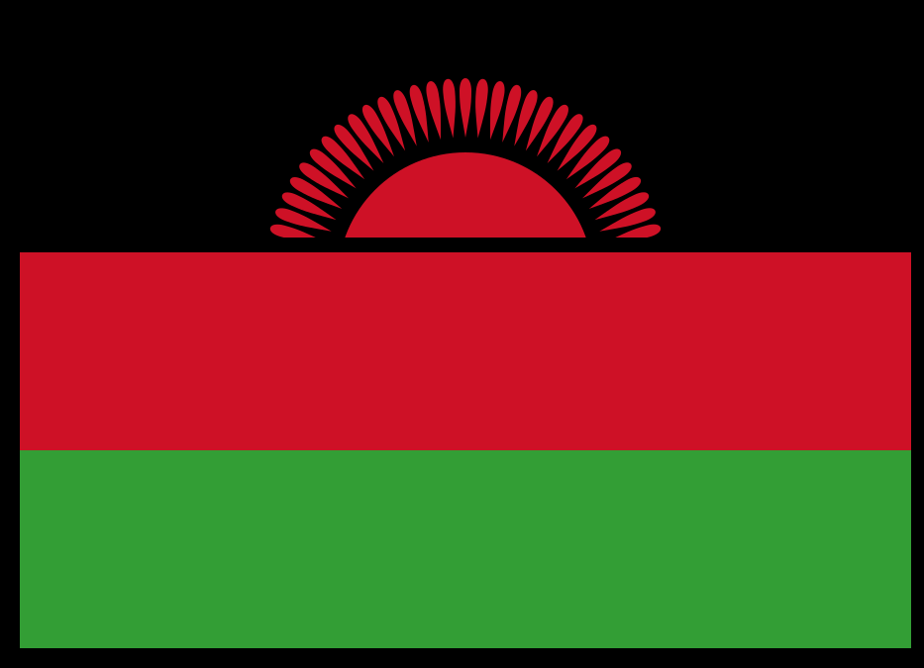
What does the Malawian flag represent?
Notes:
The Malawian flag, is vertical bands of Black, Red and Green.
- The 31 rays of the sun represent the fact that Malawi was the 31st African nation at the time of its independence.
- The black represents the indigenous people of the continent.
- The red symbolises the blood of their struggle.
- The green represents nature.

Slide 12
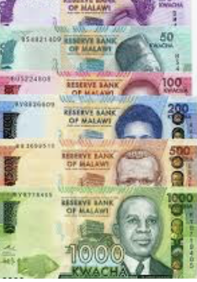
What currency do they use in Malawi?
Malawi Kwacha (MK) and Tambala (t)
(MK1 = 100t)
At the moment £1 = about MK1100
Notes:
The currency of Malawi is Kwacha, the kwacha is similar to our pounds and tambala is similar to our pence.
Practitioners are advised to check the exchange rate and update the slide accordingly: https://www.xe.com/currencyconverter/convert/?Amount=1&From=GBP&To=MWK

Slide 13
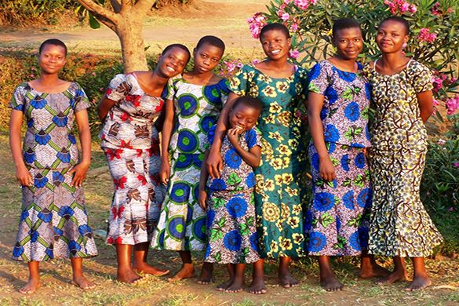
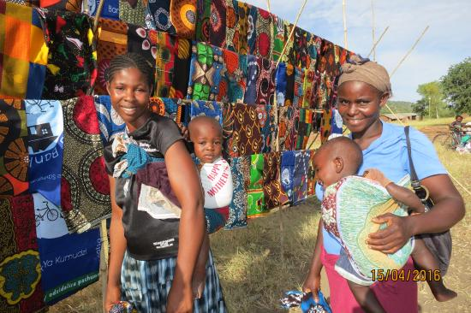
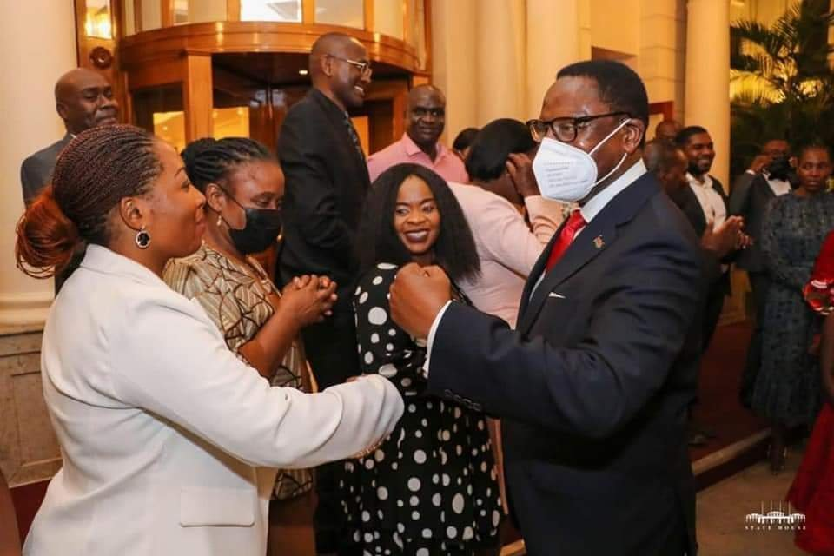
What do Malawians typically wear?
Notes:
In Malawi, many people wear beautiful, brightly coloured local-produced fabrics which people use to make clothes. These fabrics are know a zitengi. (sit-ten-jay). It is very uncommon for women to show their knees or shoulders.
Like in Scotland, men tend to wear suits for formal business-wear.
Emphasise that, just like in Scotland, different people wear different things. Fashions change over time and between different groups in society.

Slide 14
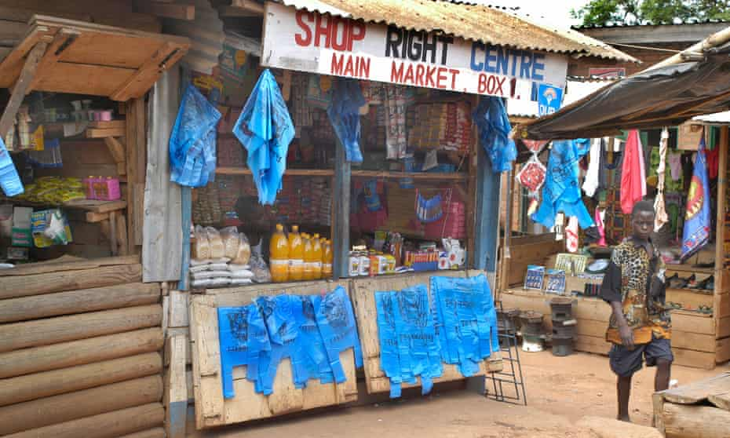
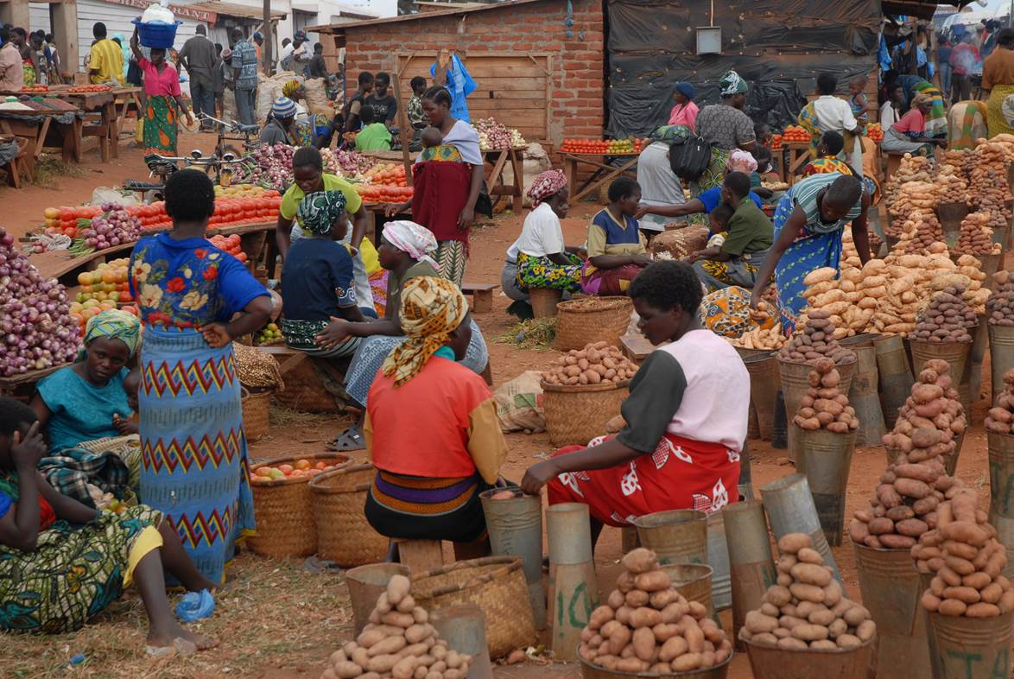
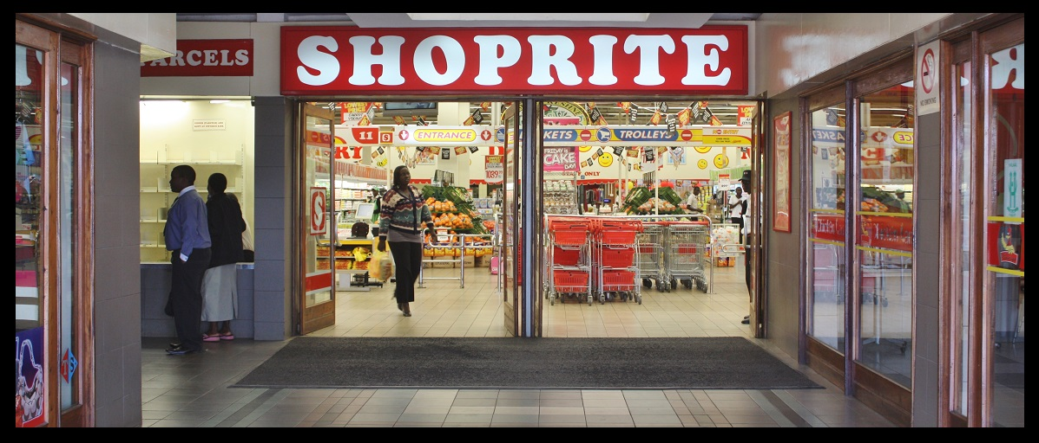
Where do Malawians tend to shop?
Notes:
Most people in Malawi grow much of their own food, buying the rest from local markets. However, in the larger towns and cities there are also large supermarkets, very similar to what we are used to in Scotland.

Slide 15

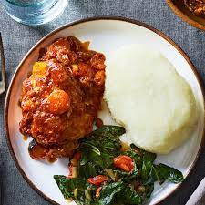
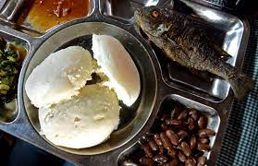
What do Malawians typically eat?
Notes:
Nsima (N-SEE-MA) is the staple food of Malawi. It is made from maize flour and has a similar consistency to mashed potato.
You can click on the speaker icon to hear the correct pronunciation.
Nsima is so dense that, only half-joking, Malawians often say they don’t feel full if a meal doesn’t have Nsima!
Nsima is served with Ndiwo (relish) which is comes in the form of tomatoes, kale, spinach, or other leafy green, it is basically anything that served on the side with your nsima.

Slide 16
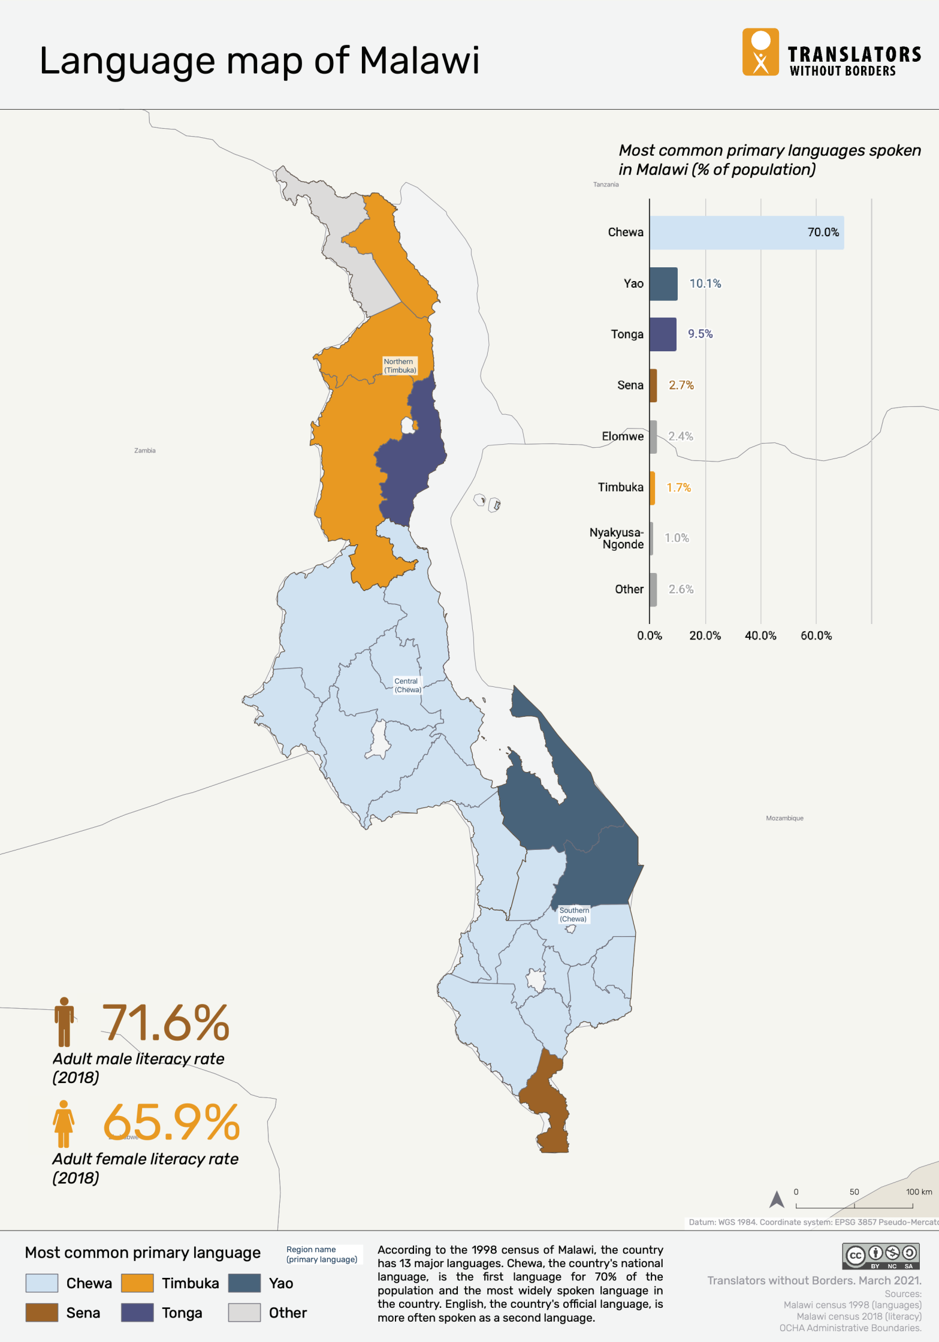
What language do Malawians speak?
Notes:
Malawi is a multilingual country – this means they speak more than one language. In fact there are 13 major languages spoken in Malawi. They are called Bantu languages.
English is the official language of business, law and education in Malawi: this is a legacy of colonial rule (Malawi was a British protectorate from 1891 to 1964). However, outside the towns and cities, most Malawians do not speak English. In the 1998 census, only 0.1% of Malawians spoke English as their first language and yet this is the language that almost all school is in. Some in Malawi now question why English continues to be imposed as the official language.
The most common primary language in the centre and south of Malawi (70% of the population) is Chichewa.
The most common primary language in the north of Malawi is Chitumbuka.
“Chi” means ‘language’ (or, to be precise, ‘in the manner of’). So Chichewa means The language of the Chewa tribe and Chitumbuka means the language of the Tumbuka.
Other common languages include:
Chiyao (especially in the east)
Tonga (especially in the north-east)
Sena (especially in the very southern tip)
‘Translators without Borders’ have an interactive map showing the relative percentages of different languages spoken in each Malawian district www.translatorswithoutborders.org/languages-of-malawi-interactive-en/ .

Slide 17

Let’s learn some Chichewa – saying hello!
Moni
(Hello!)
Task: Move round the class and everyone you meet you must shake their hand and say Moni.
Notes:
You can click on the speaker icon to hear the correct pronunciation.
When shaking hands in Malawi, you can show respect to the person you are greeting by touching the inside of your right elbow with your left hand. This can also be accompanied by a slight dip at the knees, accompanied by bowing down the head. Learners could practice this, shaking hands and saying ‘Moni’
This video is correct without the snap at the end: https://youtu.be/W3p2uR8cMdk

Slide 18

How to introduce yourself.
Ndine (I am)..........
Task: Move round the class and everyone you meet you must shake their hand and say ndine then followed by your name.
Notes:
The word Ndine means ‘I am’ for example you can introduce yourself by saying ‘Ndine [your name]’
.
You can click on the speaker icon to hear the correct pronunciation.

Slide 19

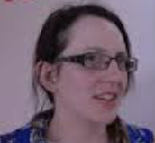
Having a basic conversation.
E: Muli bwanji?
(How are you?)
S: Ndili bwino, kaya inu?
(I am fine, and you?)
E: Ndili bwinonso
(I am fine too)
S: Zikomo!
(B: Thank you!)
Notes:
You can click on the speaker icon to hear the correct pronunciation.

