Slide 1
Empowering Communities Through Renewable Energy: My Journey with ASE
Leticia Siyaya
Renewable Energy Engineer

Slide 2
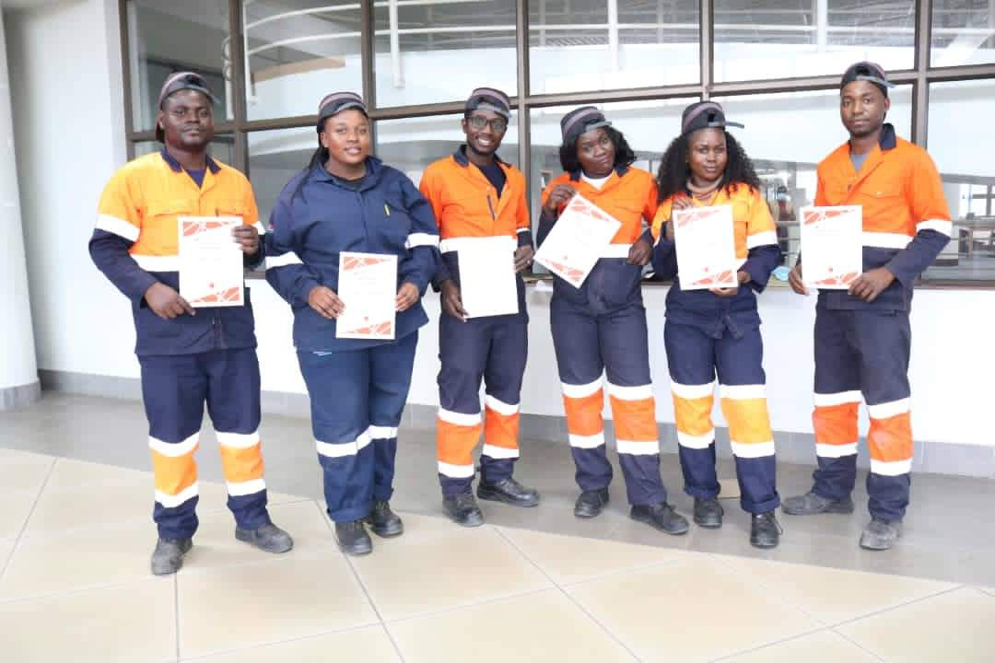
introduction
My journey with ASE commenced in June 2021 when I participated in the solar installation at the Blantyre Research Facility as a solar apprentice. Initially, there were over 100 applicants for the training, and out of those, 78 students were selected to undergo certified online training.
Following this, six of us were chosen for competency-based on-the-job training, and I emerged as the top candidate. Consequently, I was awarded a contract as a Renewable Energy Engineer and Business Development Manager, responsible for overseeing our business expansion in Malawi and acquiring new clients.
Solar appprentices

Slide 3
The BT-BT RF
The attached photo displays the BT-BT RF project in which I was involved, as previously mentioned in the preceding slide.
The setup consists of a 45 kWh energy storage system and a 30 kWp rooftop solar panel system that provides continuous, uninterrupted power to the laboratory.
The BT-BT RF

Slide 4
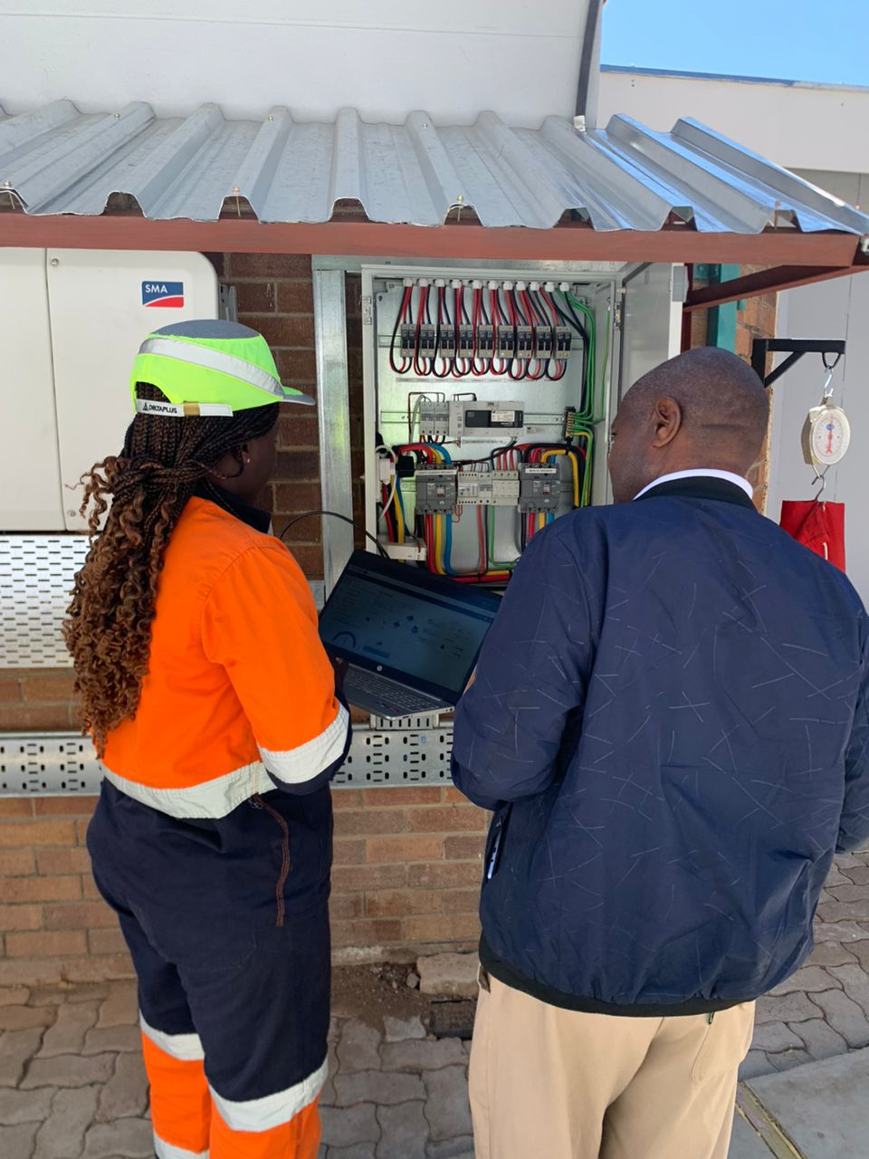
Skill enhancement in Botswana
Since then, I've been actively involved in various capacity-building programs in Botswana, further enriching my skill set.
Most notably, I led the installation of Botswana's FIRST solar hospital, a 62 kWp grid tied roof-mounted system. This endeavor encompassed responsibilities in both the design. installation phases and commissioning.
This project obtained authorization within the framework of Botswana's solar rooftop program.
Riverside hospital system

Slide 5
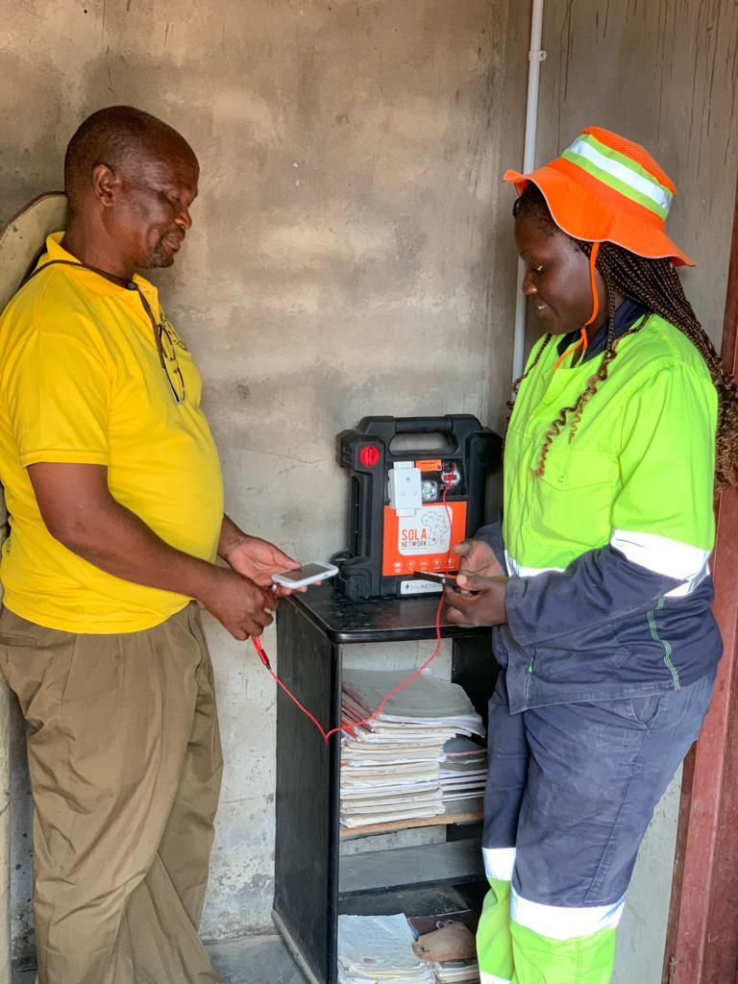
Empowering Communities Through Renewable Energy: the case of jamataka
What has profoundly intrigued me during my experiences in Botswana is the implementation of off-grid solar systems in rural areas.
The Mini Grid connected system also has a battery exchange scheme and prosumer units for more remote areas this has empowered local residents to produce and utilize their energy, enabling them to charge their mobile phones, illuminate their homes, and enjoy radio broadcasts. The service is scalable allowing client to add further battery support as there demand for electricity grows,

Slide 6
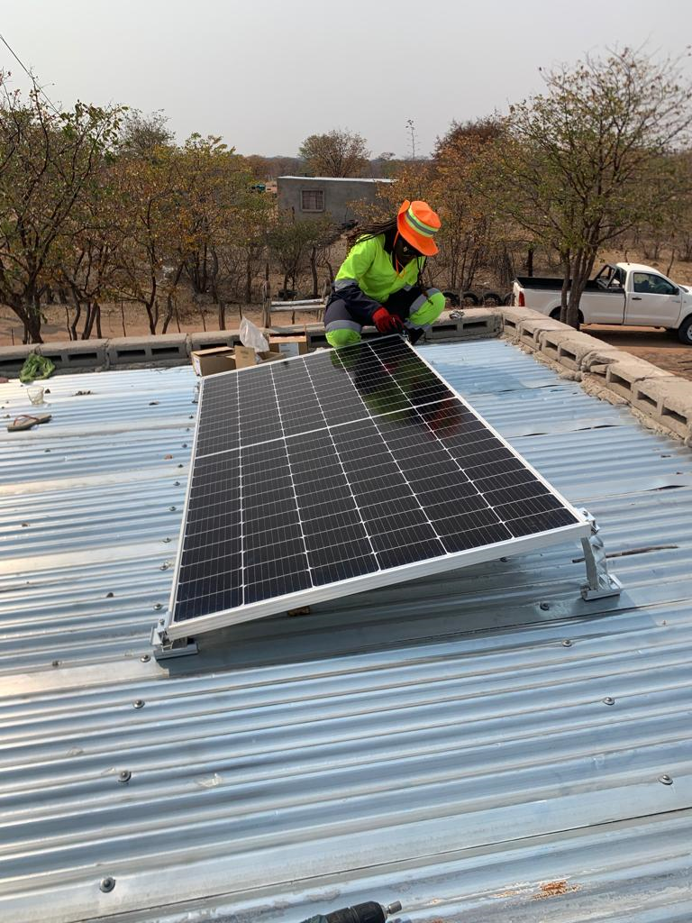
This technology has demonstrated its effectiveness and ability to extend its reach to remote, off-grid regions. It boasts user-friendliness, cost-effectiveness, and straightforward installation and maintenance.
I eagerly anticipate the day when this technology will be implemented in Malawi, particularly in Machinga, where we are actively working to provide electricity to an off-grid community.

Slide 7
The foundation of a joyful village begins with the availability of reliable, eco-friendly, and sustainable energy sources.
Thank you

