Slide 1
MALAWI PUBLIC HEALTH EMERGENCY UPDATE Date: 18 March 2022

Slide 2
OUTLINE
Polio Outbreak
Background
Planned response activities
Coordination Structure
Activity Updates
COVID-19
Global and Regional Epidemiological Status
Local Situation
Epidemiological
Health Care Worker
Epidemic level
Operational Updates
PoE
Vaccination

Slide 3
Polio Outbreak

Slide 4
Background
Last polio case reported in Malawi in 1992 (30 years ago!)
Malawi obtained Polio free status in 2005
No wild polio case in Africa for 5 years
WHO African Region received its Polio free status in 2020
Malawi has been meeting all the required Polio reporting indicators throughout the years & sustained polio surveillance robustly…that’s why was able to pick up this case.
Declared National Public Health Emergency on 17th February , after getting confirmation of results on February 16th , 2022

Slide 5
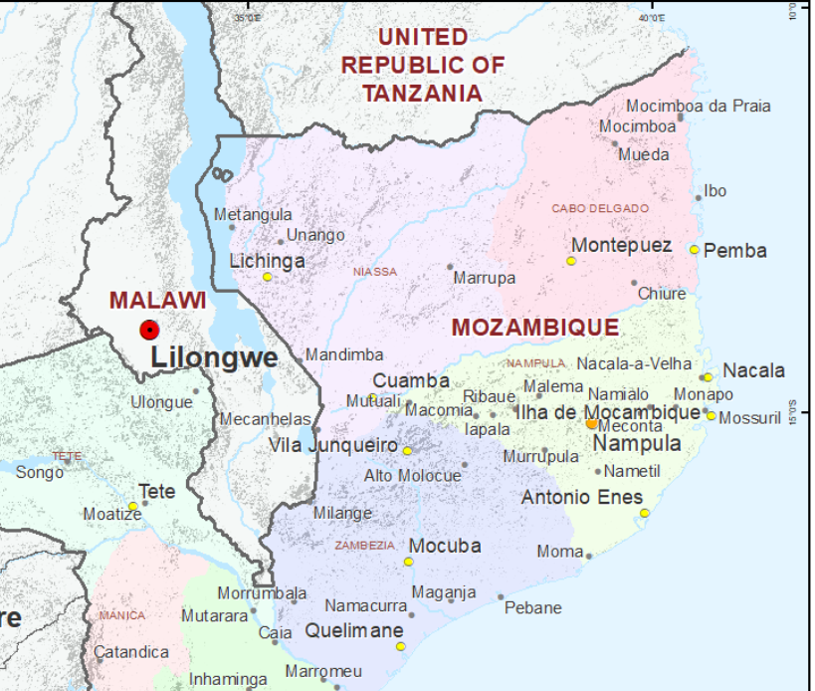
WPV 1 case in Lilongwe Malawi
Age: 3.5 years
Sex: Female
Child received only bivalentOPV birth dose
Address: Mtuwa village, TA Tsabango (Area 24 ) Lilongwe
Date of onset of paralysis : 19 November 2021
Samples collected on the 26 and 27 November 2021.
6 contact samples tested Negative

Slide 6
Planned and Ongoing Response Activities
Planned High Quality Supplementary Immunisation Activities campaign response activities
Four campaign rounds
Round 1: 21 March, Round 2: 18 April, Round 3: June and Round 4: July
Door to Door
Enhanced surveillance
Active search – target NPAFP 3:100,000
Environmental surveillance
11 e-Surveillance sites established
Strengthening Routine Immunization – bOPV and IPV (inactivated Polio vaccine)

Slide 7
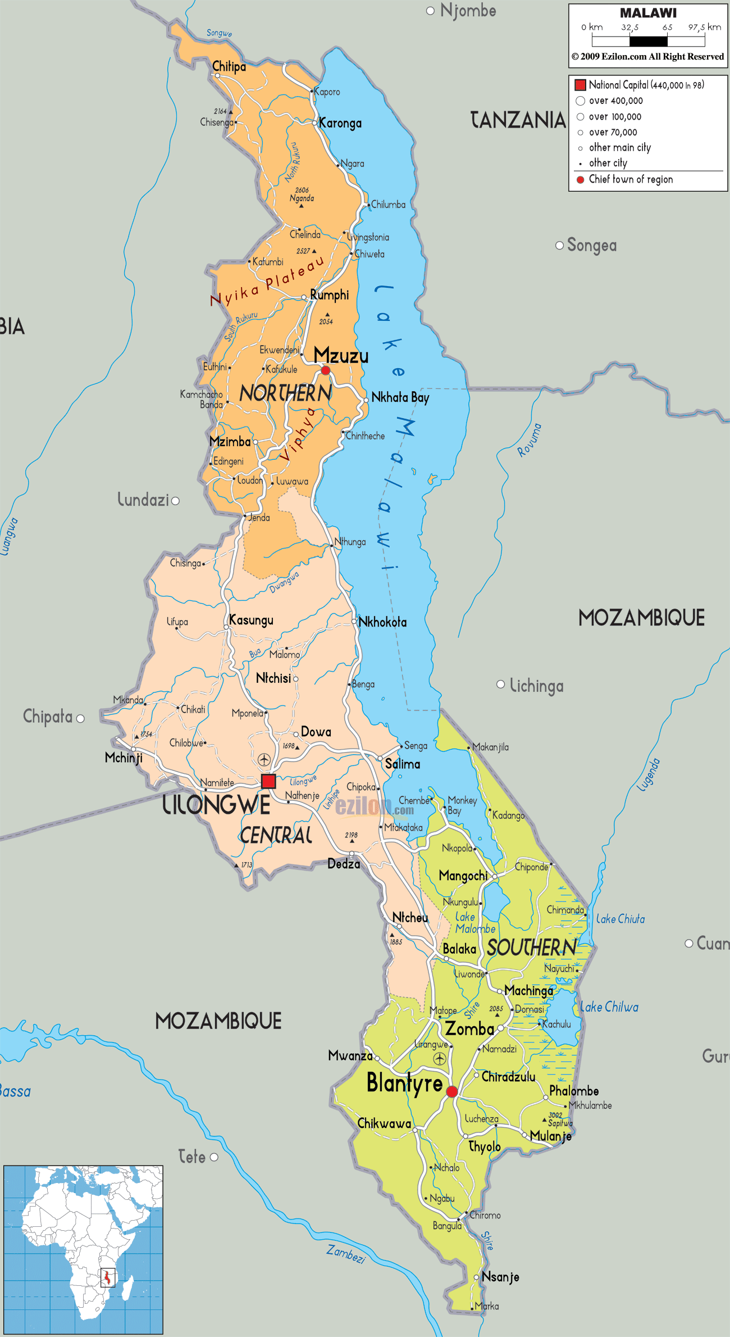
Scope of Approved Nationwide Campaign
Vaccine: Bivalent oral polio vaccine (bOPV) Campaign date: 21-24 March, 2022 Strategy: House to House
Geopolitical zones | Number of districts | Population of 0-5years
North | 7 | 347,681
Central East | 5 | 454,996
Central West | 4 | 741,443
South East | 6 | 818,831
South West | 7 | 559,224
Total | 29 | 2,922,175

Slide 8
Response Coordination Structure
Two levels
National Polio Operation Centre (EOC)
District Polio Operation Centre
Incident Management System Technical Working Groups
Operations
Service Delivery
Logistics and Vaccine Management
Social Mobilization (C4D), RCCE
Surveillance & Laboratory
Data Management
Human Resources and Adminstration
Resource Mobilisation
Space with a working computer with internet: Data for action

Slide 9
Activity updates
Planning, coordination and financing:
Regular EOC continue at national level
Ongoing cross-border planning and coordination at the district levels
National supervisors and Partners deployed to the districts to support campaign implementation
Training
Ongoing cascaded training to team supervisors and vaccinators
Monitoring and Supervision
Commence validation of preparedness status, 3 days to the campaign by national supervisors and partners
Ongoing IM trainings at the district levels for all 29 districts
Commence LQAS training for Kamuzu University of Health Science (KUHES) for the campaign

Slide 10
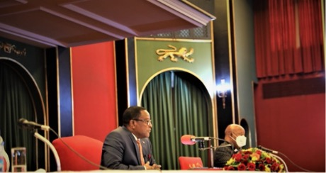
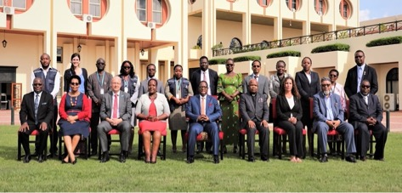
Pictures from High Level Advocacy Meeting from MOH and GPEI team to His Excellency (HE), President of Malawi on Polio Outbreak Response 10 March 2022
HE, President of Malawi addressing the visiting MOH and GPEI teams with commitment to fully support the Polio outbreak response activities
HE, President of Malawi with Minister of Health, Senior Management of MOH, Heads of Agencies of UNICEF, WHO, CDC, PAC and GPEI team
https://twitter.com/WHOMalawi/status/1501921060832399364?t=IZ8Ik7QBs-XHWQ1g0ILlVw&s=08
https://twitter.com/WHOAFRO/status/1501975426910105617?t=mrkCajf5uulwm45mE1F39g&s=08
https://twitter.com/MoetiTshidi/status/1502223684341309444?t=VruuCM9BROALzb-xkRiOWw&s=08

Slide 11
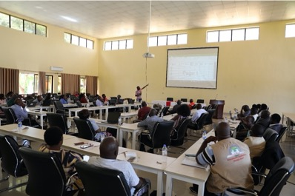
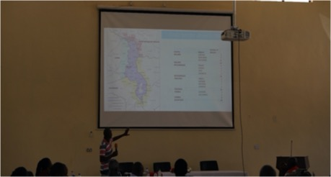
Pictures from Zonal and District Level TOT Sessions 10 – 11 March 2022
Session on Data Management, Monitoring and Evaluation of the campaign
Session on Cross-border microplanning and coordination

Slide 12
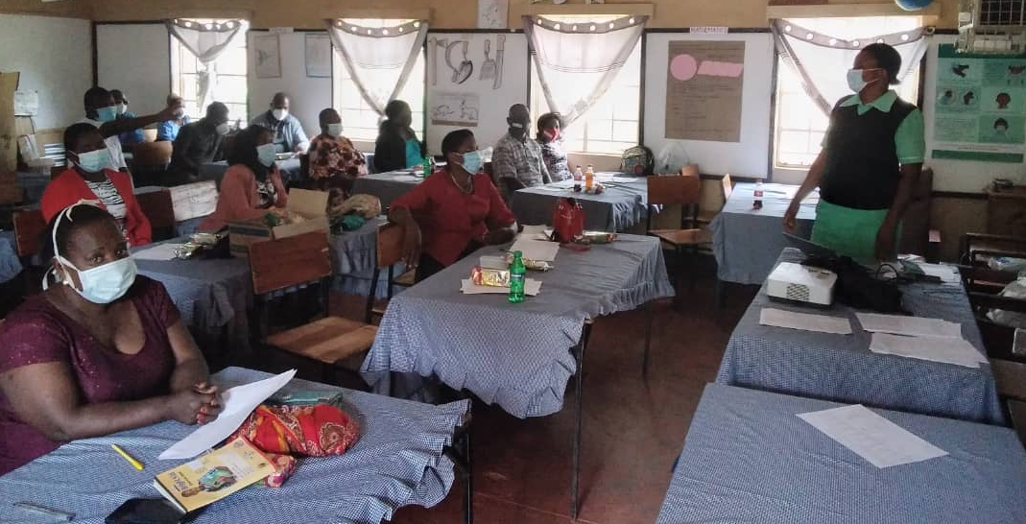
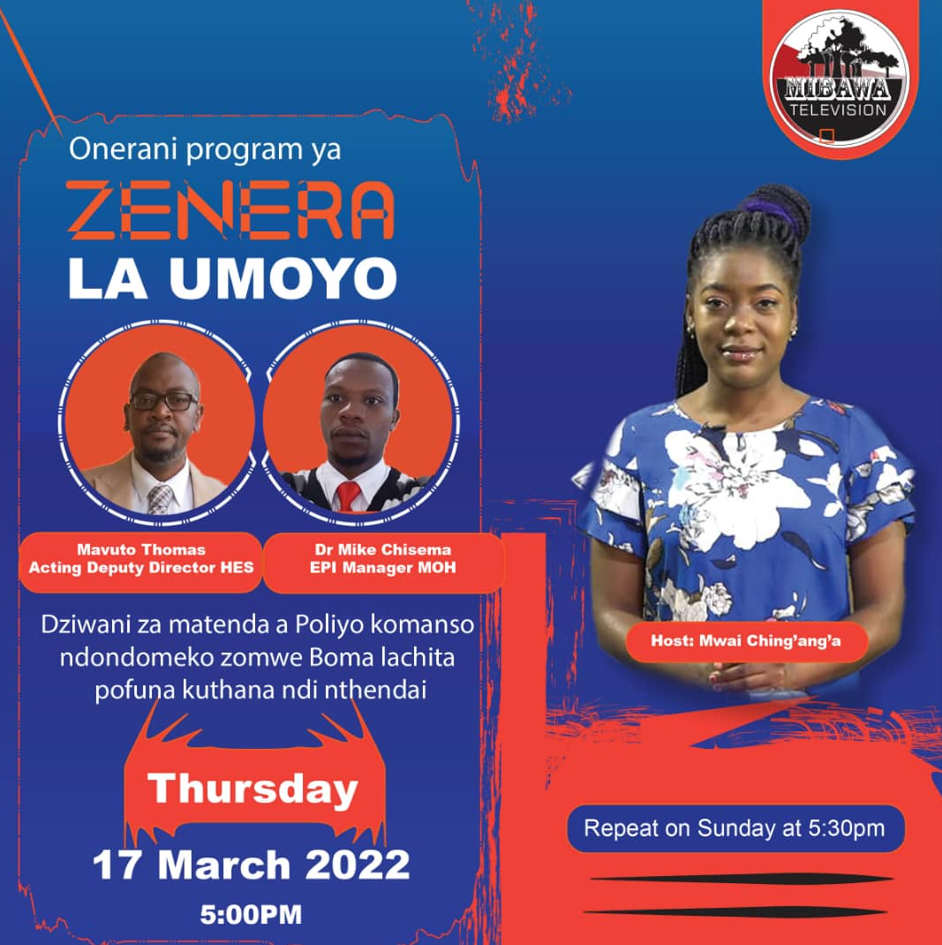
Pictures
Team supervisor and vaccination training in the districts
Advocacy and Social mobilization for the campaign

Slide 13
Campaign preparedness status: National and Zonal Level as of 18 March 2022

Slide 14
Next steps
Complete lower-level trainings for team supervisors and vaccinators
Officially Launch First Round SIA on 20 th March 2022 in Dowa, Central Malawi
Fast track validation of SIA preparedness, particularly at the northern region
Complete IM and LQAS training for the campaign
Continue enhanced active surveillance for AFP cases at health facility and community levels.

Slide 15
COVID-19 Pandemic

Slide 16
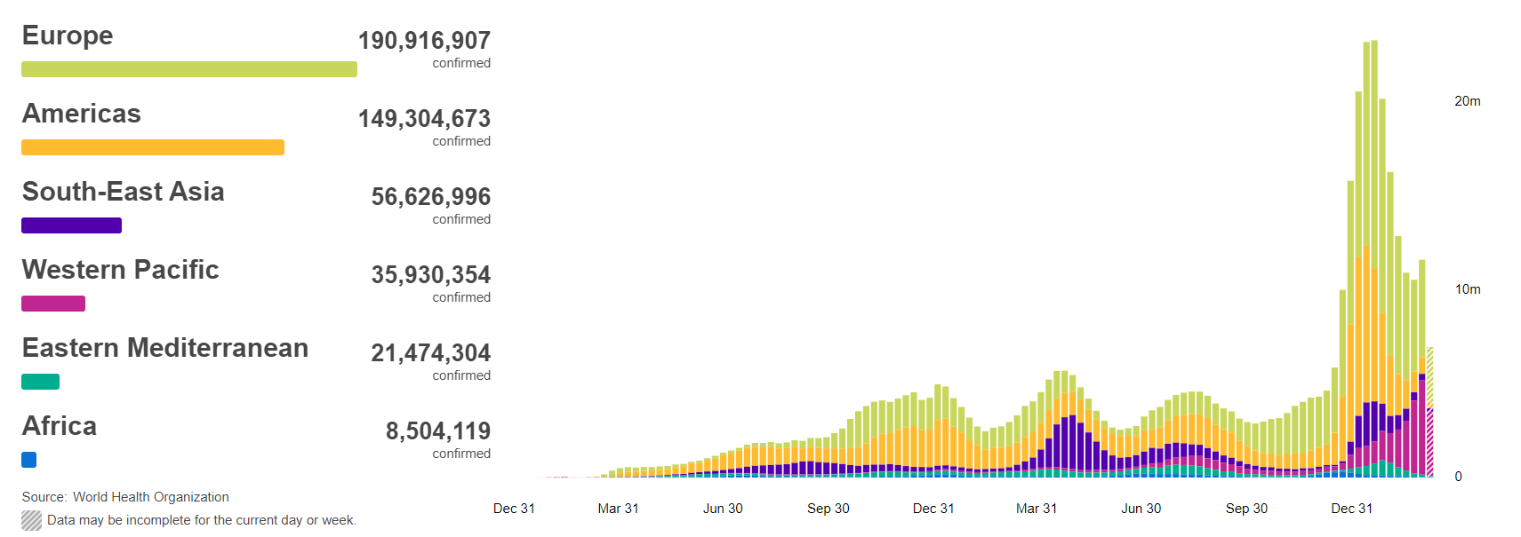
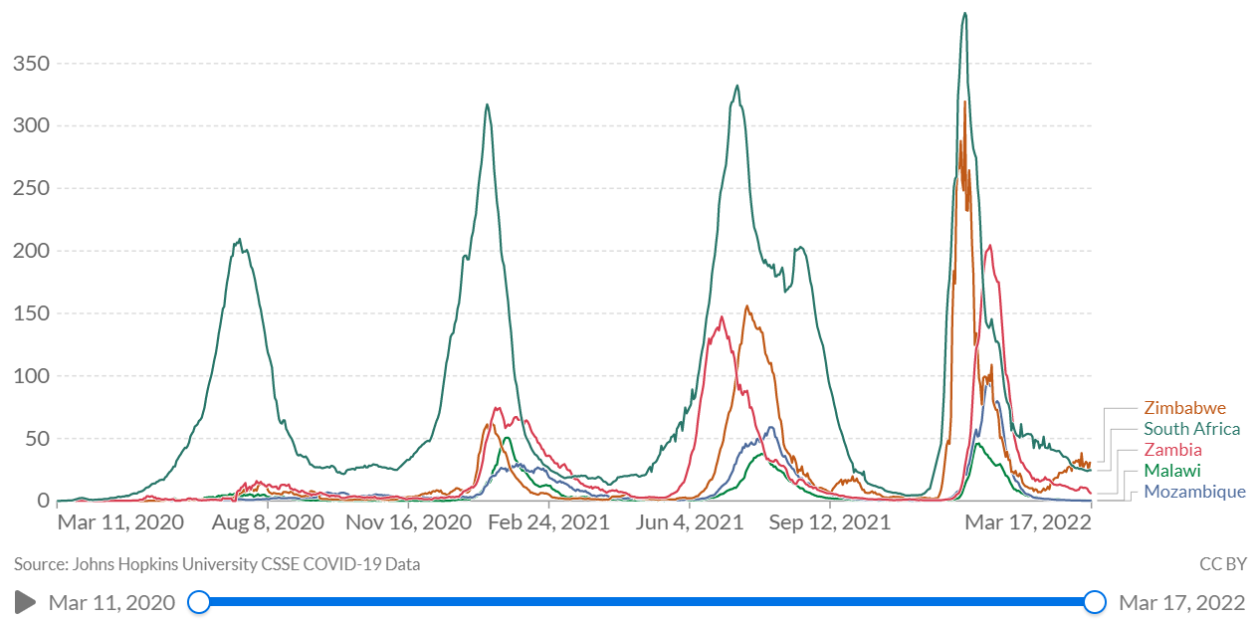
Global and Regional Situation Update as of 17th March 2022
462,758,117 Confirmed cases
6,056,725 Deaths
1.3% CFR
10,783,650,787 Vaccine Doses Administered
as of 14th March 2022

Slide 17
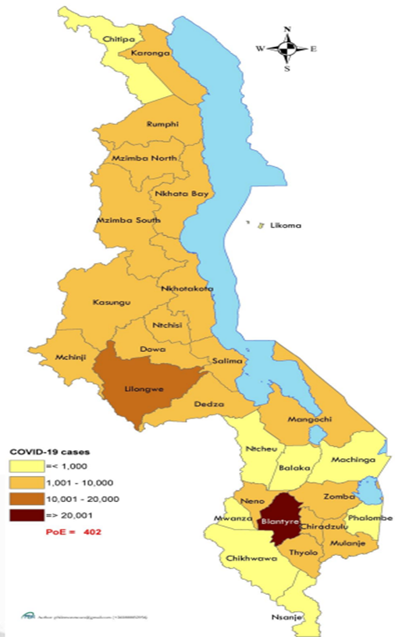
Malawi Situation Update as of 17th March 2022

Slide 18
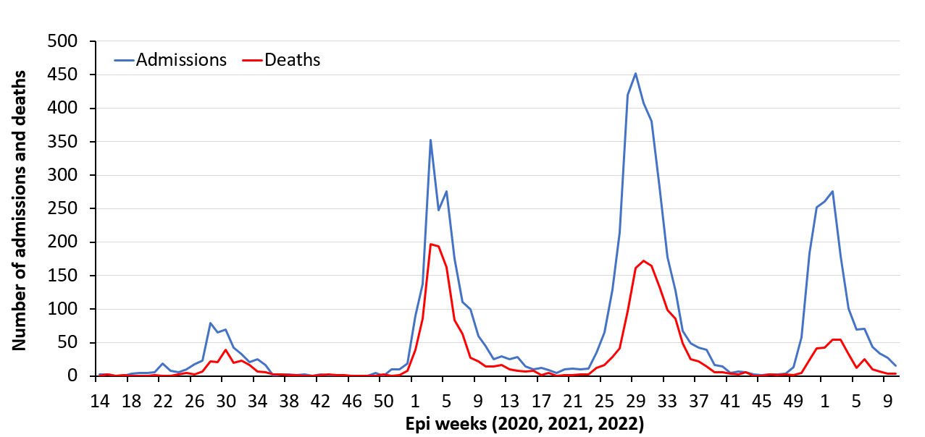
Weekly COVID-19 Cases, Admissions and Deaths as of 13th March 22

Slide 19
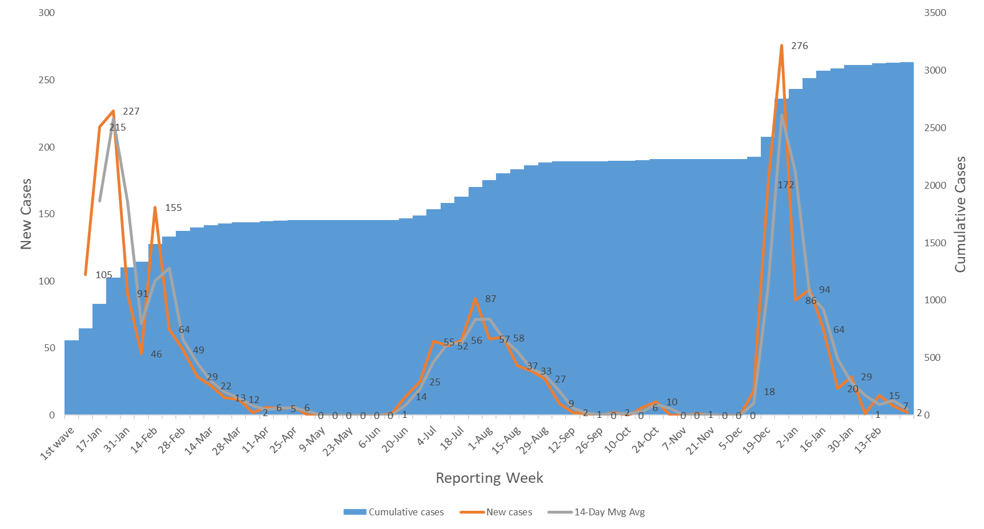
Overview as of 13 March 2022 (Epi-Week 10)
3073 Health Care Workers (0 new confirmed case in past week)
3039 recoveries
0 active
0 new death
24 Deaths (cumulative)
All Districts Affected

Slide 20
Country Epidemic and Response Level Assessment as of Epidemiological Week 10
Epidemic Level for the past week is Level 1

Slide 21
UPDATE ON ENTRIES AT POE
Screening of outgoing and incoming travellers
Vaccination at POE
4,207 travellers entered through the PoEs in the past week of which 55% came through ground crossings 45% through airports.
Of the 1,125 travellers coming through Mwanza border, 188 were truck drivers and 937 were self-repatriated returnees from RSA

Slide 22
COVID-19 Vaccine Update
Malawi has targeted to vaccinate 13.3million people and currently, 6.5% are fully vaccinated
Access to vaccines has been affected by cyclone Anna
277,080 doses of AstraZeneca vaccines were received on 26 February 2022
Currently have in stock Astrazeneca,
J &J and Pfizer vaccines

Slide 23
Key challenges and way forward
Polio response being implemented in the context of COVID-19 pandemic and natural disaster following Tropical Cyclone Storm Ana, Gombe and Cholera Outbreak
Strategic coordination to integrate response
Post Tropical storm flooding potential impact on Polio SIA and COVID-19 Vaccination
Special teams and funding to address SIA implementation
Limited resources – human and financial
Plan to utilize all cadres of Health Care Workers to close human resource gap during campaign
Leverage existing community structures- volunteers, HSAs, VHCs, VDCs, ADCs to support vaccination campaign and enhanced surveillance
GPEI partners already in country providing support to the polio response
Local partners have already engaged in provision of support

Slide 24
Areas Needing Support
Support local recruitment of Surge Staff for 4 Rounds of Supplementary Immunisation Activities (SIA) for Polio Outbreak, Cholera Outbreak Response
Support implementation of the International Health Regulations (IHR) Recommendations to establish system for traveler vaccination( Malawi would like to digitalize certification for Polio, Yellow Fever as a potential PHEIC)
Extra social mobilization efforts and logistics to flood affected areas to ensure SIA for Polio, Cholera is accessible to all displaced communities
More support/ funding to the Global Polio Elimination Initiative

Slide 25
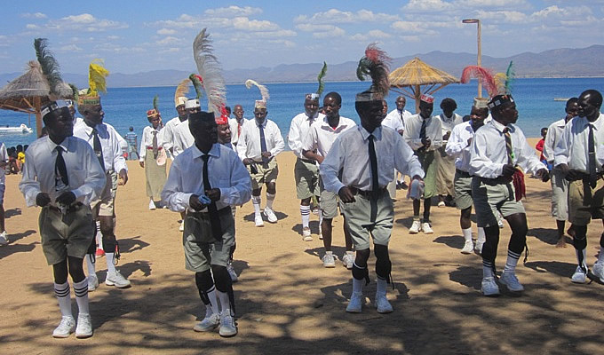
THANK YOU

