Slide 1
Food Crisis Response
Caritas Malawi

Slide 2
About CADECOM
The Catholic Development Commission in Malawi (CADECOM) is the development and relief arm of the Episcopal Conference of Malawi
At National level, it is a member of the national humanitarian cluster
Has physical presence in all the 28 districts of the country through its 8 dioceses
Thematic areas include climate change adaptation and adaptation, resilience, livelihoods, food and nutrition security. development and humanitarian assistance

Slide 3
Work Highlights
CADECOM has established built capacity of 524 village savings groups (67% - women) that has enhanced their capacity to match grants
In 2023, CADECOM provided humanitarian assistance in form of food and non-food items to 8000 households across communities affected by floods
Accorded the best organization in emergency response presented by the president of the republic of Malawi

Slide 4
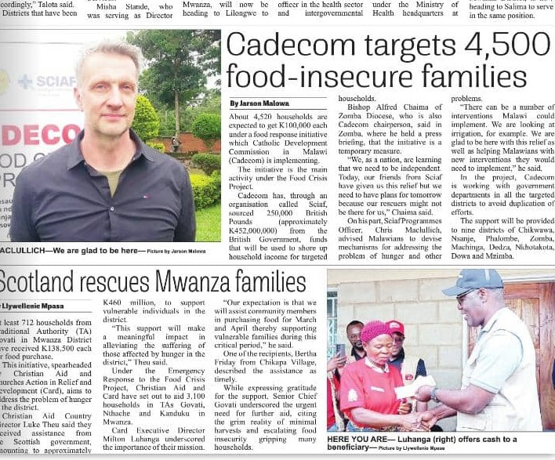
The food crisis response
With financial assistance worth GBP 250, 000 from the Scottish government through SCIAF, CADECOM has provided cash transfers to address food crisis to 4520 households across districts hugely affected by hunger over a 6-week period
Support is localised to segments that are worse off on food insecurity
MK100,000 (about £46) for each HH

Slide 5
Emerging concerns
Demand for support remains huge.
Prevalent hunger situation with high prices of maize
Farm gate prices for maize have risen from MK300 per Kg in 2023 during harvest period to around MK500 to MK800 per Kg, a rise of over 150%
Floods across the lake shore areas worsening the situation
Stunting estimated at 42% is likely to increase with the hunger crisis
Emergency appeal launched platform (EUR 382 062 (MWK 709 490 000)

