Slide 1
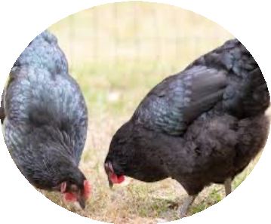
CHARACTERISING THE RESISTANCE PATTERNS AND AMR
DRIVERS OF Escherichia coli ISOLATED FROM POULTRY, HUMANS AND ENVIRONMENT IN THE CENTRAL REGION OF MALAWI: A ONE HEALTH APPROACH
Catherine Kamwana

Slide 2
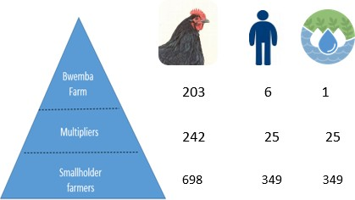
COLLABORATIVE PROJECT
INTRODUCTION
AMR – Global OH threat
In animals, antibiotics used for prophylaxis and growth – intensify the risk to humans and the environment
Collaborative Project:
AMR patterns of E.coli in poultry, humans and the environment against 9 classes of antibiotics
Drivers of AMR
Study Location: Central Region, Malawi

Slide 3
PRELIMINARY RESULTS
a. KNOWLEDGE
Know antibiotics
Knowledge Among Each Category
42%
120
58%
100
80
60
Yes No
Know AMR
40
20
0
47%
Yes
No
Yes
No
Yes
No
53%
Smallholder
Mult iplier
Nucleus
Know Antibiotics
Know AMR
Yes No

Slide 4
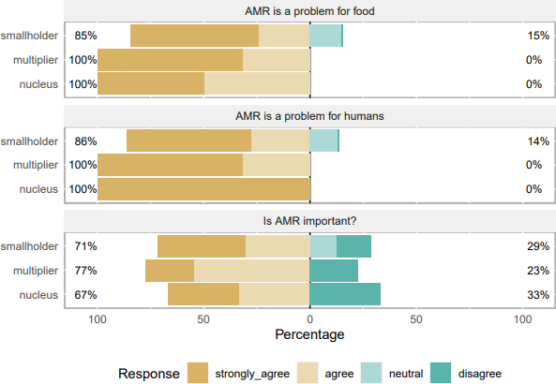
PRELIMINARY RESULTS
b. ATTITUDES

Slide 5
PRELIMINARY RESULTS
c. PRACTICES
DURATION OF ANTIBIOTIC USAGE - HUMAN
stop feel better 23%
Get extra 2%
SELF MEDICATION
Yes 41%
Finish dose 75%
No 59%
DURATION OF ANTIBIOTIC USAGE - POULTRY
62%
20%
10%
3%
5%
1
As directed
2 weeks
1 week
< 1 week
Once they getter

Slide 6
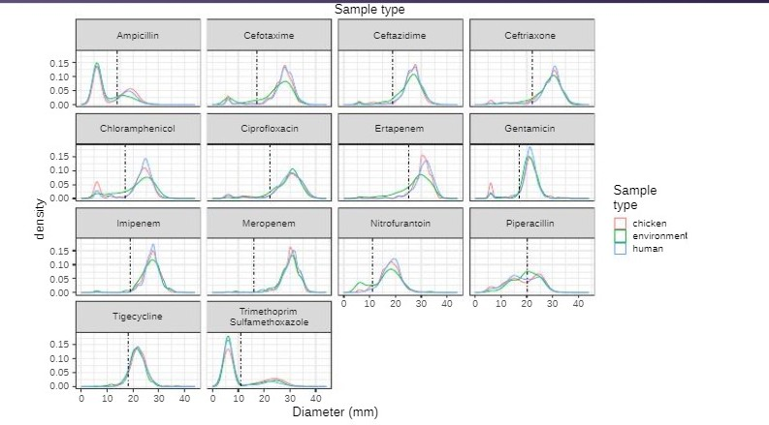
PRELIMINARY RESULTS

Slide 7
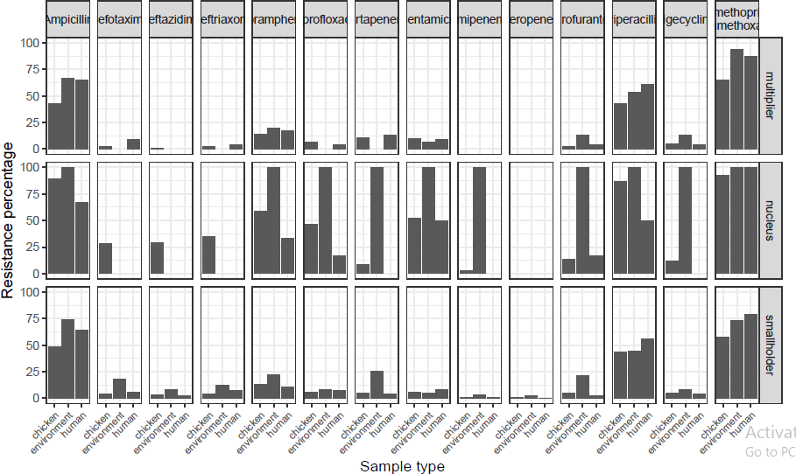
PRELIMINARY RESULTS
MICROBIOLOGICAL

Slide 8
FUTURE UTILISATION
Come up with a policy brief
Evidence-based awareness campaigns
Opportunities for further studies

