Slide 1

Scotland Malawi Partnership
Water Forum
26 January 2023
Welcome!
Tweet us @ScotlandMalawi
Or find us on Insta, Facebook & LinkedIn
Plus, share your email in the chat if you would like to receive the Scotland-Malawi weekly newsletter
Notes:
Purpose
•To get together, not just with water, agricultural or environmental organisations and individuals, but also all of you involved in education, in health, and in a multitude of other areas.
•To look across the cross-cutting theme of Water – its multiple dimensions - and how it impacts and is relevant to members’ work across Malawi.
•Its about building understanding. Opportunities to learn and future opportunities to collaborate.
•What is it not? Grand standing – we are doing the ‘right’ thing or the ‘best’ thing. Competing for attention. Water is such a vast topic, that there is a place for everyone.

Slide 2
Keynote
Welcome to the Government of Malawi’s Principal Secretary, Ministry of Water & Sanitation, Elias Chimulambe
    Update on the current Cholera situation and the Government’s present and planned response.

Slide 3
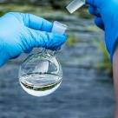
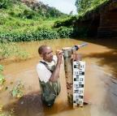

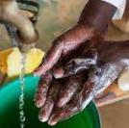
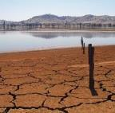



The Glasgow Declaration for Fairwater Footprints
Zero water pollution
Sustainable water withdrawal
Protect & restore nature
Drought, flood & water conflict resilience
Universal WASH
Visit https://waterwitness.org/programmes/fairwaterfootprints
Notes:
Overview of key water issues in Malawi, as identified in Malawi’s delivery plan designed to meet its commitments in the Glasgow Declaration for Fair Water Footprints.
The Glasgow Declaration signed at COP26 by 28 national Govts, companies, investors, CSOs and CSO networks representing 185 million people and a GDP of $5.1 trillion. Malawi is a global leader in demonstrating to others how it is driving its delivery plan to meet its commitments.
These commitments are :
For Zero water pollution: No adverse impacts on the environment, water users or functions from wastewater discharges, and control of diffuse pollution.
For Sustainable water withdrawal: Abstraction & use within hydrological limits of sustainability, not compromising the human right to water, needs of downstream communities or future generations.
For Drought, flood & water conflict resilience: Effective plans, policies, governance & investment mitigates risks of water-related disasters & conflict, with legal compliance & water tenure for all.
For Universal WASH: All workers have access to reliable & safe drinking water, toilets & washing facilities, & collective action reaches communities in need.
To Protect and Restore Nature: Ecosystems & their services are valued, protected, & sustainably managed, & nature-based/regenerative solutions prioritised.
Key issues in the five commitment areas

Slide 4

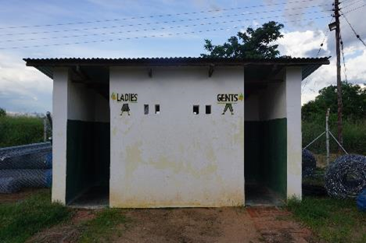
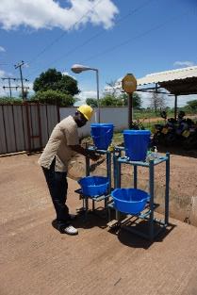
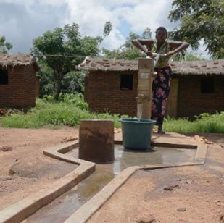

Improving urban and rural WASH services for vulnerable communities remains an urgent national priority
A significant opportunity exists to improve WASH via action in the workplace and supply chains, by investors and the public & private sector water users

Slide 5

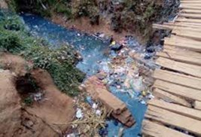
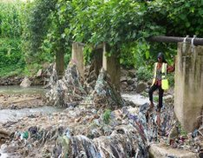
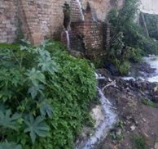
Performance of municipal wastewater facilities, onsite sanitation, solid waste management, and urban pollution are of particular concern
Pollution is widespread because monitoring and enforcement of the permitting system for control of wastewater discharges is not fully operational

Slide 6

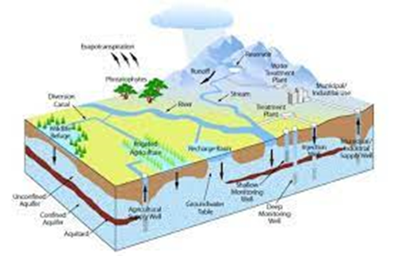
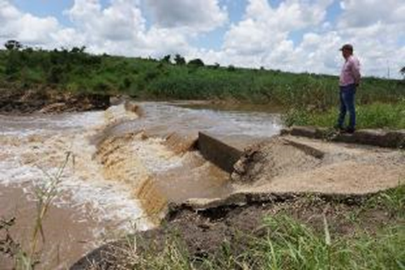
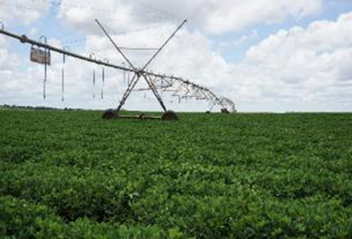
Regulation of water abstraction is yet to protect the needs of downstream users and the environment because of challenges in licence determination, enforcement, and compliance. This is a strategic hazard for development in Malawi.
There is no effective system to recognise water tenure for small-scale users or to register and resolve grievances and conflicts
Notes:
Licences and permits reflect what is asked for on the application form. They don’t reflect availability or the needs of the environment and downstream users.
The e-licencing system built by Aurecon and the World Bank hasn’t worked for 3 years
We are not immune from being told who to give water to.
There is conflict with smallholders and fisherfolk who claim the same water as irrigators

Slide 7

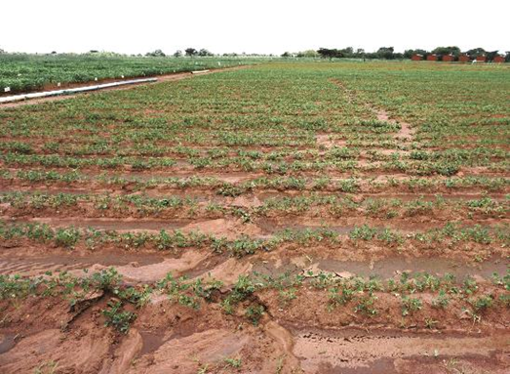
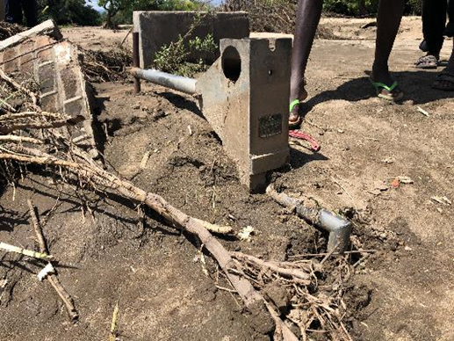
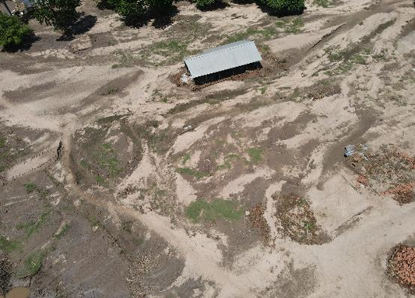
Soil loss and siltation of water courses is a national catastrophe
Land and water use planning, and implementation of development control/EIA are yet to adequately protect and promote nature
Notes:
Licences and permits reflect what is asked for on the application form. They don’t reflect availability or the needs of the environment and downstream users.
The e-licencing system built by Aurecon and the World Bank hasn’t worked for 3 years
We are not immune from being told who to give water to.
There is conflict with smallholders and fisherfolk who claim the same water as irrigators

Slide 8
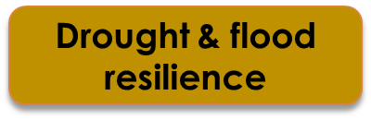
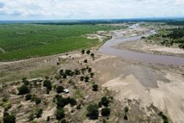
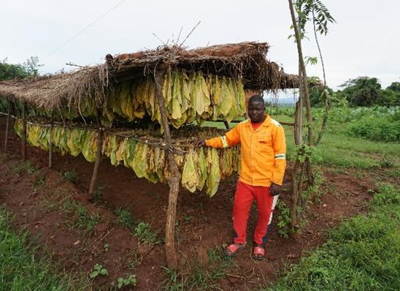
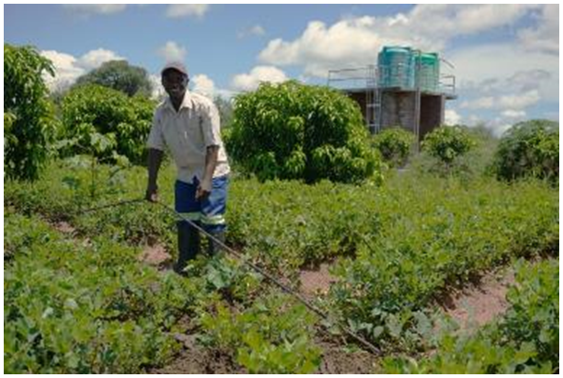
Flood and drought events regularly impose a devastating impact, and action to plan, prepare for, manage and minimise impacts can be dramatically improved.
Building resilience with small-holder farmers and in key sectors of water, energy and transportation are the key to Malawi’s sustainable development
Notes:
Licences and permits reflect what is asked for on the application form. They don’t reflect availability or the needs of the environment and downstream users.
The e-licencing system built by Aurecon and the World Bank hasn’t worked for 3 years
We are not immune from being told who to give water to.
There is conflict with smallholders and fisherfolk who claim the same water as irrigators

Slide 9
UNIVERSAL ACCESS TO SAFE WASH
Natasha Mwenda, WaterAid (WASH)
Derek Mavesere, Strathclyde University - alternative water supply provision models
2. WATER POLLUTION
Dr Tracy Morse, Strathclyde University
3. SUSTAINABLE WATER WITHDRAWAL
Muthi Nhlema, BASEflow
4. PROTECT AND RESTORE NATURE & DROUGHTS AND FLOOD RESILIENCE
Gaia Marini, Water Witness International
5. INFORMATION GATHERING FOR WATER
Donald Robertson, Strathclyde University – citizen science in water.
Notes:
As the speakers are giving a brief outline of how they are involved is different areas of water that are of concern to Malawi, think through
Does your work touch on this theme? How?
Where?
Who is working with you on this? Govt – national/local? CSOs? Private sector?

Slide 10
Next?
Opportunities to learn more and link up with others
Opportunity to learn more about the Glasgow Declaration for Fair water Footprints and Malawi's Delivery Plan
Contact with WESNET, Malawi's Water and Sanitation Network

Slide 11
THANK YOU !

Slide 12

Scotland Malawi Partnership

