Slide 1
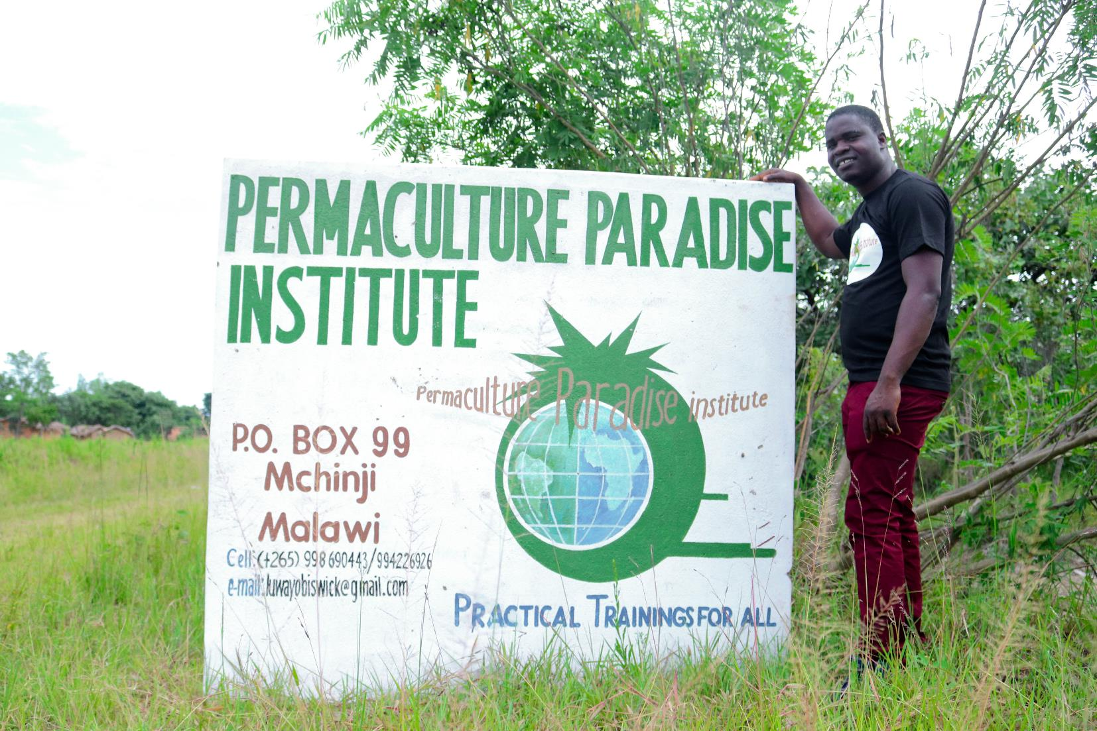
WELCOME TO PPI

Slide 2
Who we are ?
Permaculture Paradise Institute is a social enterprise, demonstration and training center that promotes permaculture systems in Malawi located in Langa village Mchinji district. Established in 2017 (February) Permaculture Paradise provides low cost social economic and ecologically sound trainings to local farmers, entrepreneurs, nongovernmental organizations as well as government.

Slide 3
FOUNDERS

Slide 4
WHY WE HAD TO QUIT JOB ?
To create a model and future where majority of the people in Malawi become mind
Independent with positive self esteem that would create possibilities of an effective life
Because we realized most of the people in Malawi are poor, jobless, malnourished and face
Many challenges
We wanted to establish a model farm because
We live in a country who's majority of its population are small holder and poor
farmers
Over 85 % of the farmers are subsistence farmers but unfortunately over 50 % of the children
Under the age of 5 are nutritionally stunted

Slide 5
URBAN PERMACULTURE

Slide 6
URBAN BACK YARD FOOD FOREST

Slide 7
URBAN GREY WATER USE

Slide 8
EDIBLE CAR PARK

Slide 9
URBAN BLACK WATER USE

Slide 10
URBAN AQUAPONICS

Slide 11
URBAN PEST MANAGEMENT

Slide 12
RURAL PERMACULTURE

Slide 13
QUARTER ACRE MODEL

Slide 14
INSIDE THE RONDAVELS

Slide 15
RAIN FED AGRICULTURE DRY LAND

Slide 16
RAIN FED AGRICULTURE WETLAND

Slide 17
ORCHARDS

Slide 18
NATURAL TREE REGENERATION AND AFORESTATION

Slide 19
FRUITS FROM THE FORESTS

Slide 20
ANIMALS

Slide 21
THANK YOU

