Slide 1
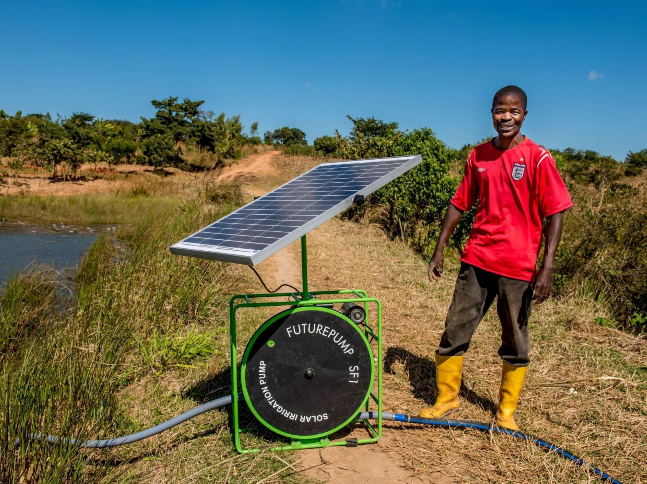
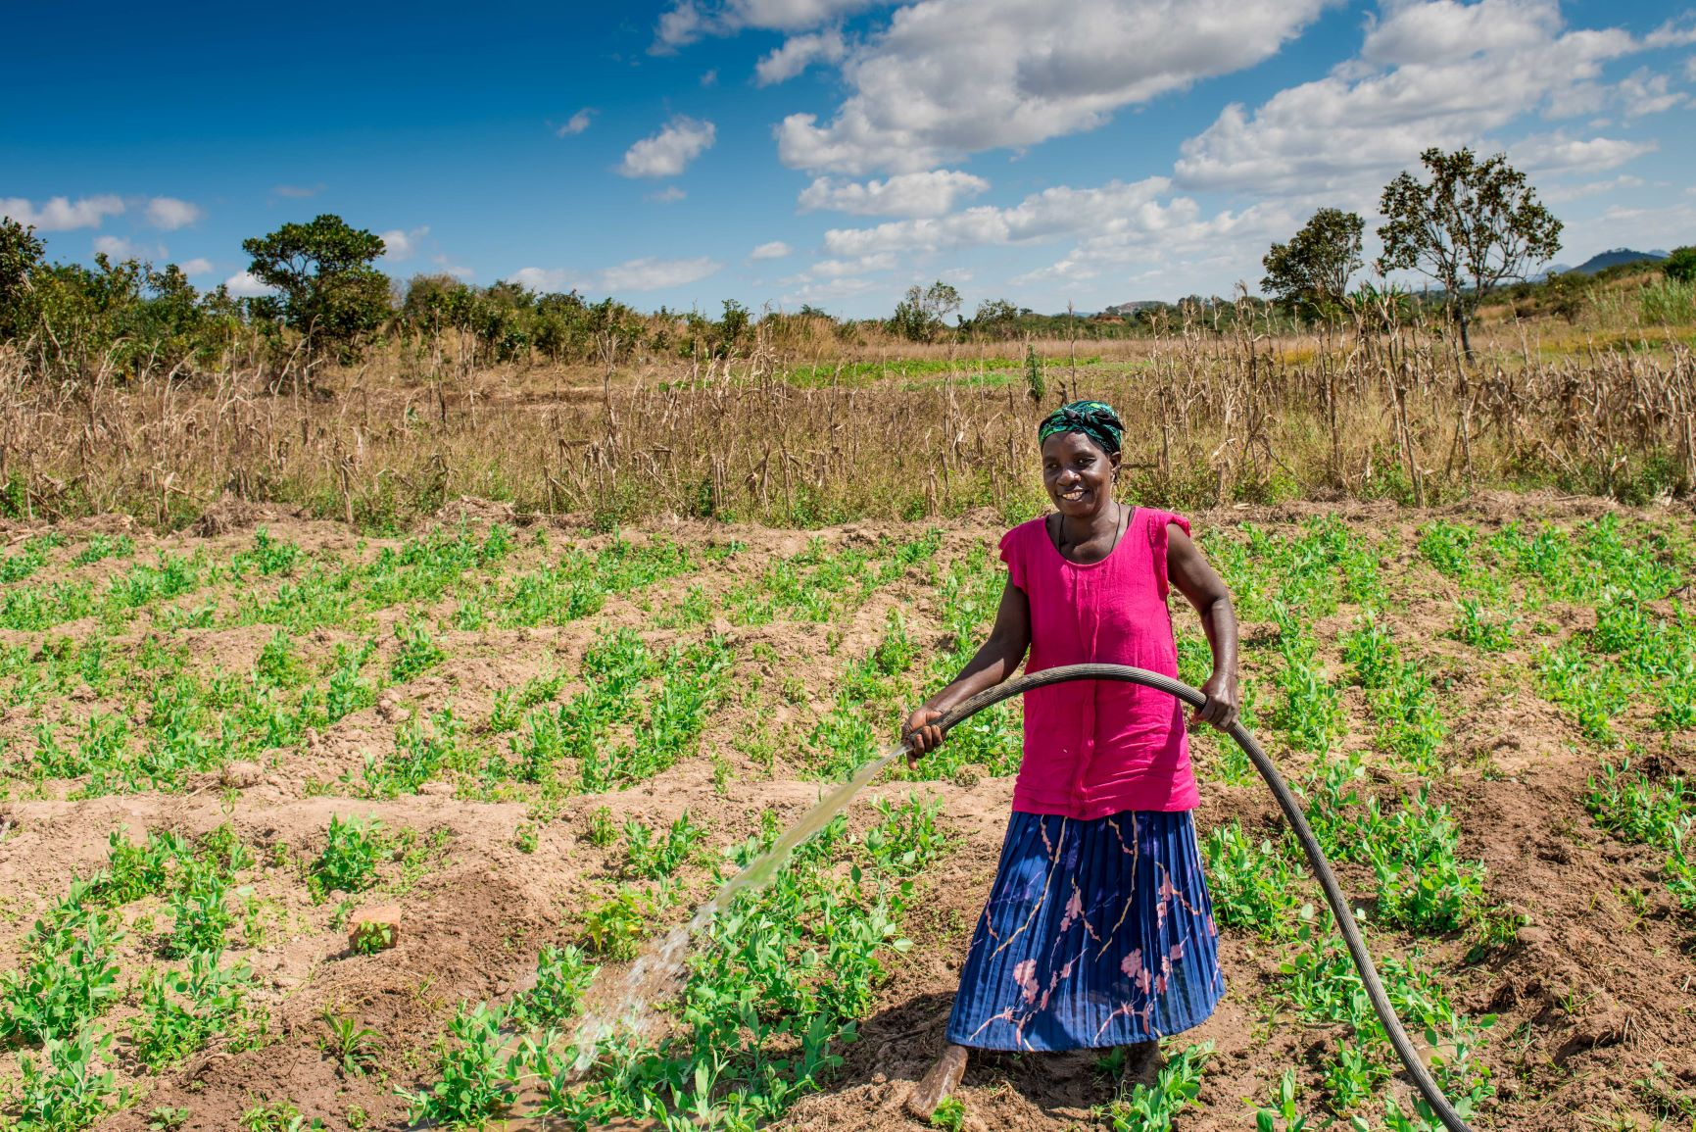
Agriculture and renewables
Improved production to increase yields, improve quality and give year-round supply

Slide 2
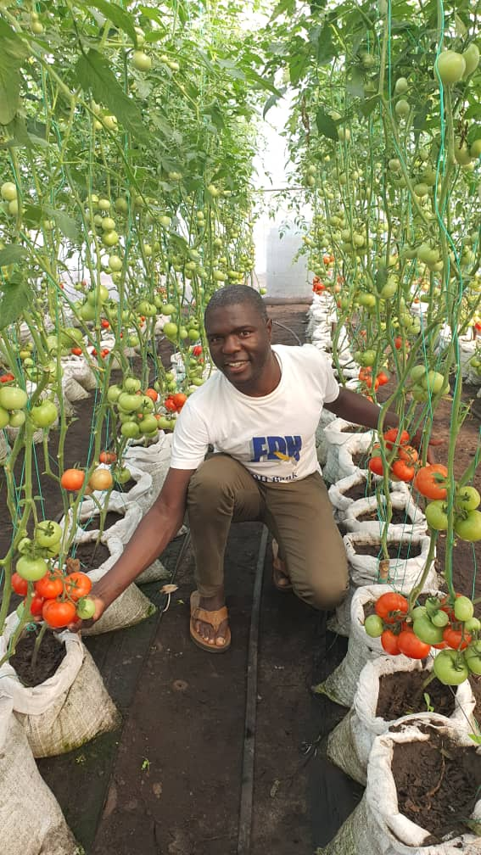
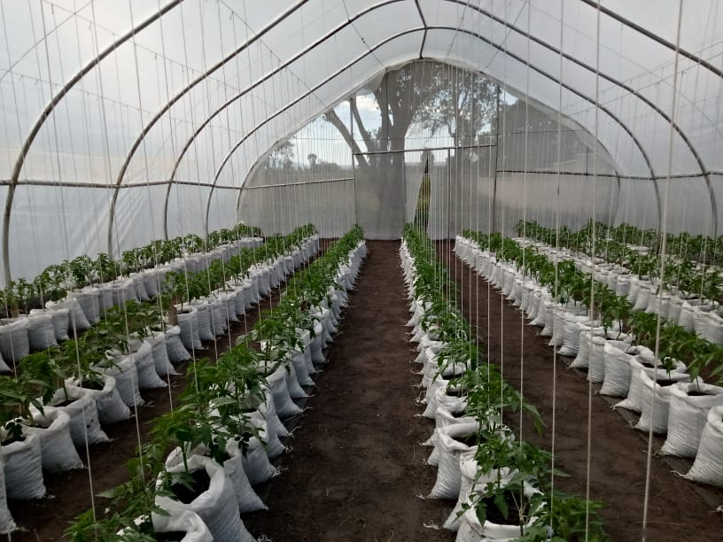
Improved production to increase yields, improve quality and give year-round supply

Slide 3
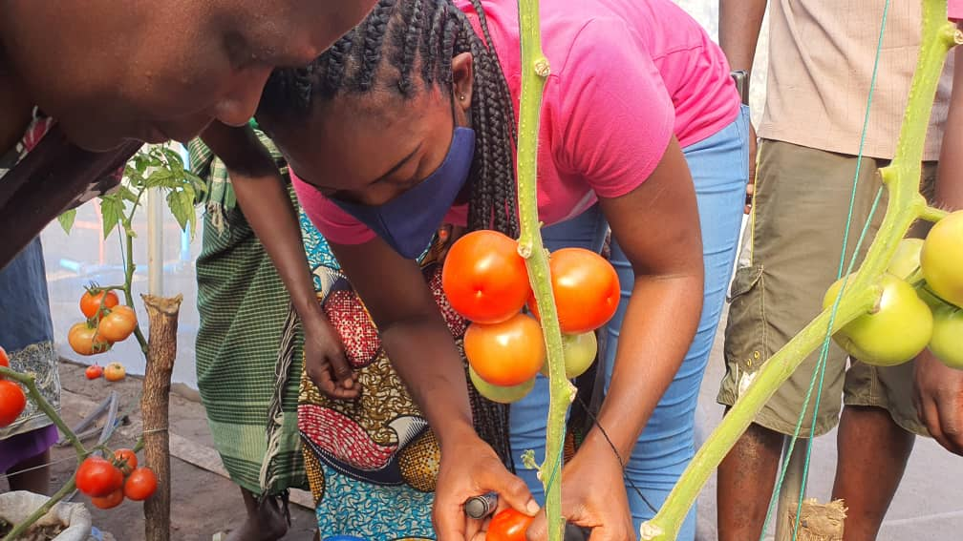
Improved production to increase yields, improve quality and give year-round supply

Slide 4
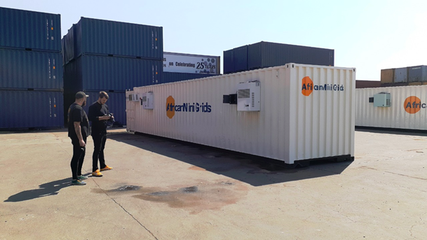
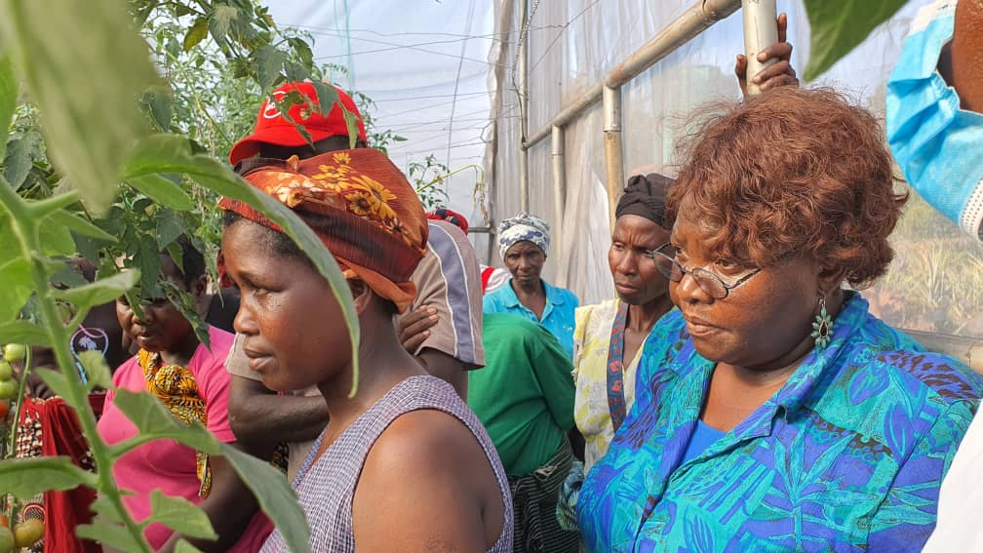
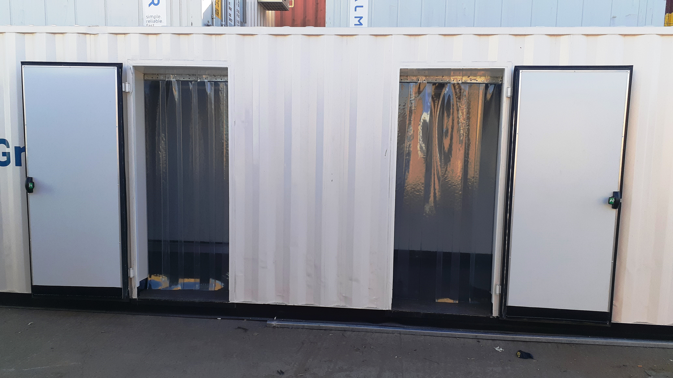
Post Harvest training and equipment to reduce crop losses

Slide 5
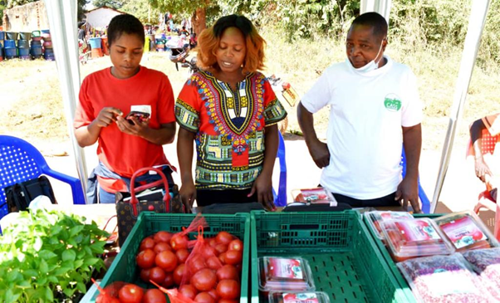
The questions we have been grappling with:
Who should own the productive assets?
How are these to be paid for?
How are they to be maintained?
How can farmers scale up?

Slide 6
