Slide 1
Members’ meeting– with Malawi High Commissioner H.E Mr Kena Mphonda
Wednesday 29th July 2015, Edinburgh City Chambers

Slide 2
Aims of the meeting
To introduce SMP members to the new Malawi High Commissioner;
To hear more about the Government of Malawi’s priority areas
To increase mutual awareness of our respective work;
To support two-way communication channels for effective joint working

Slide 3
Scotland Malawi Partnership – a partnership approach towards Malawian priorities
Charlie Bevan, Keith Bohannon, Emily Mnyayi

Slide 4
overview
SMP in context
aligning with Malawian priorities
progress from forums…
BITT
Governance
Schools
Youth
Higher and Further Education
Health

Slide 5
SMP in context…

Slide 6
SMP: who are we?
We are the national civil society network coordinating, supporting and representing the people-to-people links between our two nations

Slide 7
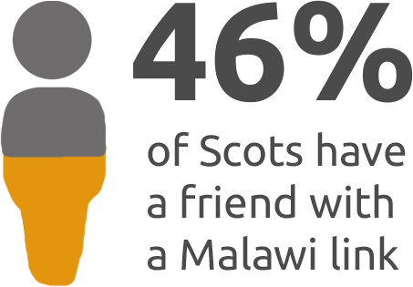
SMP: who is involved?

Slide 8
SMP: who are our members?
The SMP has over 700 members, including:
160 primary and secondary schools
Half of Scotland’s local authorities
Every Scottish university and most of its colleges
Dozens of different churches and faith-groups
Hospitals, businesses, charities, NGOs
Wide range of grass-root community-based organisations

Slide 9
SMP: how do we support
our members?
MEMBER-OWNED and MEMBER LED
Connect: Facilitate networking & joint working; forums
Inform: Disseminate information
Advise: Answering enquiries; providing training
Support: Partnership development; visa applications
Develop: Best practice; partnership principles
Represent: Media, governments and the public
Influence: Lobbying and advocacy (CPG)

Slide 10
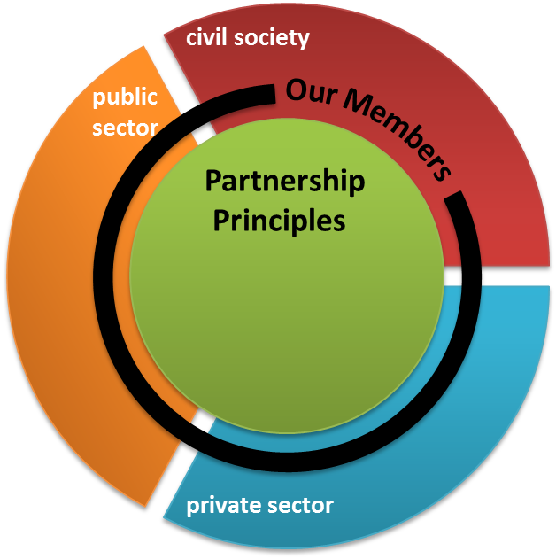
SMP: where we fit in
Government of Malawi
Scottish Government
Priorities from MGDS II…
Sustainable Economic Growth
Social Development
Governance
Infrastructure Development
Strands of engagement…
Sustainable Economic Development
Education
Health
Civic Governance and Society
Renewable energy

Slide 11
Malawian priorities…

Slide 12
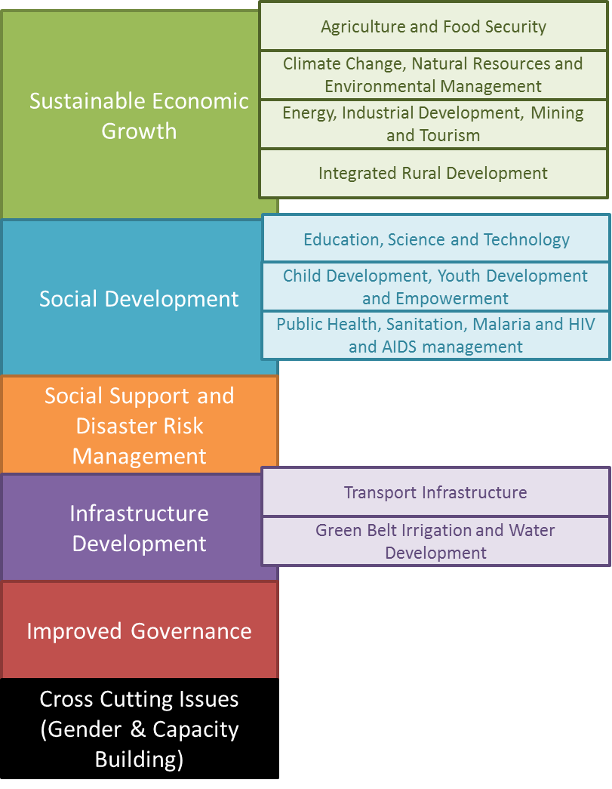
Malawi Growth and Development Strategy II (MGDS II)
6 thematic areas
9 key priority areas
SMP activities
Business, Investment Trade and Tourism (BITT) Forum
Tourism Working Group (TWG)
Schools Forum
Youth Forum
Higher and Further Education Forum
Health Forum
Governance Forum

Slide 13
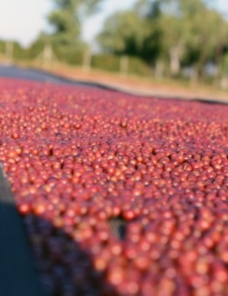
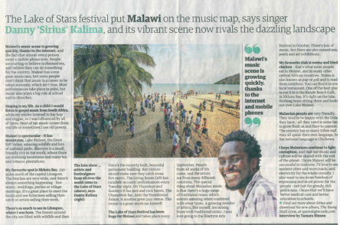
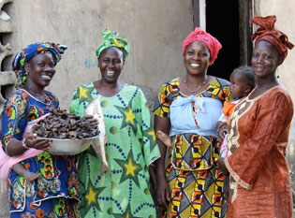
BITT activities
Members Forum
Members sharing experience and knowledge
e.g. case studies on JTS and GALVmed
Trade
Promoting quality Malawian products here in Scotland
e.g. Mzuzu Coffee, Kilombero Rice
Tourism
Promoting Malawi as a world class destination to new audiences
Tourism Working Group
Private sector engagement / Investment
working closely with MITC to identify and promote suitable opportunities

Slide 14
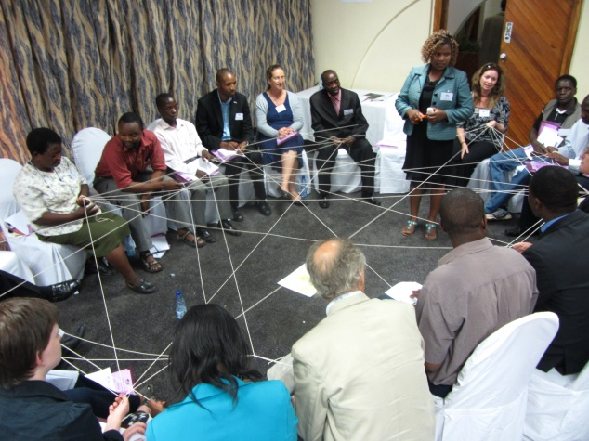
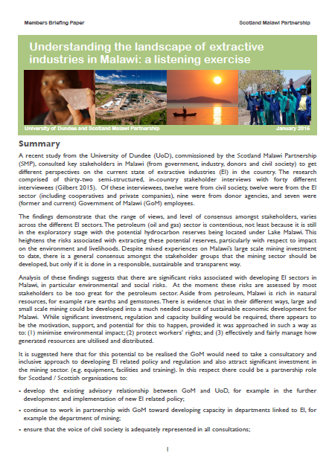
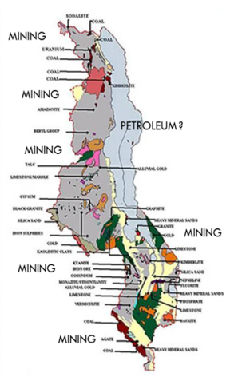
Governance activities
Members Forum
Political governance (sharing information, e.g. election analysis)
Service delivery (good examples of transparency, e.g. construction)
Local governance (capacity building, e.g. ALC)
Project governance (support and guidance from SMP & MaSP)
Governance Landscape
Working with DFID and other donors to map and communicate what is happening on the ground
Extractive Industries
Understanding the issues and potential from different perspectives
Offering advice from trusted partners (University of Dundee)

Slide 15
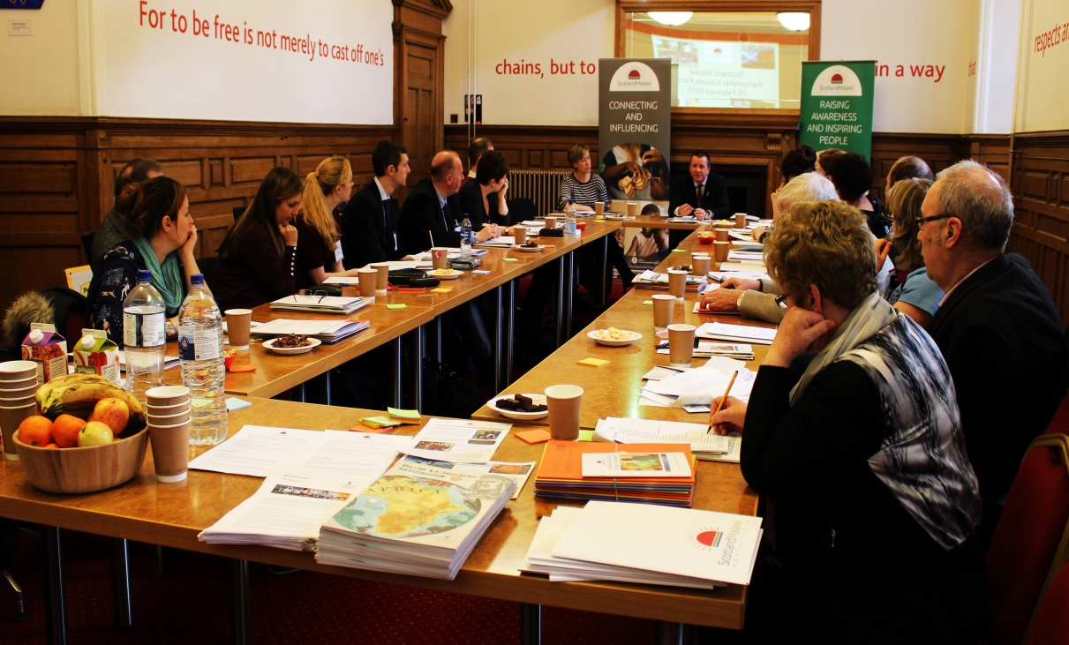
Schools Forum
Our 160 schools members are offered individual support and regular forums:
Meets four times a year in various locations across Scotland.
An opportunity for schools to network with each other to share ideas/solutions to problems, and network with others working in the Education sector.
Presentations from Scottish schools about their links and about how they have used the SMP Partnership Principles to reflect on their Malawi links.
Key themes at Schools Forums this year have been:
Examples of interesting practice from Education Scotland.
Useful resources to support partnerships/global citizenship.
How can we listen to/be guided by Malawian priorities?
Organisations in Scotland that can support school links with Malawi/offer funding/resources.

Slide 16
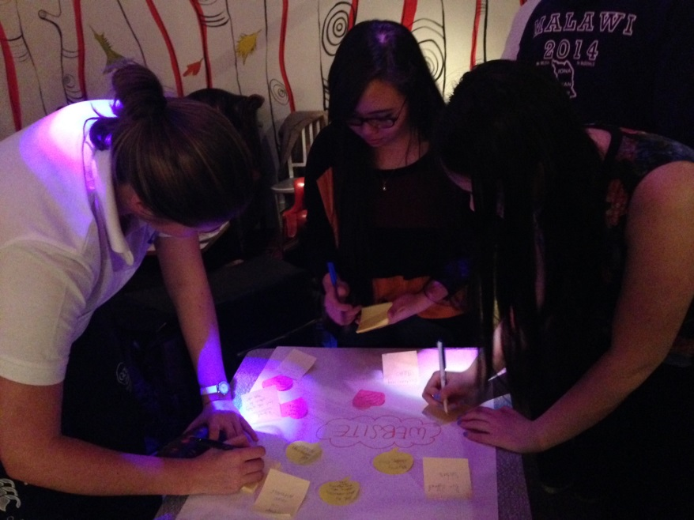
Youth Forum
Meets every 2 months during term time.
An opportunity for our Youth members to network with each other and discuss their Malawi links.
A chance for youth members to feed into our Youth engagement strategy, Youth roadshows and youth congress each year.
Monica Dzonzi came along to the forum in March to share Malawian priorities.
Plans for future youth events include a film screening to engage a wider audience.
We also plan to have SMP Youth ambassadors.

Slide 17
Higher and Further
Education Forum
Members:
Representatives from across Scotland’s universities and many colleges
Key activities in 2015:
Publication of Higher and Further Education Directory
Led by colleagues in Malawi, “skills for development” as a priority focus for the sector
David Livingstone Scholarships
Malawian partners
National Council for Higher Education in Malawi, Mathilda-Chithila
Malawian universities and colleges

Slide 18
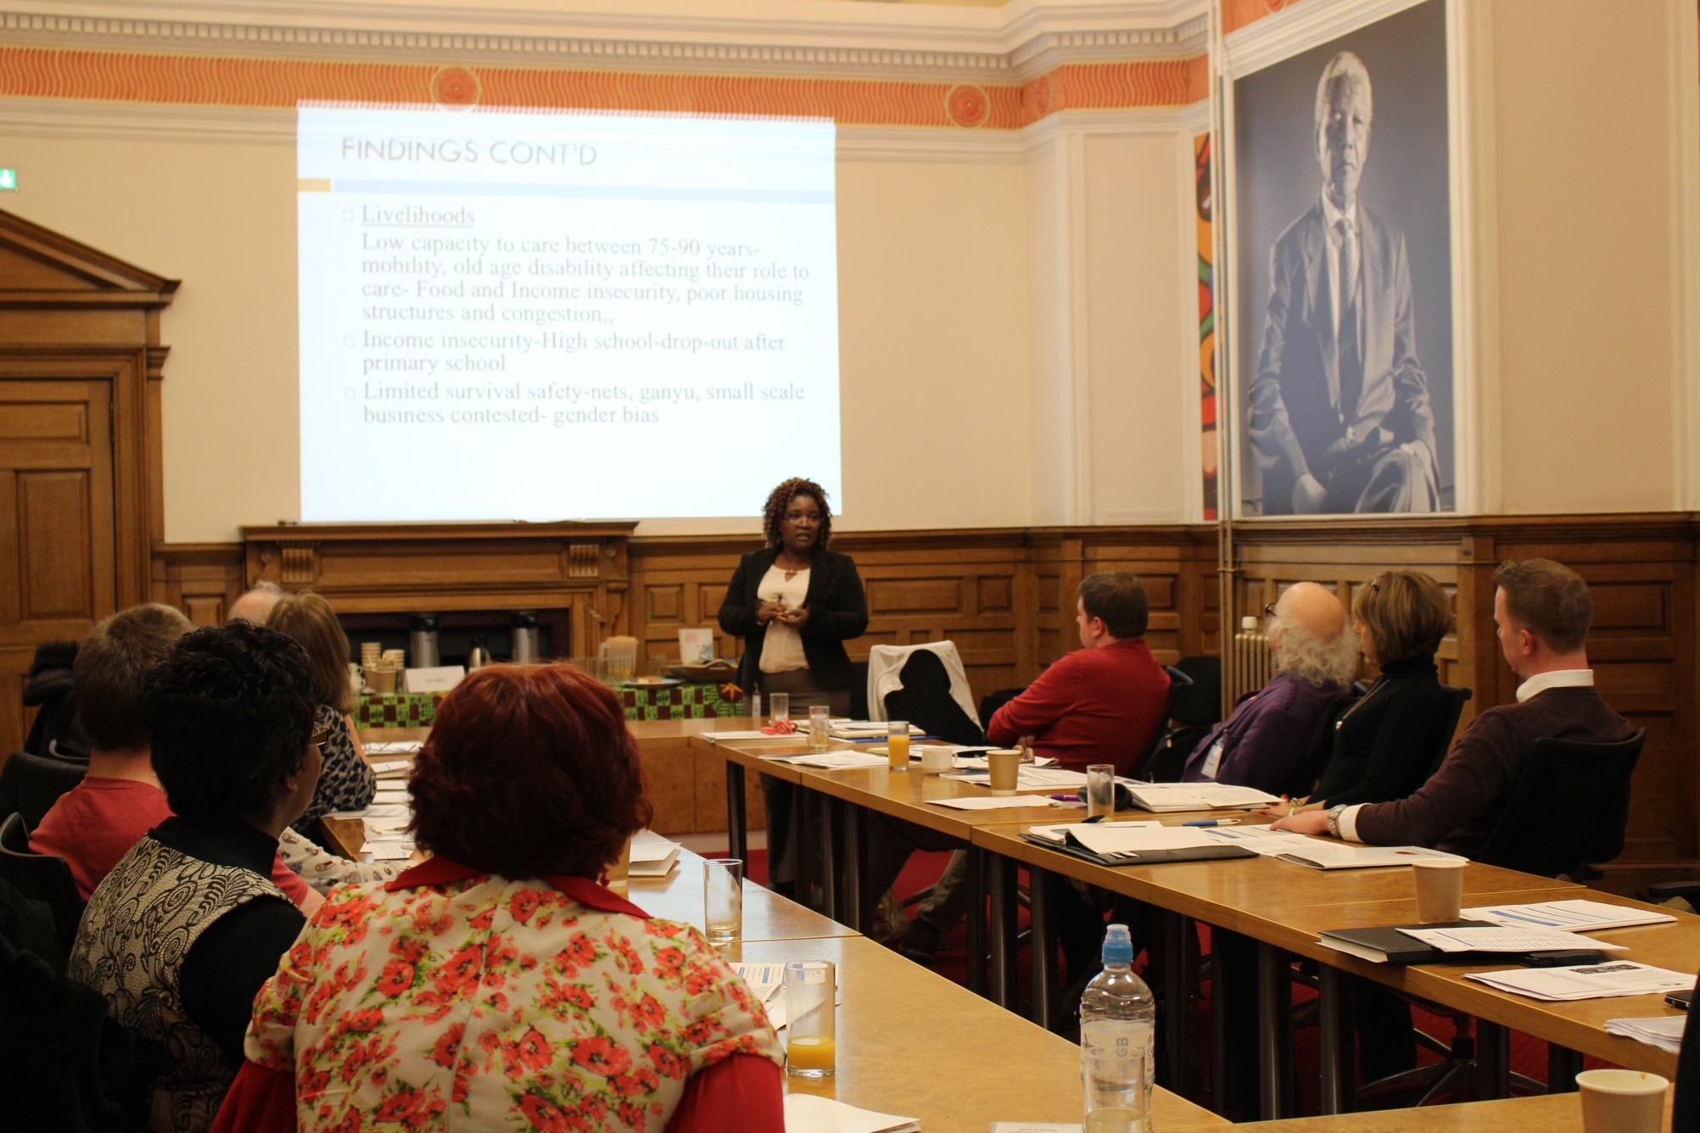
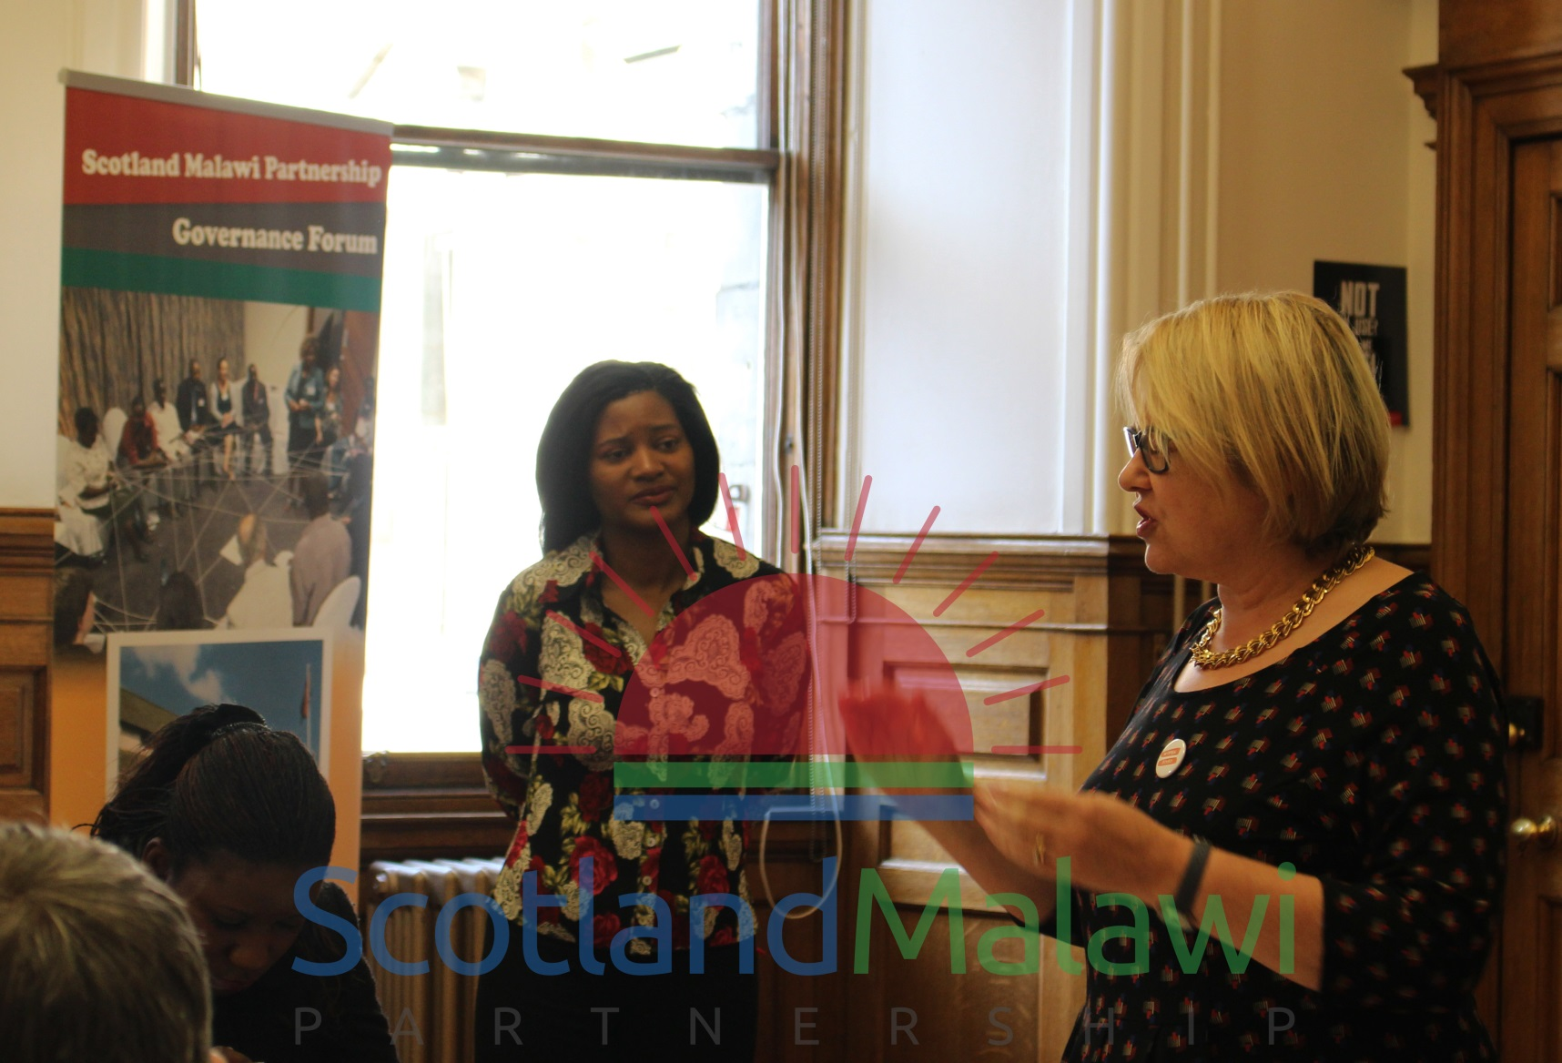
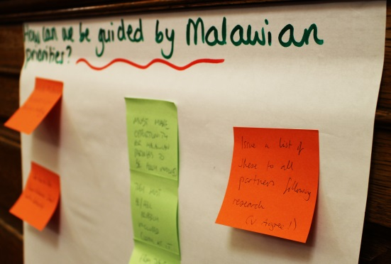
Health Forum
Members:
Representatives from across various health interests and areas
Working together towards priorities outlined in MGDS II and Health SWAP.
Key activities in 2015:
Sharing best practice on donating medical equipment
Support for NHS Scotland staff volunteering in Malawi
Mhealth in Malawi case studies
Malawian partners
Rabson Kachala, MoH, Health Strand lead

Slide 19
Priorities for the Malawi
High Commission in the UK

Slide 20
Q and A

Slide 21
Members’ meeting– with Malawi High Commissioner H.E Mr Kena Mphonda
Wednesday 29th July 2015, Edinburgh City Chambers

