Slide 1
Tweet us @ScotlandMalawi #SMPhealthforum

Slide 2
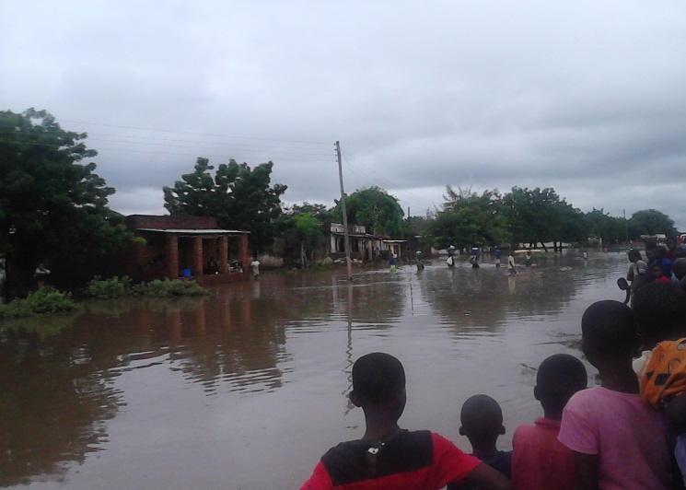
Flooding Update
638,000 people affected
174,000 displaced in the 3 most affected districts (Chikwawa, Nsanje and Phalombe)
79 deaths
153 missing in Nsanje
15 Districts affected
63,976 hectares of land flooded
Tweet us @ScotlandMalawi #SMPhealthforum

Slide 3
EMMS

Slide 4
Flooding Update- ANN PHOYA VIDEO
Tweet us @ScotlandMalawi #SMPhealthforum

Slide 5
Flooding Update
Tweet us @ScotlandMalawi #SMPhealthforum

Slide 6
Research in Practice
Tweet us @ScotlandMalawi #SMPhealthforum

Slide 7
Updates and
Information
Tweet us @ScotlandMalawi #SMPhealthforum

Slide 8
SG Malawi funding
Organisation | Project Manager (Scotland) | Contact email | Project | Funding
Christian Aid Scotland | Keryn Banks | KBanks@christian-aid.org | Increasing Citizen's Demand for Accountability and Transparency for maternal and child health | £600,000
Meningitis Research Foundation | Mary Millar | MaryMillar@scotland-meningitis.org.uk | Triage and treatment, training and engagement. A package for sustainable healthcare improvement in Malawi's primary health clinics | £594,899
NHS Lothian | Ewen Brown | Ewan.Brown@nhslothian.scot.nhs.uk | The Edinburgh Malawi Breast Cancer Project | £185,340
Yorkhill Children's Charity | Shona Cardle (CEO) | shona.cardle@yorkhill.org | Improving Eye Health and Reducing Unnecessary Blindness in Malawi | £173,355
University of Strathclyde | Carol Clements and Sandy Gray | c.j.clements@strath.ac.uk or a.i.gray@strath.ac.uk | Impact on malaria, maternal health and the prognosis for AIDS by Quality Assurance Knowledge exchange and training | £275,918
Robert Gordon University | TBC | TBC | Improving Respectful Midwifery Care in Rural Malawi: A Human Rights Approach | £432,196
 |  |  |  | TOTAL: £2,261,708
SMP Updates [Paper C]:
NHS work
Funding News
Training:
SMP Language and Culture Workshops
Tweet us @ScotlandMalawi #SMPhealthforum

Slide 9
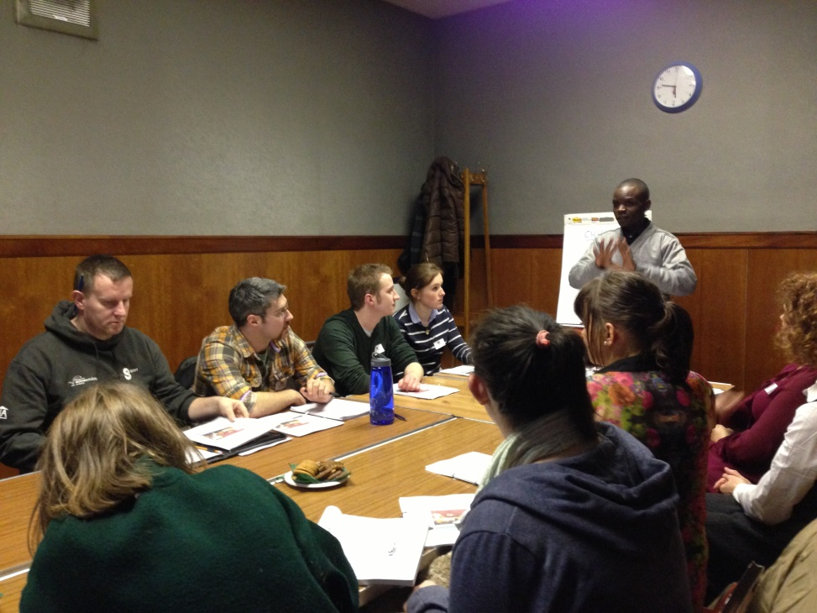
Updates and
Information
SMP Language Classes Edinburgh Classes: Dates: Tuesday 10th March, 17th March and 24th March Times: 5.30-7.30pm Venue: Edinburgh City Chambers Glasgow Classes: Dates: Wednesday 25th February, 4th March and 11th March Time: 5.30-7.30pm Venue: Partick Burgh Hall For further information and to download the booking form visit www.scotland-malawipartnership.org/events.html
Tweet us @ScotlandMalawi #SMPhealthforum

Slide 10
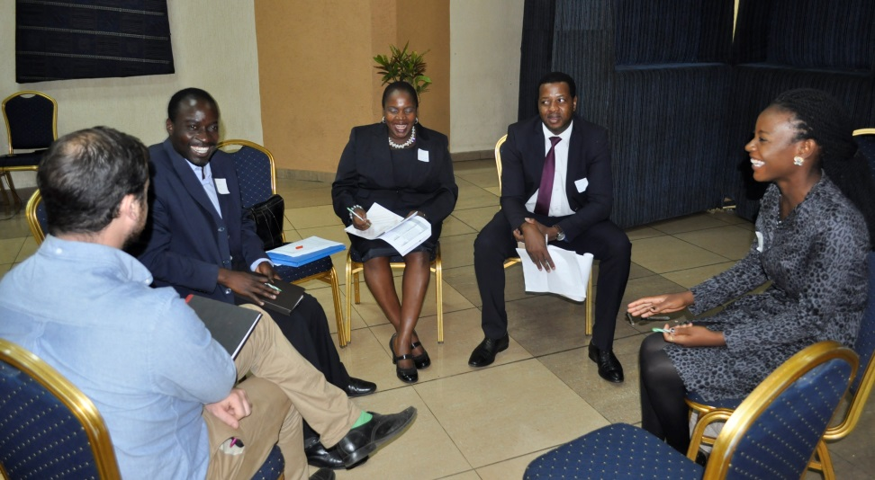
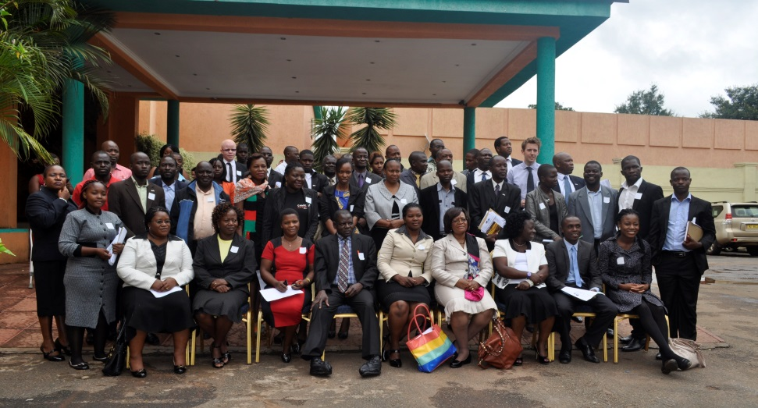
MaSP Symposium
2015
Tweet us @ScotlandMalawi #SMPhealthforum

Slide 11
Tweet us @ScotlandMalawi #SMPhealthforum

